Slide 1
Psych 204b: Computational Neuroimaging: Data Analysis
Instructor: Kalanit Grill-Spector
TA: Lior Bugatus

Slide 2
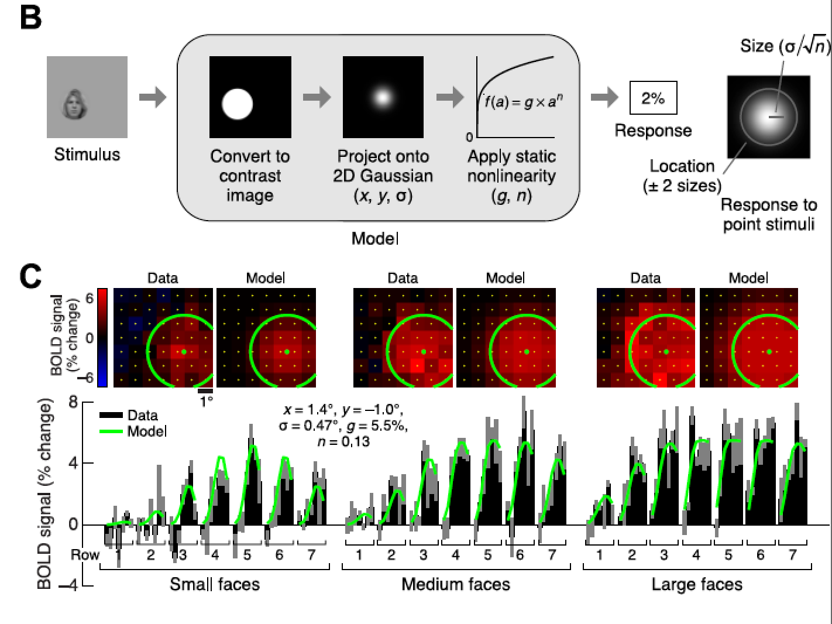
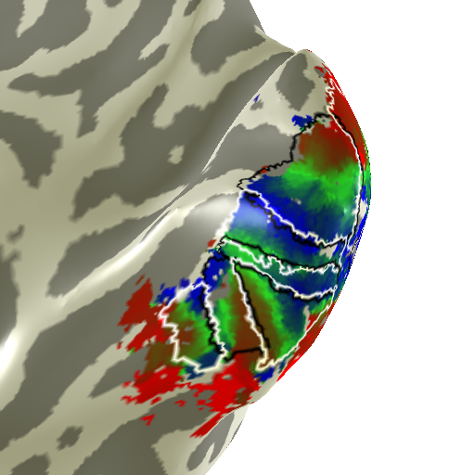
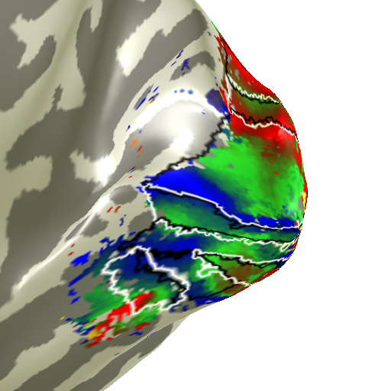
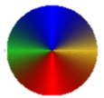
Repetition
Number
2
1
2
1.5
3
4
5
1
6
7
% signal
8
V1
V1
0.5
V2
V2
V3
V3
hV4
hV4
VO1
0
7yo
VO1
26yo
-0.5
0
5
10
15
Time [s]

Slide 3
In which you tell me about your interests…..

Slide 4
Information about course, activities, materials & assignments will be on the canvas website.
canvas.stanford.edu

Slide 5
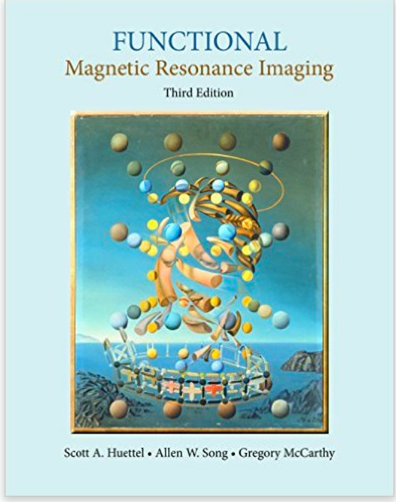
Book
Functional Magnetic Resonance Imaging
Third Edition
Scott A Huettel
Allen W Song
Gregory McCarthy

Slide 6
Your involvement
Reading (10%)
Matlab tutorials (20%)
Class project: Collect and analyze fMRI data
Collect functional MRI data at CNI
Part I: Initialize data analysis (5%)
Part II: Perform basic data analyses (5%)
Project presentation (25%) and project write-up (25%)
Experimental question
Methods
Results
Class wiki
Discussion on best practices in fMRI (10%)

Slide 7
Office Hours by Appointment
Lior Bugatus (liorbu@stanford.edu) 420-425
Kalanit Grill-Spector (kalanit@stanford.edu) 420-414

Slide 8
brain
Some Numbers…
neuron ≈ 10⁻⁶ m ≈ 1 micron
10¹² neurons in the brain
10¹⁵ synapses in the brain
basic neural circuit ≈ 1mm³ (each side is 1000 microns)
in a cubic mm (1mm³) there are about 50,000 cell bodies
and 10⁸ synapses
brain area ≈ 1cm ≈ 10 mm ≈ 10,000 microns
whole brain ≈ 20cm
neuron

Slide 9
What spatial and temporal scale is relevant for studying systems neuroscience questions?
1m
brain
10 cm
gyrus
1 cm
voxel
1 mm
Spatial resolution
cortical
column
0.1 mm
10 μm
neuron
1 μm
axon
0.1 μm
synapse
1ms
10ms
0.1s
1s
1min
1 hr
1 day
1 week
1 year
Temporal resolution
Adapted from: PS Churchland and TJ Sejnowski, Perspectives on cognitive neuroscience, 1988 Science, Vol 242, Issue 4879, 741-745

Slide 10
What spatial and temporal scale is relevant for studying systems neuroscience questions?
1m
lesion
brain
10 cm
gyrus
1 cm
voxel
1 mm
Spatial resolution
cortical
column
0.1 mm
10 μm
neuron
1 μm
axon
0.1 μm
synapse
1ms
10ms
0.1s
1s
1min
1 hr
1 day
1 week
1 year
Temporal resolution
Adapted from: PS Churchland and TJ Sejnowski, Perspectives on cognitive neuroscience, 1988 Science, Vol 242, Issue 4879, 741-745

Slide 11
What spatial and temporal scale is relevant for studying systems neuroscience questions?
1m
lesion
brain
10 cm
gyrus
1 cm
voxel
1 mm
Spatial resolution
cortical
column
0.1 mm
Single neuron recording
10 μm
neuron
1 μm
axon
0.1 μm
synapse
1ms
10ms
0.1s
1s
1min
1 hr
1 day
1 week
1 year
Temporal resolution
Adapted from: PS Churchland and TJ Sejnowski, Perspectives on cognitive neuroscience, 1988 Science, Vol 242, Issue 4879, 741-745

Slide 12
What spatial and temporal scale is relevant for studying systems neuroscience questions?
1m
lesion
brain
10 cm
fMRI
lesion
gyrus
1 cm
voxel
1 mm
Spatial resolution
cortical
column
0.1 mm
Single neuron recording
10 μm
neuron
1 μm
axon
0.1 μm
synapse
1ms
10ms
0.1s
1s
1min
1 hr
1 day
1 week
1 year
Temporal resolution
Adapted from: PS Churchland and TJ Sejnowski, Perspectives on cognitive neuroscience, 1988 Science, Vol 242, Issue 4879, 741-745

Slide 13
What spatial and temporal scale is relevant for studying systems neuroscience questions?
1m
lesion
brain
10 cm
Scalp
MEG/EEG
fMRI
gyrus
1 cm
voxel
1 mm
Spatial resolution
cortical
column
Single neuron recording
0.1 mm
Single neuron recording
10 μm
neuron
1 μm
axon
0.1 μm
synapse
1ms
10ms
0.1s
1s
1min
1 hr
1 day
1 week
1 year
Temporal resolution
Adapted from: PS Churchland and TJ Sejnowski, Perspectives on cognitive neuroscience, 1988 Science, Vol 242, Issue 4879, 741-745

Slide 14
What spatial and temporal scale is relevant for studying systems neuroscience questions?
1m
lesion
brain
10 cm
Scalp
MEG/EEG
fMRI
ECoG
gyrus
1 cm
voxel
1 mm
Spatial resolution
cortical
column
Single neuron recording
0.1 mm
Single neuron recording
10 μm
neuron
1 μm
axon
0.1 μm
synapse
1ms
10ms
0.1s
1s
1min
1 hr
1 day
1 week
1 year
Temporal resolution
Adapted from: PS Churchland and TJ Sejnowski, Perspectives on cognitive neuroscience, 1988 Science, Vol 242, Issue 4879, 741-745

Slide 15
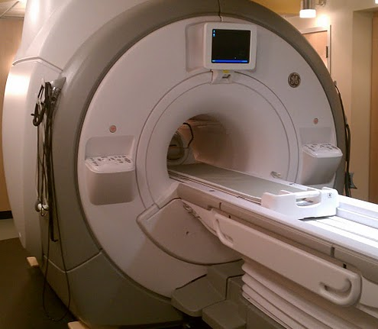
Functional MRI Facility
Stanford CNI

Slide 16
From neural signals to BOLD signals

Slide 17
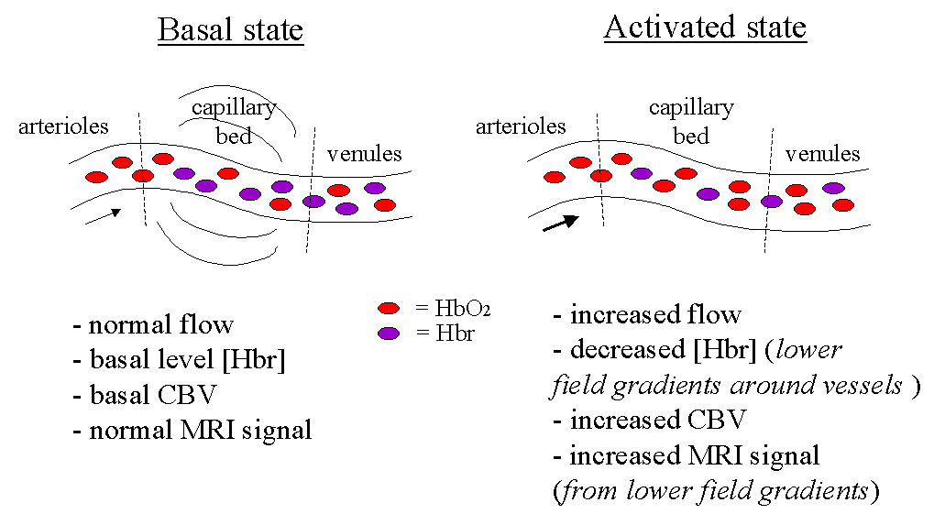
Blood Oxygen Level Dependent (BOLD) Signal
neural activity ➔ ↑ blood flow ➔ ⬇ deoxyhemoglobin ➔ ↑ T2* ➔ ↑ MR signal
CBV: Cerebral Blood Volume
CBF: Cerebral Blood Flow
HBr: Deoxy- Hemoglobin
Source: Jorge Jovicich

Slide 18
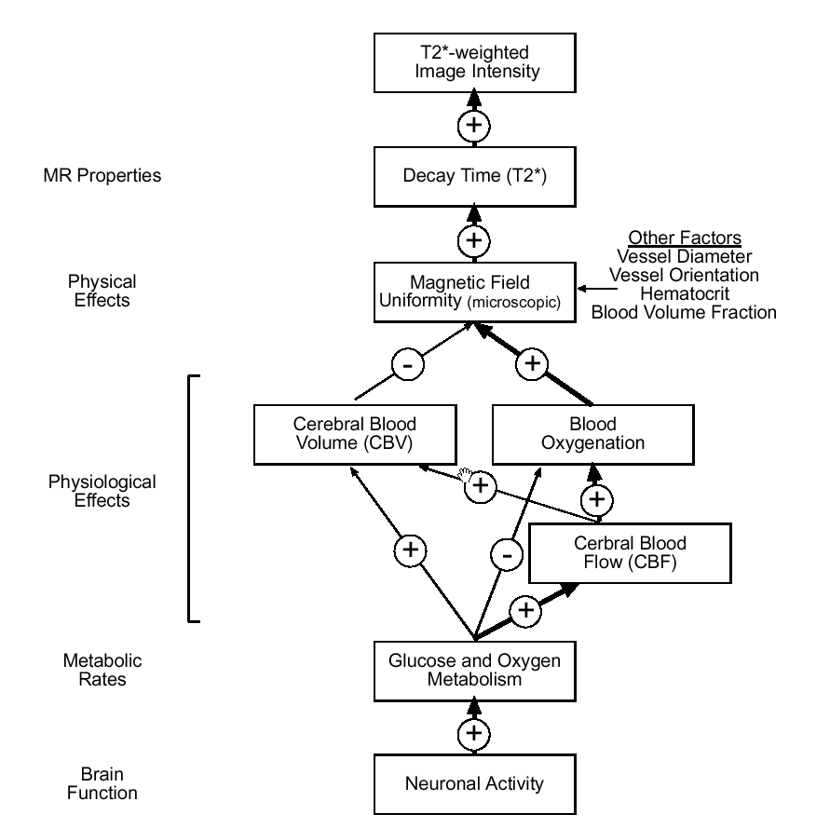
BOLD Signal
Source: Doug Noll’s primer

Slide 19
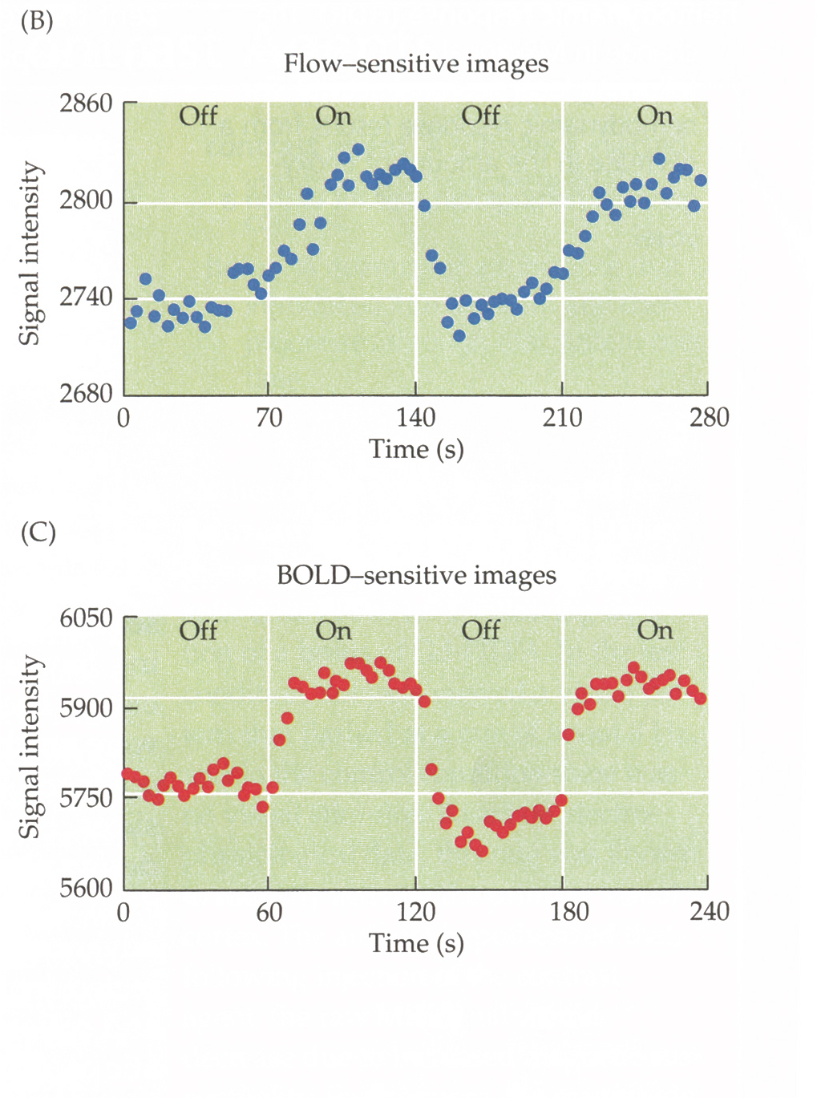
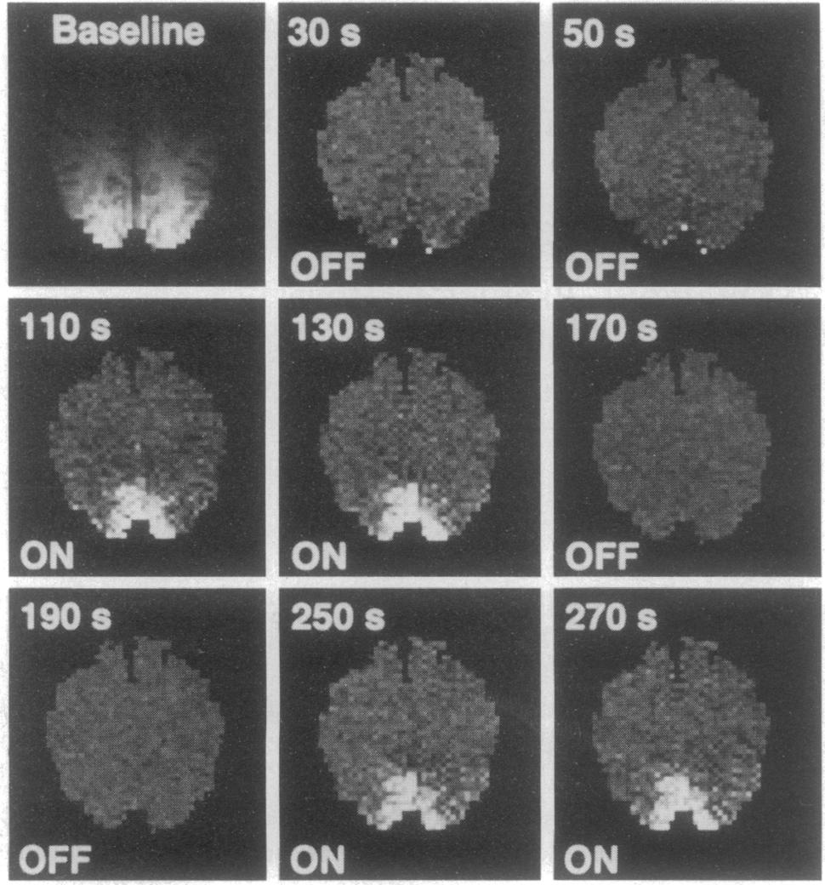
First Functional Images Generated with BOLD Signal
Kwong et al. 1992
Notes:
Images are subtracted from baseline image

Slide 20
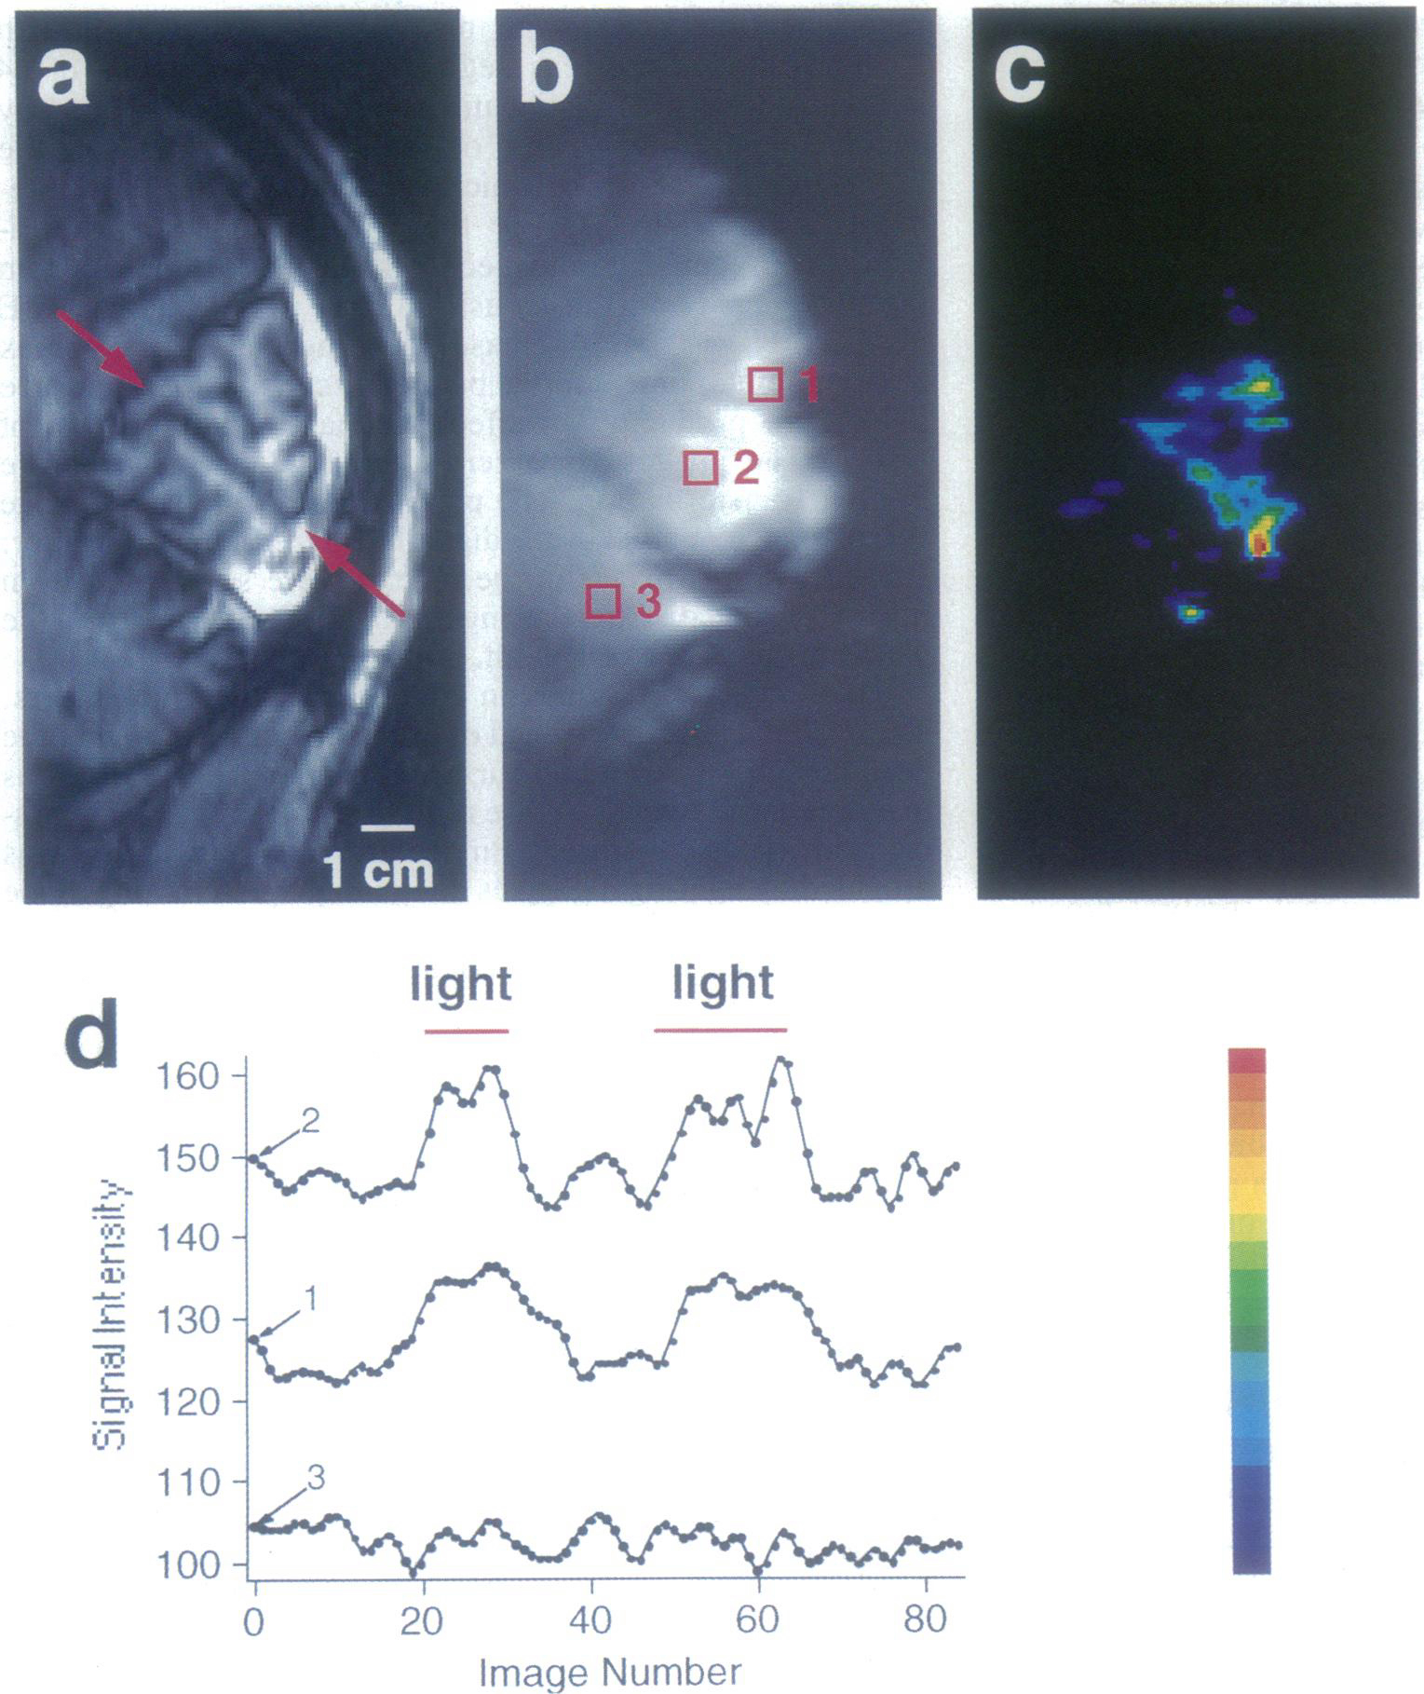
First Functional Images Generated with BOLD Signal
Ogawa et al. 1992

Slide 21
Grill-Spector, Hasson & Malach

Slide 22
Optional matlab tutorials on MRI Image formation
Basic principles of magnetic resonance signals: BasicMR_Tutorial.zip (BasicMR.m)
Pulse sequence methods for measuring T1 or T2 & how images are formed from T1 or T2 relaxation constants: T1_T2_Tutorial.zip (mrimaging.m)
MR image reconstruction, kspace, Fourier transform: KSpace_Tutorial.zip (mrdemo.m)

