Slide 1
Quantifying the signal to noise of the data

Slide 2
Signal-to-Noise Ratio (SNR)
Signal to noise is the ratio between the signal and the noise:
SNR = signal/noise

Slide 3
The Physicist’s SNR
In the context of MRI, Signal-to-Noise Ratio (SNR) reflects static or single image MRI signal ratio over the noise present in the absence of signal. However, it does not provide insight into the temporal noise characteristics of fMRI time courses.
A useful measure of image time course stability is the Temporal Signal-to-Noise Ratio (TSNR) calculated by dividing the mean of a time series by its standard deviation.
Murphy, Bodurka & Bandettini 2007

Slide 4
The Physicist’s SNR and the Psychologist’s SNR
The Physicist’s and Psychologist’s SNR differ on what defines the signal and what defines the noise.
Physicist: Raw SNR; time series SNR (tSNR);
Psychologist: Functional SNR; Contrast-to-noise-ratio (CNR)

Slide 5
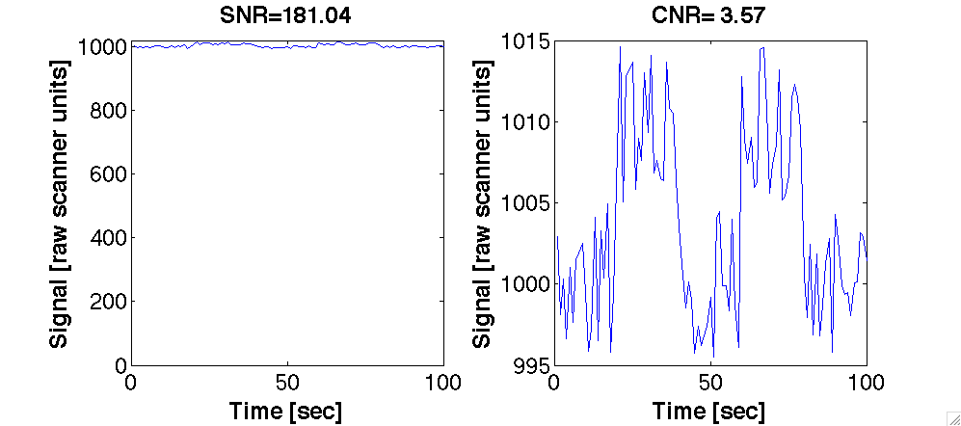
Physicist
Psychologist
Same data in different eyes....

Slide 6
The Physicist’s SNR: Raw SNR; time series SNR (tSNR)
tSNR = mean(time series) /std(time series)
Signal: Mean of time series
Noise: Standard deviation of time series.
5.5
1003.7

Slide 7
The Psychologist SNR: Functional SNR or Contrast to noise (CNR)
CNR = mean(condition-baseline) /std(baseline)
Signal: Difference (contrast) between response to a condition versus baseline.
Noise: Standard deviation of baseline condition
2.7
9.6

Slide 8
Physicist
Psychologist
SNR=1004/5.5=181
CNR=9.6/2.7=3.57
5.5
1004
2.7
9.6
Same data in different eyes....

Slide 9
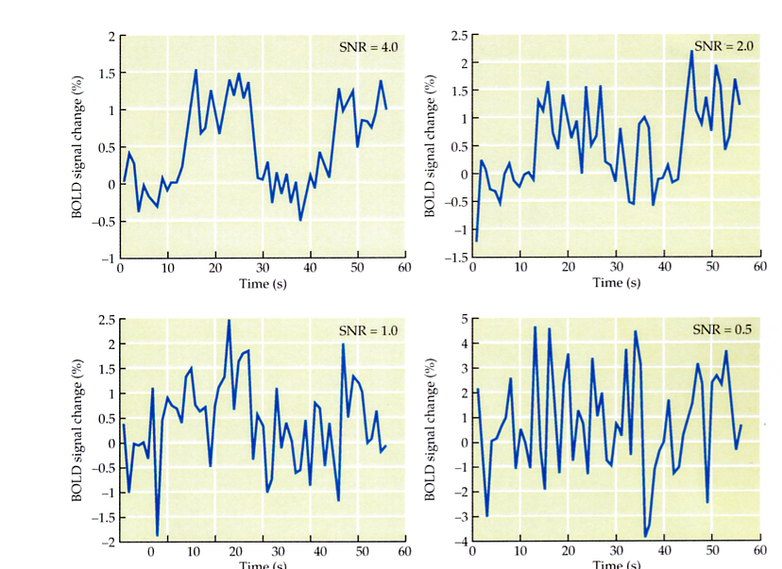
Voxels with the same signal, but different functional CNR (contrast to noise ratio)
CNR=4
CNR=2
CNR=1
CNR=.5
How can they have different CNR and the same tSNR?

Slide 10
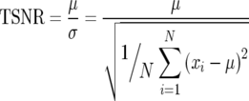
Relation between tSNR and functional effect size
For an effect size of 1 %
Need 300 time points
for tSNR of 50 or larger
TSNR increases with number of samples
Decreases with functional effect size
Murphy, Bodurka & Bandettini 2007

Slide 11
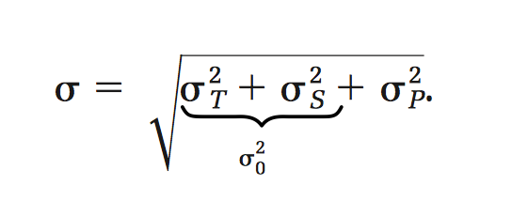
Physiological Noise in Oxygenation-Sensitive Magnetic Resonance Imaging
Gunnar Kru ̈ger* and Gary H. Glover
ISMRM 2001
In this paper Kruger & Glover showed that the physiological noise is the limiting factor in BOLD imaging
σ_{T} Thermal noise
σ_{s} Scanner noise (e.g. drift; imperfections in gradients)
σ_{p} Physiological noise arises from fluctuations in the basal cerebral metabolism, blood flow, and blood volume, but also from cardiac and respiratory functions that cause quasiperiodic oscillations in the vascular system, motion from subtle brain pulsatility, and magnetic field modulations.

Slide 12
Physiological Noise in Oxygenation-Sensitive Magnetic Resonance Imaging
Gunnar Kru ̈ger* and Gary H. Glover
ISMRM 2001
The problem is that the physiological noise (σ_{p} ) is signal (BOLD) dependent
In contrast to the raw noise, the physiological noise is signal-dependent.
They distinguish between two different physiological noise terms, B and NB .
B: describes fluctuations in the transverse relaxation rate $R_{2}^{∗}$ that gives rise to small changes in the $T_{2}^{∗}$ weighted signal. These fluctuations, which are closely linked to brain physiology, are caused by the same mechanism that results in activation-induced signal changes in BOLD imaging
NB: arises from image-to-image signal fluctuations due to cardiac and respiratory functions and scanner imperfections that demonstrate no TE-dependency.

Slide 13
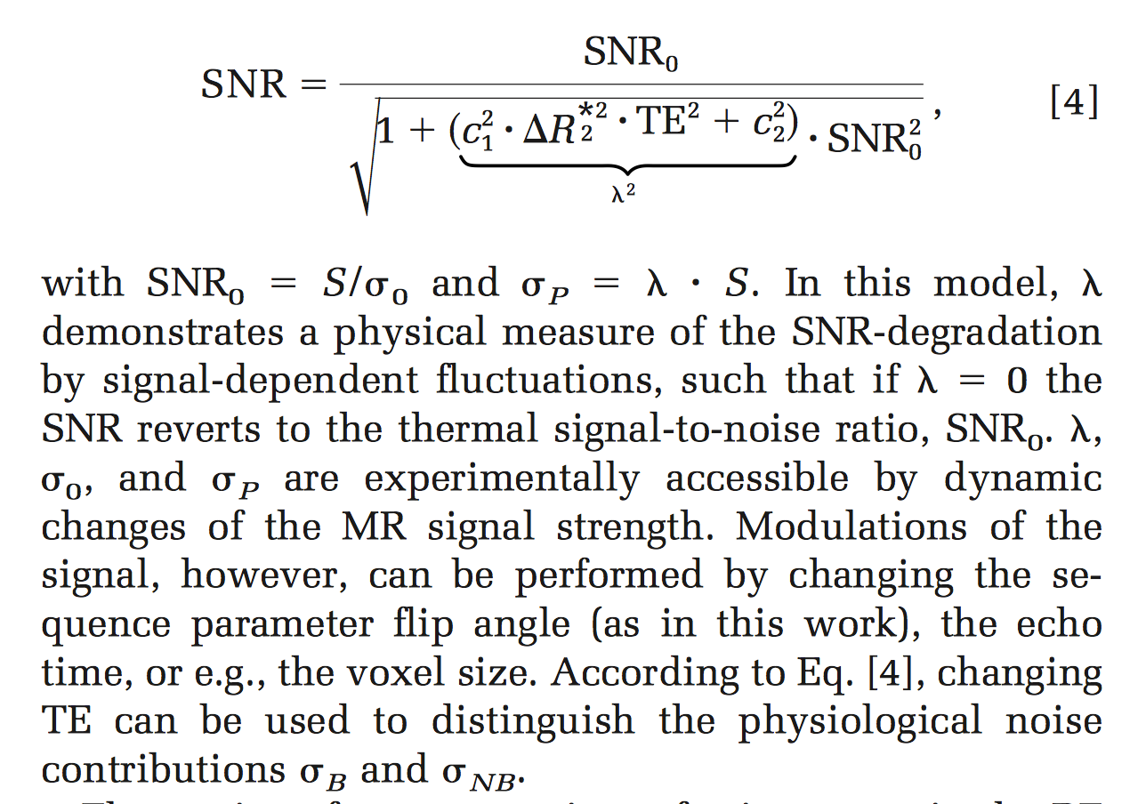
They derive and test the limiting achievable SNR for BOLD imaging

Slide 14
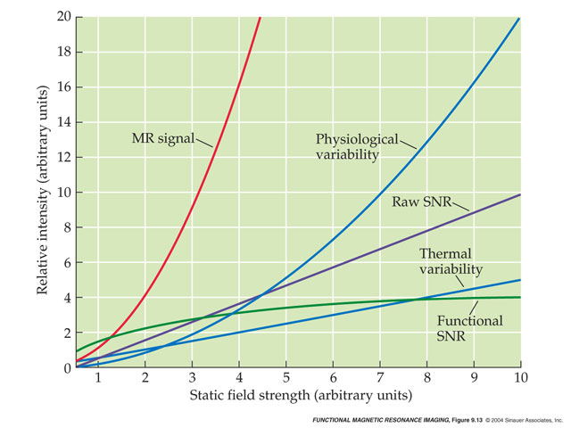
Increase SNR by scanning at higher Teslas
Huettel, Song & McCarthy, 2004, Functional Magnetic Resonance Imaging
Although raw SNR goes up with field strength, so does thermal and physiological noise
Thus there are diminishing returns for increases in field strength

Slide 15
Tradeoffs for improving SNR in fMRI
PHYSICAL FACTORS | SOLUTION & TRADEOFF
Thermal Noise (body & system) | Inherent – can’t change
Magnet Strength e.g. 1.5T → 4T gives 2-4X increase in SNR | Use higher field magnet additional cost and maintenance physiological noise may increase
Coil e.g., head → surface coil gives ~2+X increase in SNR | Use surface coil Lose other brain areas Lose homogeneity
Voxel size e.g., doubling slice thickness increases SNR by sqrt(2) | Use larger voxel size Lose resolution
Sampling time | Longer scan sessions additional time, money and subject discomfort
Source: Doug Noll’s online tutorial

Slide 16
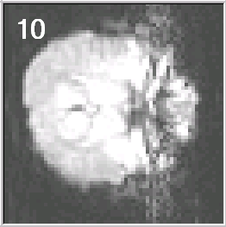
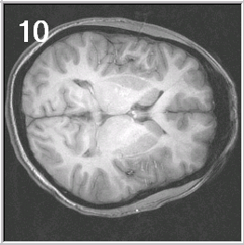
Know Thy Data
Inspect raw functional images
Where are the artifacts and distortions?
How well do the functionals and anatomicals correspond
View the scan movies
Is there any evidence of head motion?
Is there any evidence of scanner artifacts (e.g., spikes)
Examine the time courses
Is there anything unexpected (e.g., abrupt signal changes at the start of the run)?
What do the time courses look like in areas that don’t have neurons (ventricles, white matter, outside head)?
Look at each data set from each subject
Think as you go. Investigate suspicious patterns.

