Slide 1
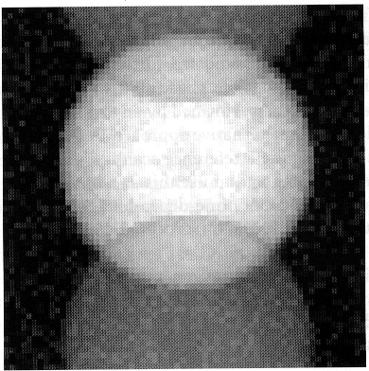
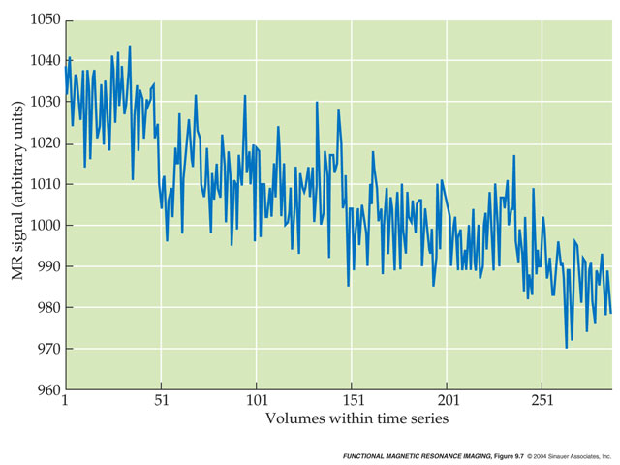
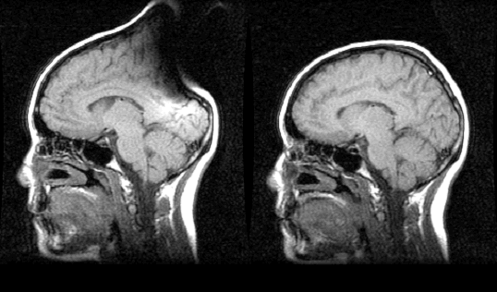
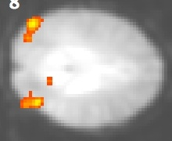
Signal and Noise in fMRI measurements

Slide 2
Tradeoffs for improving
SNR in fMRI
PHYSICAL FACTORS | SOLUTION & TRADEOFF
Thermal Noise (body & system) | Inherent – can’t change
Magnet Strength e.g. 1.5T → 4T gives 2-4X increase in SNR | Use higher field magnet additional cost and maintenance physiological noise may increase
Coil e.g., head → surface coil gives ~2+X increase in SNR | Use surface coil Lose other brain areas Lose homogeneity
Voxel size e.g., doubling slice thickness increases SNR by sqrt(2) | Use larger voxel size Lose resolution
Sampling time | Longer scan sessions additional time, money and subject discomfort
Source: Doug Noll’s online tutorial

Slide 3
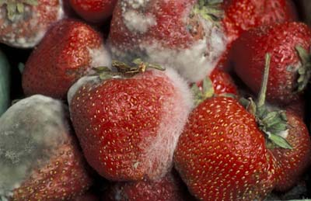
Rule #1: The Fridge Rule
When in doubt, throw it out!
Source: Jody Culham, University of Western Ontario

Slide 4
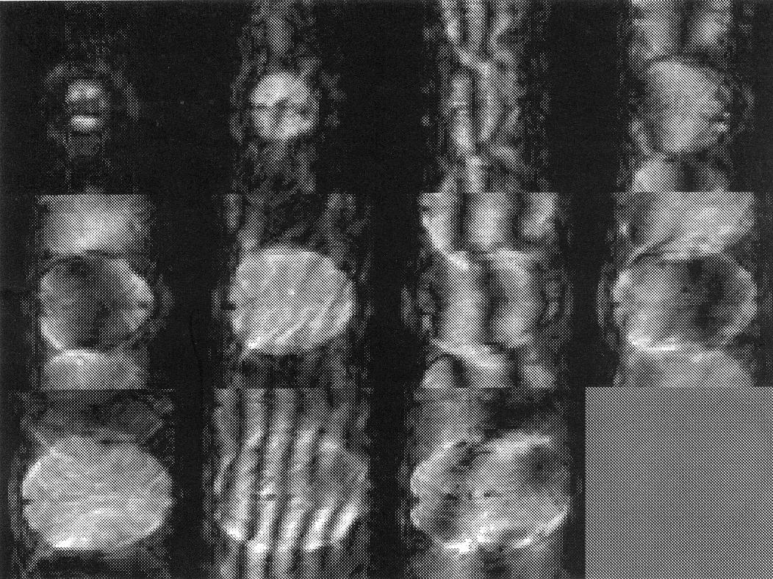
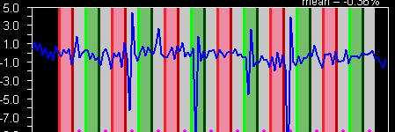
Rule #2: Inspect your raw data
Sample Artifacts
Ghosts
Hardware Malfunctions
Metallic Objects (e.g., hair tie)
Spikes
Source: Jody Culham

Slide 5
Sources of Noise
Physical noise
“Blame the magnet, the physicist, or the laws of physics”
  Thermal noise
  Linear drift
  Inhomogenities in the acquisition (magnet/coil)
Physiological noise
“Blame the subject”
  Susceptibility artifacts: Air & draining veins
  Physiological noise (breathing, pulsation)
  Motion
  Cognitive noise (inattention to task)

Slide 6
Sources of Noise
Physical noise
“Blame the magnet, the physicist, or the laws of physics”
  Thermal noise
  Linear drift
  Inhomogenities in the acquisition (magnet/coil)
Physiological noise
“Blame the subject”
  Susceptibility artifacts: Air & draining veins
  Physiological noise (breathing, pulsation)
  Motion
  Cognitive noise (inattention to task)

Slide 7
Sources of Noise
Physical noise
“Blame the magnet, the physicist, or the laws of physics”
  Thermal noise
  Linear drift
  Inhomogenities in the acquisition (magnet/coil)
Physiological noise
“Blame the subject”
  Susceptibility artifacts: Air & draining veins
  Physiological noise (breathing, pulsation)
  Motion
  Cognitive noise (inattention to task)

Slide 8
Linear Drift
Huettel, Song & McCarthy, 2004, Functional Magnetic Resonance Imaging

Slide 9
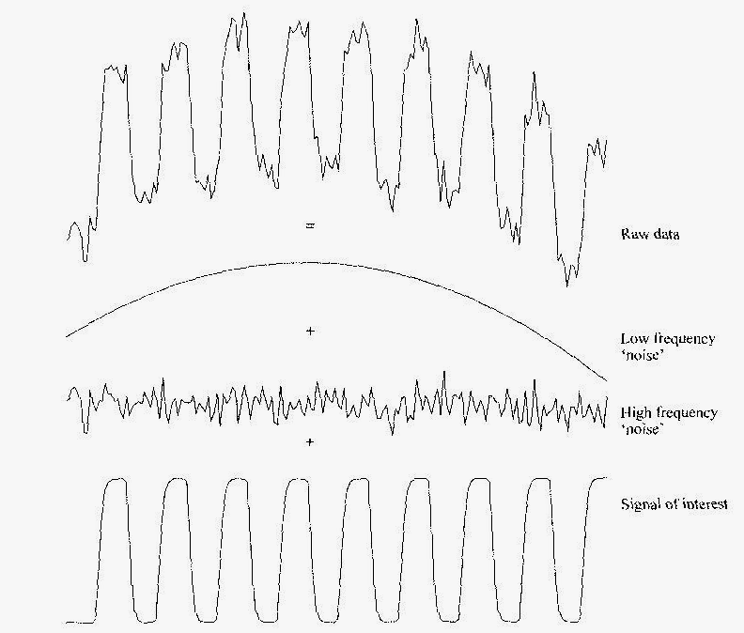
Low and High Frequency Noise
Source: Smith chapter in Functional MRI: An Introduction to Methods

Slide 10
Remedies to reduce noise
Physical noise: “Blame the magnet, the physicist, or the laws of physics”
  Thermal noise smooth/filter data
  Linear drift
    Remove linear trend line
Physiological noise
“Blame the subject”
  Susceptibility artifacts: Air & draining veins
  Motion
  Physiological noise (breathing, pulsation)
  Cognitive noise (inattention to task)

Slide 11
Removing a Linear trend line
Find coefficients of a the linear trend line using a least-squares algorithm
Temporally filter your data with a high-pass filter to remove low temporal frequencies in your data

Slide 12
Removing a linear trend line with a least-squares algorithm
h(t) : measured hemodynamic response
h’(t) : real hemodynamic response
a₁,a₀ : linear trendline coefficients
ε : additive noise

Slide 13
Sources of Noise
Physical noise
“Blame the magnet, the physicist, or the laws of physics”
  Thermal noise
  Linear drift:: Remove linear trend line
  Inhomogenities in the acquisition (magnet/coil)
Physiological noise
“Blame the subject”
  Susceptibility artifacts: Air & draining veins
  Physiological noise (breathing, pulsation)
  Motion
  Cognitive noise (inattention to task)

Slide 14
Sources of Noise
Physical noise
“Blame the magnet, the physicist, or the laws of physics”
  Thermal noise
  Linear drift: Remove linear trend line
  Inhomogenities in the acquisition (magnet/coil): get better equipment
Physiological noise
“Blame the subject”
  Physiological noise (breathing, pulsation)
  Motion
  Cognitive noise (inattention to task)

Slide 15
Sources of Noise
Physical noise
“Blame the magnet, the physicist, or the laws of physics”
  Thermal noise
  Linear drift: Remove linear trend line
  Inhomogenities in the acquisition (magnet/coil): get better equipment
Physiological noise
“Blame the subject”
  Susceptibility artifacts: Air & draining veins
  Physiological noise (breathing, pulsation)
  Motion
  Cognitive noise (inattention to task)

Slide 16
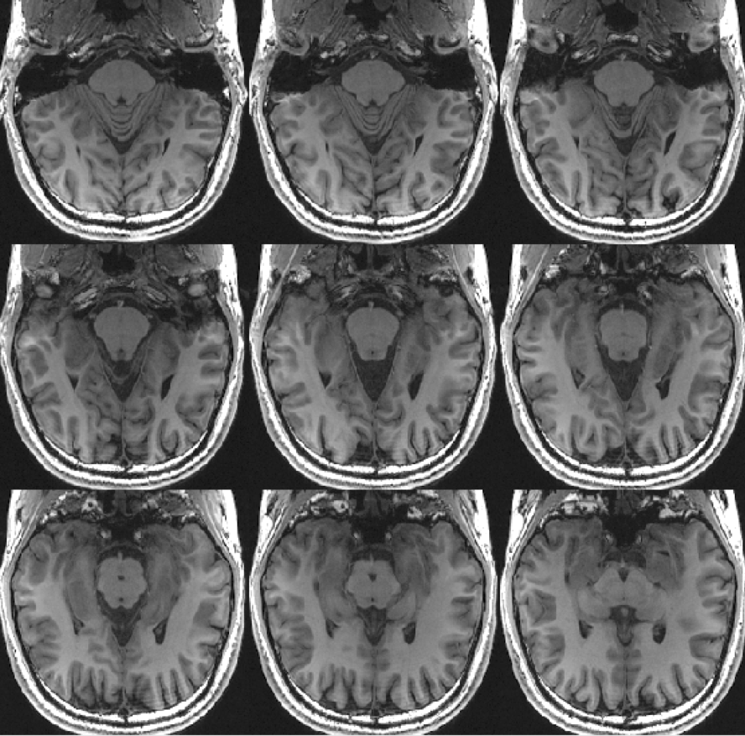
Example anatomical inplane
Envelope of temporal lobe

Slide 17
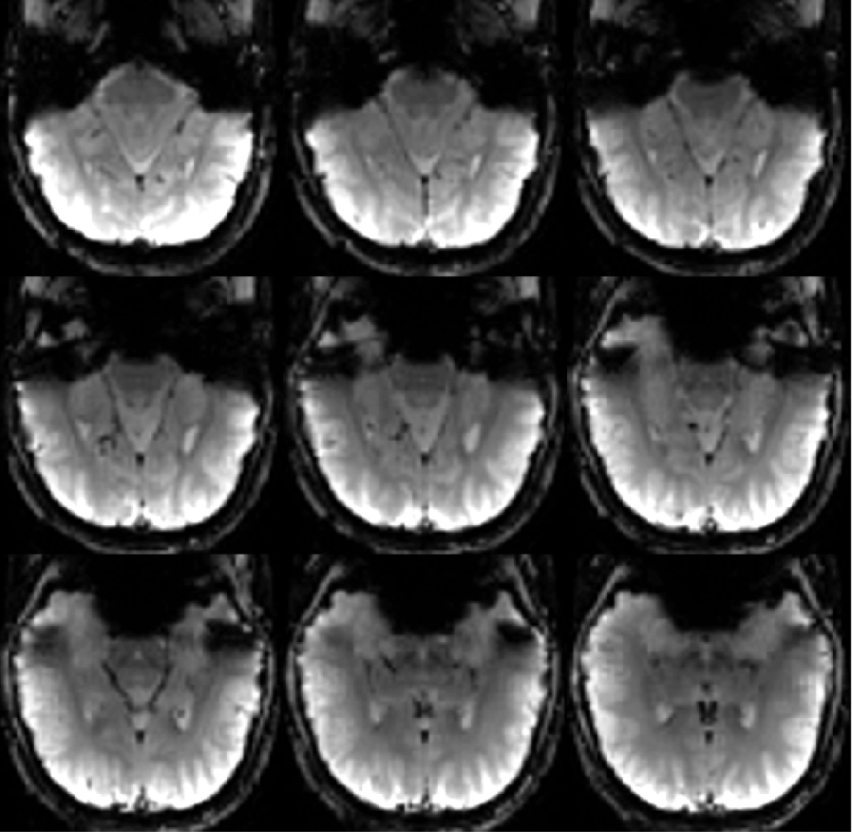
Example of the temporal lobe ear canal susceptibility artifact
Envelope of temporal lobe
Signal dropout due to ear
canal susceptibilty artifact

Slide 18
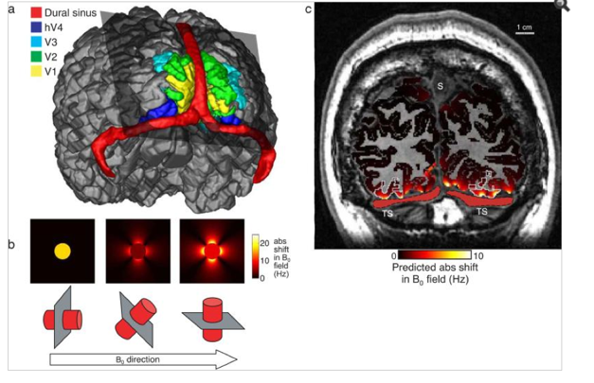
The venous eclipse
Text
Text
Mapping hV4 and ventral occipital cortex: the venous eclipse.
Winawer J, Horiguchi H, Sayres RA, Amano K, Wandell BA.
J Vis. 2010 May 1;10(5):1. doi: 10.1167/10.5.1.
Winawer & Wandell JOV 2010

Slide 19
Air induced artifacts cause dephasing of the spins casting a shadow on adjacent tissue
- Artifacts increase with voxel size
- Artifacts increase with strength of external field
(larger at 7T than 3T)

Slide 20
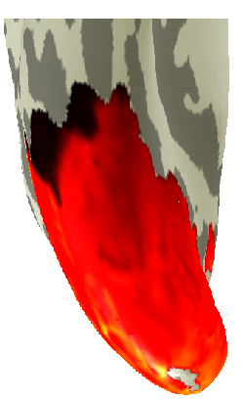
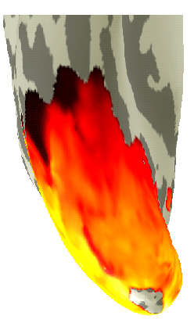
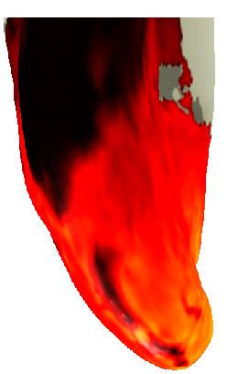
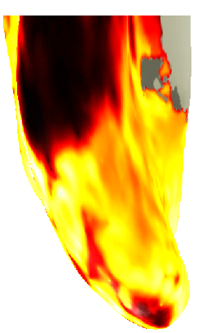
Air Canal Artifacts and Transverse sinus artifact (TSA) gets worse with bigger voxels
1.5 mm isotropic
1.5 x 1.5 x 3mm
3.125 x 3.125 x 3mm
3.75 x 3.75 x 4mm
Ear canal susceptibility artifact
Draining vein
mean map
2000
4000
6000
8000
10000
12000
14000
raw signal
Source: Kevin Weiner

Slide 21
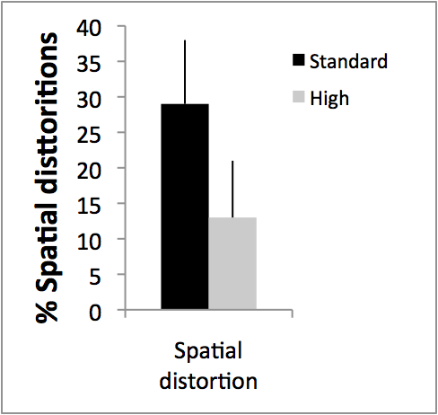
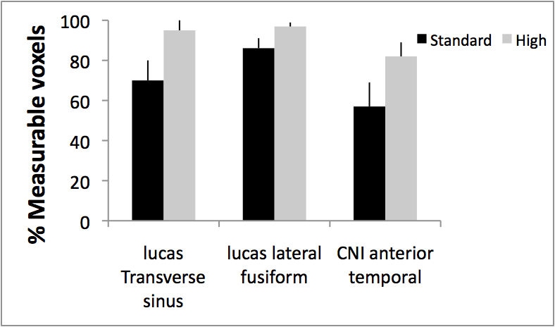
Larger voxels produce more spatial distortions and
less measurable voxels in the anterior temporal lobe
High resolution 1.8 mm isotropic
Standard resolution 3.125 x 3.125 x3 mm
Source: Kevin Weiner

Slide 22
Sources of Noise
Physical noise
“Blame the magnet, the physicist, or the laws of physics”
  Thermal noise
  Linear drift: remove trend line
  Inhomogenities in the acquisition (magnet/coil): better equipment
Physiological noise
“Blame the subject”
  Susceptibility artifacts: Air & draining veins: smaller voxels
  Physiological noise (breathing, pulsation)
  Motion
  Cognitive noise (inattention to task)

Slide 23
Sources of Noise
Physical noise
“Blame the magnet, the physicist, or the laws of physics”
  Thermal noise
  Linear drift: remove trend line
  Inhomogenities in the acquisition (magnet/coil): better equipment
Physiological noise
“Blame the subject”
  Susceptibility artifacts: Air & draining veins: smaller voxels
  Physiological noise (breathing, pulsation)
  Motion
  Cognitive noise (inattention to task)

Slide 24
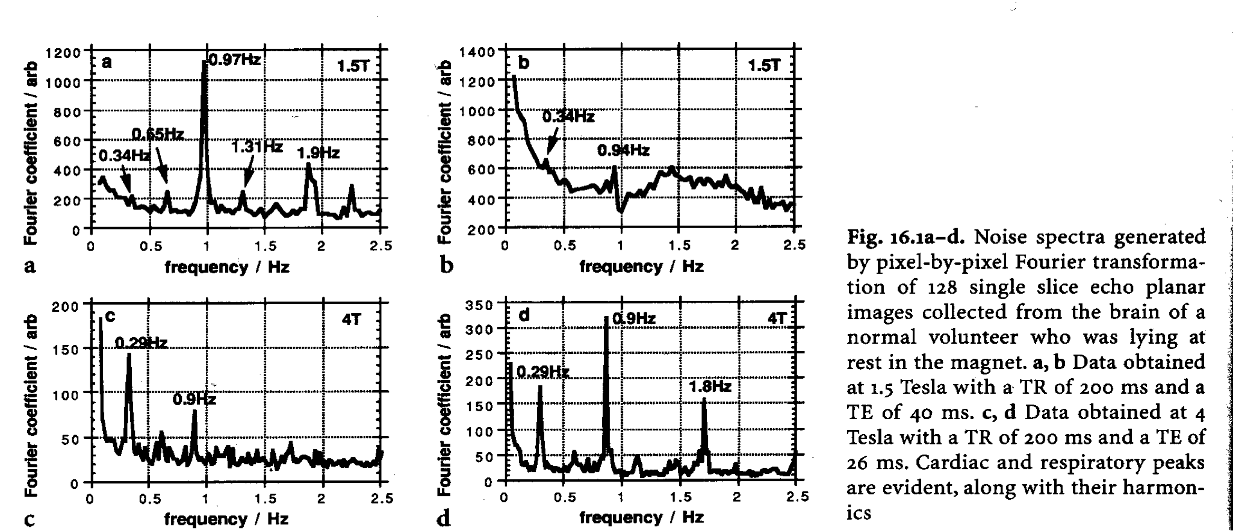
Physiological Noise
Respiration
every 4-10 sec (0.3 Hz)
moving chest distorts susceptibility
Cardiac Cycle
every ~1 sec (0.9 Hz)
pulsing motion, blood changes
Solutions
gating
avoiding paradigms at those frequencies

Slide 25
Sources of Noise
Physical noise
“Blame the magnet, the physicist, or the laws of physics”
  Thermal noise
  Linear drift: remove trend line
  Inhomogenities in the acquisition (magnet/coil): better equipment
Physiological noise
“Blame the subject”
  Susceptibility artifacts: Air & draining veins: smaller voxels
  Physiological noise (breathing, pulsation): gating/short TR
  Motion
  Cognitive noise (inattention to task)

Slide 26
Sources of Noise
Physical noise
“Blame the magnet, the physicist, or the laws of physics”
  Thermal noise
  Linear drift: remove trend line
  Inhomogenities in the acquisition (magnet/coil): better equipment
Physiological noise
“Blame the subject”
  Susceptibility artifacts: Air & draining veins: smaller voxels
  Physiological noise (breathing, pulsation): gating/short TR
  Motion
  Motion
  Cognitive noise (inattention to task)Mot

Slide 27
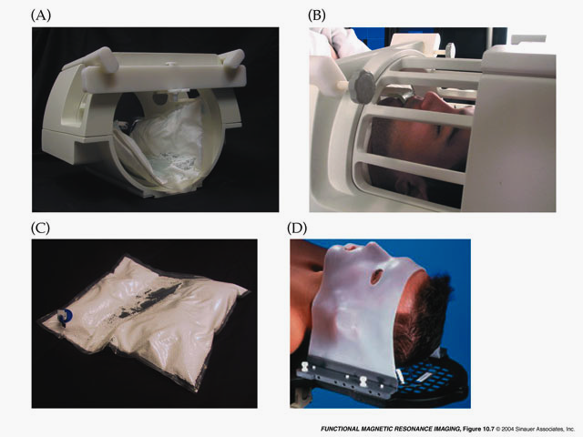
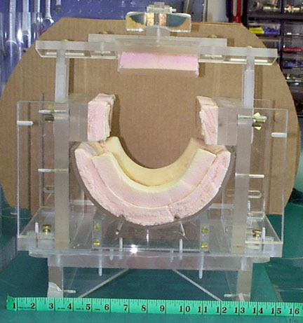
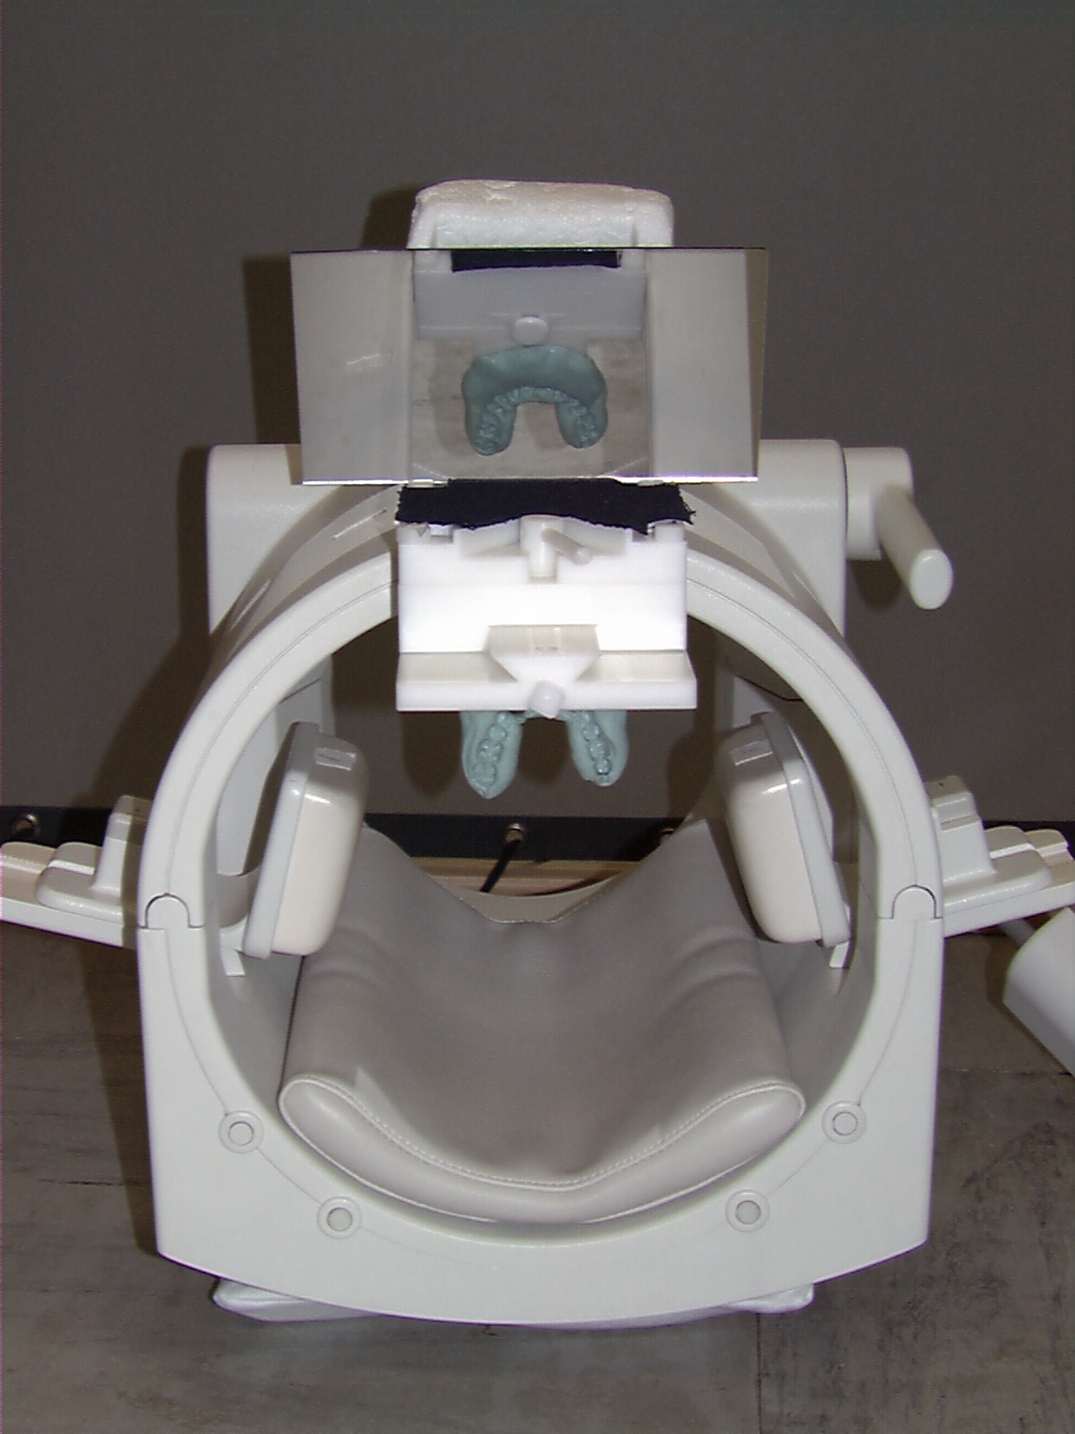
Reduce motion during scan by restraining the subject’s head.
Vacuum Pack
Head Vise
Bite Bar
Thermoplastic mask
Often a whack of foam padding works just as well as train subjects to stay in a scanner simulator
Source: Jody Culham

Slide 28
Post scan:
Run motion correction algorithm
Aims:
  Reduce motion artifacts
  Compare/average/concatenate data across scans
Motion correct runs from the same session:
  Motion correct within run
  Co-register between runs

Slide 29


Movie of the slice
Movie of the slice
after motion correction
Blood vessel
pulsation
Susceptibility
artifact
Small motion: can correct with motion correction algorithm

Slide 30

Movie of the slice
Movie of the slice
after motion correction
Large motion: hard to correct with motion correction algorithm

Slide 31
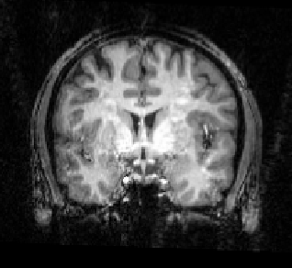
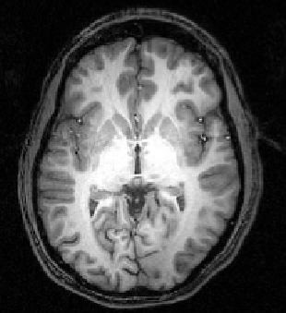
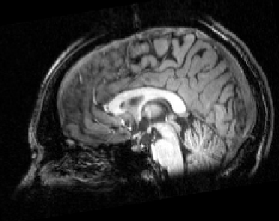
Motion Correction Algorithms
pitch
roll
yaw
z translation
y translation
x translation
Most algorithms assume a rigid body (i.e., that brain doesn’t deform with movement)
Align each volume of the brain to a target volume using six parameters: three translations and three rotations
Target volume: the functional volume that is closest in time to the anatomical image

Slide 32
Within Scan Motion:
Reference Frame 10
Too much motion
Can be motion corrected
3
3
Translation
Rotation
2
2
Total
Motion (voxels)
1
1
0
0
0
50
100
150
200
0
50
100
150
200
Time (frames)
Time (frames)

Slide 33
Between Scan Motion:
Reference Scan 1
Scan 2 - motion (voxels): rot = 0.9; trans = 1.2; total = 1.5
Scan 3 - motion (voxels): rot = 1.6; trans = 2.9; total = 3.3
Scan 4 - motion (voxels): rot = 2.0; trans = 2.6; total = 3.3
Scan 5 - motion (voxels): rot = 2.3; trans = 2.6; total = 3.5
Scan 6 - motion (voxels): rot = 1.6; trans = 2.0; total = 2.6
Scan 7 - motion (voxels): rot = 1.6; trans = 1.8; total = 2.4
Scan 8 - motion (voxels): rot = 2.6; trans = 2.2; total = 3.5
Scan 9 - motion (voxels): rot = 4.3; trans = 4.5; total = 6.3
Rule of thumb: We would like to keep the between scan motion less than 2 voxels

Slide 34
Sources of Noise
Physical noise
“Blame the magnet, the physicist, or the laws of physics”
  Thermal noise
  Linear drift: remove trend line
  Inhomogenities in the acquisition (magnet/coil): better equipment
Physiological noise
“Blame the subject”
  Susceptibility artifacts: Air & draining veins: smaller voxels
  Physiological noise (breathing, pulsation): gating/short TR
  Motion: limit subject motion & motion correct
  Motion
  Cognitive noise (inattention to task)Mot

Slide 35
Temporal Smoothing / Filtering
Average across runs
  n repetitions increases the SNR by factor of sqrt(n)
Temporal smoothing
  High-pass filtering: removes trendline
  Low-pass filtering: removes (some) physiological noise
  Increases the false alarms and false discovery rate as it introduces temporal correlations in the data

Slide 36
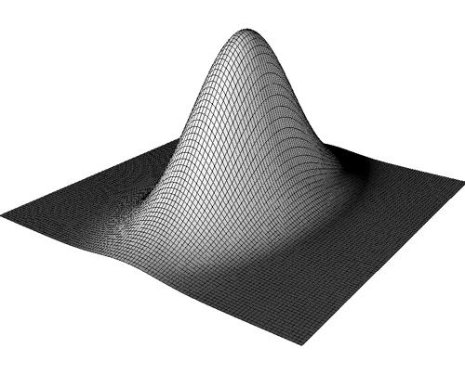
Spatial Smoothing
Gaussian kernel:
smooth each voxel by a Gaussian function, such that the nearest neighboring voxels have the strongest weighting
Maximum
Half-Maximum
Full Width at Half-Maximum
(FWHM)
FWHM Values:
some smoothing: 4 mm
typically smoothing: 6-8 mm
heavy duty smoothing: 10 mm
Matched filter theorem
3D Gaussian smoothing kernel

Slide 37
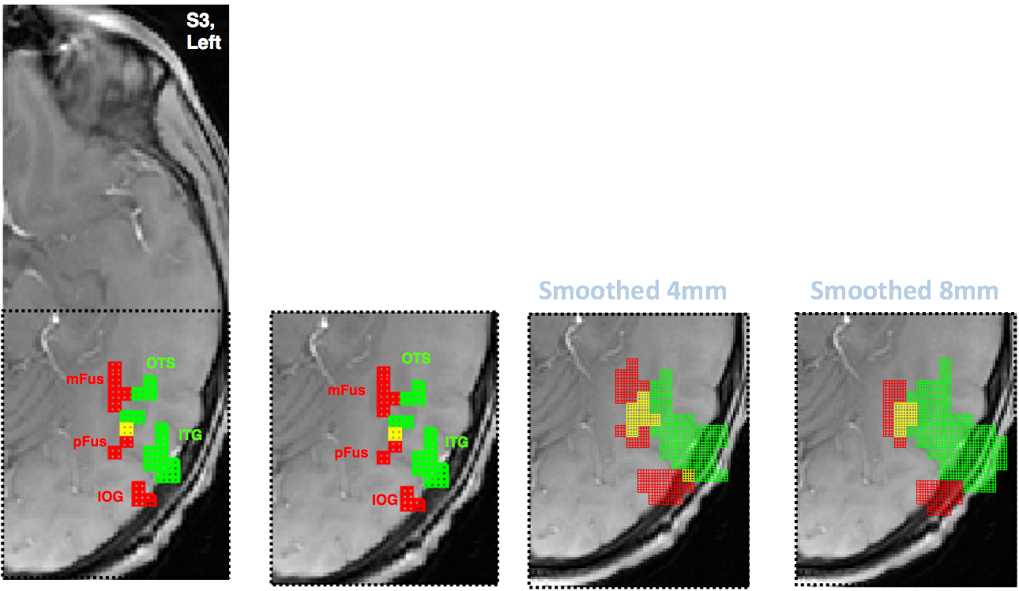
How might spatial smoothing affect activations?
anterior
3.75x3.75x4mm voxels
faces & limbs overlap
faces > others, T>3
limbs > others, T>3
Weiner & Grill-Spector, Psychological Research, 2013

Slide 38
With spatial smoothing and not restricting data to gray matter, mFus- and pFus-faces merge, and OTS- and ITG-limbs merge.
4mm smoothing
anterior
Ouch!
activations leak
outside of brain
3.75x3.75x4mm voxels
faces & limbs overlap
faces > others, T>3
limbs > others, T>3
Weiner & Grill-Spector, Psychological Research, 2013

Slide 39
Spatial smoothing can displace activations
4mm smoothing
8mm smoothing
anterior
3.75x3.75x4mm voxels
faces & limbs overlap
faces > others, T>3
limbs > others, T>3
Weiner & Grill-Spector, Psychological Research, 2013

Slide 40
To smooth or not to smooth?
Advantages
  Increases Signal to Noise Ratio (SNR)
    Matched Filter Theorem: Maximum increase in SNR by filter with same shape/size as signal
  Reduces number of comparisons
    Allows application of Gaussian Field Theory (we’ll return to this later)
  May improve comparisons across subjects if you perform group analyses.
Disadvantages
  Reduces spatial resolution
  Challenging to smooth accurately if size/shape of signal is not known
  You will gain a higher increase in SNR if you just measured your data with larger voxels and no smoothing
  Smoothing done on the slices/volume rather than on the cortical surface will extend activations beyond the gray matter

Slide 41
To smooth or not to smooth?
Advantages
  Increases Signal to Noise Ratio (SNR)
    Matched Filter Theorem: Maximum increase in SNR by filter with same shape/size as signal
  Reduces number of comparisons
    Allows application of Gaussian Field Theory (we’ll return to this later)
  May improve comparisons across subjects if you perform group analyses.
Disadvantages
  Reduces spatial resolution
  Challenging to smooth accurately if size/shape of signal is not known
  You will gain a higher increase in SNR if you just measured your data with larger voxels and no smoothing
  Smoothing done on the slices/volume rather than on the cortical surface will extend activations beyond the gray matter

Slide 42
To smooth or not to smooth?
Advantages
  Increases Signal to Noise Ratio (SNR)
    Matched Filter Theorem: Maximum increase in SNR by filter with same shape/size as signal
  Reduces number of comparisons
    Allows application of Gaussian Field Theory (we’ll return to this later)
  May improve comparisons across subjects if you perform group analyses.
Disadvantages
  Reduces spatial resolution
  Challenging to smooth accurately if size/shape of signal is not known
  You will gain a higher increase in SNR if you just measured your data with larger voxels and no smoothing
  Smoothing done on the slices/volume rather than on the cortical surface will extend activations beyond the gray matter

Slide 43
To smooth or not to smooth?
Advantages
  Increases Signal to Noise Ratio (SNR)
    Matched Filter Theorem: Maximum increase in SNR by filter with same shape/size as signal
  Reduces number of comparisons
    Allows application of Gaussian Field Theory (we’ll return to this later)
  May improve comparisons across subjects if you perform group analyses.
Disadvantages
  Reduces spatial resolution
  Challenging to smooth accurately if size/shape of signal is not known
  You will gain a higher increase in SNR if you just measured your data with larger voxels and no smoothing
  Smoothing done on the slices/volume rather than on the cortical surface will extend activations beyond the gray matter

Slide 44
To smooth or not to smooth?
Advantages
  Increases Signal to Noise Ratio (SNR)
    Matched Filter Theorem: Maximum increase in SNR by filter with same shape/size as signal
  Reduces number of comparisons
    Allows application of Gaussian Field Theory (we’ll return to this later)
  May improve comparisons across subjects if you perform group analyses.
Disadvantages
  Reduces spatial resolution
  Challenging to smooth accurately if size/shape of signal is not known
  You will gain a higher increase in SNR if you just measured your data with larger voxels and no smoothing
  Smoothing done on the slices/volume rather than on the cortical surface will extend activations beyond the gray matter

Slide 45
To smooth or not to smooth?
Advantages
  Increases Signal to Noise Ratio (SNR)
    Matched Filter Theorem: Maximum increase in SNR by filter with same shape/size as signal
  Reduces number of comparisons
    Allows application of Gaussian Field Theory (we’ll return to this later)
  May improve comparisons across subjects if you perform group analyses.
Disadvantages
  Reduces spatial resolution
  Challenging to smooth accurately if size/shape of signal is not known
  You will gain a higher increase in SNR if you just measured your data with larger voxels and no smoothing
  Smoothing done on the slices/volume rather than on the cortical surface will extend activations beyond the gray matter

Slide 46
To smooth or not to smooth?
Advantages
  Increases Signal to Noise Ratio (SNR)
    Matched Filter Theorem: Maximum increase in SNR by filter with same shape/size as signal
  Reduces number of comparisons
    Allows application of Gaussian Field Theory (we’ll return to this later)
  May improve comparisons across subjects if you perform group analyses.
Disadvantages
  Reduces spatial resolution
  Challenging to smooth accurately if size/shape of signal is not known
  You will gain a higher increase in SNR if you just measured your data with larger voxels and no smoothing
  Smoothing done on the slices/volume rather than on the cortical surface will extend activations beyond the gray matter

Slide 47
To smooth or not to smooth?
Advantages
  Increases Signal to Noise Ratio (SNR)
    Matched Filter Theorem: Maximum increase in SNR by filter with same shape/size as signal
  Reduces number of comparisons
    Allows application of Gaussian Field Theory (we’ll return to this later)
  May improve comparisons across subjects if you perform group analyses.
Disadvantages
  Reduces spatial resolution
  Challenging to smooth accurately if size/shape of signal is not known
  You will gain a higher increase in SNR if you just measured your data with larger voxels and no smoothing
  Smoothing done on the slices/volume rather than on the cortical surface will extend activations beyond the gray matter

Slide 48
Remedies to reduce noise
Physical noise: “Blame the magnet, the physicist, or the laws of physics”
  Thermal noise/f
    Average
    Spatially or temporally smooth/filter datai
  Linear drift: Remove linear trend line
  Inhomogenities in the acquisition (magnet/coil): Get better equipment
Physiological noise: “Blame the subject”
  Susceptibility artifacts: Air & draining veins:
    Smaller voxels
    Adjust prescription
  Motion: Motion correction
  Physiological noise (breathing, pulsation): cardiac gating; higher temporal resolution
  Cognitive noise (inattention to task)

Slide 49
Remedies to reduce noise
Physical noise: “Blame the magnet, the physicist, or the laws of physics”
  Thermal noise/f
    Average
    Spatially or temporally smooth/filter data
  Linear drift: Remove linear trend line
  Inhomogenities in the acquisition (magnet/coil): Get better equipment
Physiological noise: “Blame the subject”
  Susceptibility artifacts: Air & draining veins:
    Smaller voxels
    Adjust prescription
  Motion: Motion correction
  Physiological noise (breathing, pulsation): Cardiac gating; higher temporal resolution
  Cognitive noise (inattention to task)

Slide 50
Remedies to reduce noise
Physical noise: “Blame the magnet, the physicist, or the laws of physics”
  Thermal noise/f
    Average
    Spatially or temporally smooth/filter data
  Linear drift: Remove linear trend line
  Inhomogenities in the acquisition (magnet/coil): Get better equipment
Physiological noise: “Blame the subject”
  Susceptibility artifacts: Air & draining veins:
    Smaller voxels
    Adjust prescription
  Motion: Motion correction
  Physiological noise (breathing, pulsation): Cardiac gating; higher temporal resolution
  Cognitive noise (inattention to task): Control subject’s task and record behavioral data during scan

Slide 51
Order of preprocessing steps is important
What should you run first?
Motion correction or temporal filtering?

Slide 52
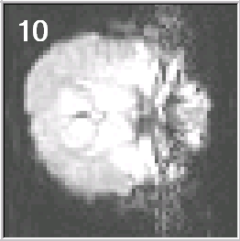
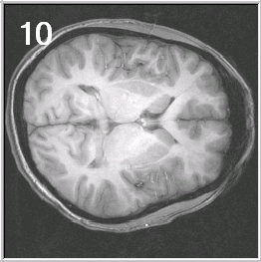
Know Thy Data
Inspect raw functional images
  Where are the artifacts and distortions?
  How well do the functionals and anatomicals correspond
View the scan movies
  Is there any evidence of head motion?
  Is there any evidence of scanner artifacts (e.g., spikes)
Examine the time courses
  Is there anything unexpected (e.g., abrupt signal changes at the start of the run)?
  What do the time courses look like in areas that don’t have neurons (ventricles, white matter, outside head)?
Look at each data set from each subject
Think as you go. Investigate suspicious patterns.

Slide 53
To smooth or not to smooth? That is the question
Smoothing affects both visualization and interpretation

Slide 54
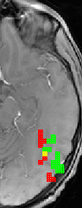
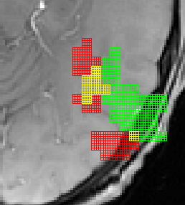
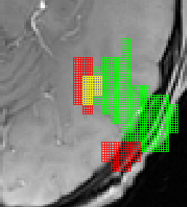
To smooth or not to smooth? That is the question
Smoothing affects both visualization and interpretation
Unsmoothed
L
Smoothed
Alternation of face- and limb-selective regions is also evident using larger functional voxels and inplane visualizations, but not with spatial smoothing. An example inplane slice from subject S3 acquired with voxels eight times as large (3.75 x 3.75 x 4mm) as our HR-fMRI scans. Left: Face-selective regions with limb-selective regions (green), and their overlap (yellow). Labeling of face-selective regions is possible using limb-selective regions as a guide (and vice versa). Right: With spatial smoothing and not restricting data to gray matter, however, mFus- and pFus-faces merge to a single region, and OTS- and ITG-limbs merge. The top rightmost image is smoothed with a 4mm kernel and the bottom rightmost image is smoothed with an 8mm kernel.
4mm
mFus
OTS
8mm
pFus
ITG
IOG
S3
Weiner & Grill-Spector, Psychological Research, 2013

Slide 55
The Many Meanings of Smoothing
SPM Manual on Smoothing http://www.fil.ion.ucl.ac.uk/spm/course/spm-introduction/text.htm#_III._Spatial_realignment_and%20normal
The motivations for smoothing the data are fourfold.
Notes:
http://www.fil.ion.ucl.ac.uk/spm/course/spm-introduction/text.htm#_III._Spatial_realignment_and%20normal

Slide 56
The Many Meanings of Smoothing
SPM Manual on Smoothing http://www.fil.ion.ucl.ac.uk/spm/course/spm-introduction/text.htm#_III._Spatial_realignment_and%20normal
The motivations for smoothing the data are fourfold.
(i) By the matched filter theorem, the optimum smoothing kernel corresponds to the size of the effect that one anticipates. The spatial scale of hemodynamic responses is, according to high-resolution optical imaging experiments, about 2 to 5mm. Despite the potentially high resolution afforded by fMRI an equivalent smoothing is suggested for most applications.
Notes:
http://www.fil.ion.ucl.ac.uk/spm/course/spm-introduction/text.htm#_III._Spatial_realignment_and%20normal

Slide 57
The Many Meanings of Smoothing
SPM Manual on Smoothing http://www.fil.ion.ucl.ac.uk/spm/course/spm-introduction/text.htm#_III._Spatial_realignment_and%20normal
The motivations for smoothing the data are fourfold.
(i) By the matched filter theorem, the optimum smoothing kernel corresponds to the size of the effect that one anticipates. The spatial scale of hemodynamic responses is, according to high-resolution optical imaging experiments, about 2 to 5mm. Despite the potentially high resolution afforded by fMRI an equivalent smoothing is suggested for most applications.
(ii) By the central limit theorem, smoothing the data will render the errors more normal in their distribution and ensure the validity of inferences based on parametric tests..
Notes:
http://www.fil.ion.ucl.ac.uk/spm/course/spm-introduction/text.htm#_III._Spatial_realignment_and%20normal

Slide 58
The Many Meanings of Smoothing
SPM Manual on Smoothing http://www.fil.ion.ucl.ac.uk/spm/course/spm-introduction/text.htm#_III._Spatial_realignment_and%20normal
The motivations for smoothing the data are fourfold.
(i) By the matched filter theorem, the optimum smoothing kernel corresponds to the size of the effect that one anticipates. The spatial scale of hemodynamic responses is, according to high-resolution optical imaging experiments, about 2 to 5mm. Despite the potentially high resolution afforded by fMRI an equivalent smoothing is suggested for most applications.
(ii) By the central limit theorem, smoothing the data will render the errors more normal in their distribution and ensure the validity of inferences based on parametric tests.
(iii) When making inferences about regional effects using Gaussian random field theory (see below) the assumption is that the error terms are a reasonable lattice representation of an underlying and smooth Gaussian field.
This necessitates smoothness to be substantially greater than voxel size. If the voxels are large, then they can be reduced by sub-sampling the data and smoothing (with the original point spread function) with little loss of intrinsic resolution.
Notes:
http://www.fil.ion.ucl.ac.uk/spm/course/spm-introduction/text.htm#_III._Spatial_realignment_and%20normal

Slide 59
The Many Meanings of Smoothing
SPM Manual on Smoothing http://www.fil.ion.ucl.ac.uk/spm/course/spm-introduction/text.htm#_III._Spatial_realignment_and%20normal
The motivations for smoothing the data are fourfold.
(i) By the matched filter theorem, the optimum smoothing kernel corresponds to the size of the effect that one anticipates. The spatial scale of hemodynamic responses is, according to high-resolution optical imaging experiments, about 2 to 5mm. Despite the potentially high resolution afforded by fMRI an equivalent smoothing is suggested for most applications.
(ii) By the central limit theorem, smoothing the data will render the errors more normal in their distribution and ensure the validity of inferences based on parametric tests.
(iii) When making inferences about regional effects using Gaussian random field theory (see below) the assumption is that the error terms are a reasonable lattice representation of an underlying and smooth Gaussian field.
This necessitates smoothness to be substantially greater than voxel size. If the voxels are large, then they can be reduced by sub-sampling the data and smoothing (with the original point spread function) with little loss of intrinsic resolution.
(iv) In the context of inter-subject averaging it is often necessary to smooth more (e.g. 8 mm in fMRI or 16mm in PET) to project the data onto a spatial scale where homologies in functional anatomy are expressed among subjects.
Notes:
http://www.fil.ion.ucl.ac.uk/spm/course/spm-introduction/text.htm#_III._Spatial_realignment_and%20normal

