Slide 1
Statistics of fMRI Data Analysis

Slide 2
Why do we need statistics?
GLM constructs a model for the way in which the BOLD response depends on the stimulus.
Notes:
GLM constructs a model for the way in which the BOLD response depends on the stimulus.
A model must include a component of random error which explains how the observations vary even if the experiment is repeated (on the same subject under exactly the same condition.
Statistics can be used to best estimate the parameters in the model, including the variability of the errors.
The random variability of the errors can then be used to assess the random variability (or standard error) of the estimated parameters themselves.
This key quantity allows the experimenter not only to say that the BOLD response is increased by say 20 units due to a particular stimulus, but also how accurate that estimate is.
Keith Worsley

Slide 3
Why do we need statistics?
GLM constructs a model for the way in which the BOLD response depends on the stimulus.
A model must include a component of random error which explains how the observations vary even if an identical experiment is repeated on the same subject.
Notes:
GLM constructs a model for the way in which the BOLD response depends on the stimulus.
A model must include a component of random error which explains how the observations vary even if the experiment is repeated (on the same subject under exactly the same condition.
Statistics can be used to best estimate the parameters in the model, including the variability of the errors.
The random variability of the errors can then be used to assess the random variability (or standard error) of the estimated parameters themselves.
This key quantity allows the experimenter not only to say that the BOLD response is increased by say 20 units due to a particular stimulus, but also how accurate that estimate is.
Keith Worsley

Slide 4
Why do we need statistics?
GLM constructs a model for the way in which the BOLD response depends on the stimulus.
A model must include a component of random error which explains how the observations vary even if an identical experiment is repeated on the same subject.
Statistics can be used to best estimate the parameters in the model and the variability of the errors.
Notes:
GLM constructs a model for the way in which the BOLD response depends on the stimulus.
A model must include a component of random error which explains how the observations vary even if the experiment is repeated (on the same subject under exactly the same condition.
Statistics can be used to best estimate the parameters in the model, including the variability of the errors.
The random variability of the errors can then be used to assess the random variability (or standard error) of the estimated parameters themselves.
This key quantity allows the experimenter not only to say that the BOLD response is increased by say 20 units due to a particular stimulus, but also how accurate that estimate is.
Keith Worsley

Slide 5
Why do we need statistics?
GLM constructs a model for the way in which the BOLD response depends on the stimulus.
A model must include a component of random error which explains how the observations vary even if an identical experiment is repeated on the same subject.
Statistics can be used to best estimate the parameters in the model and the variability of the errors.
The random variability of the errors can then be used to assess the standard error of the estimated parameters themselves.
Notes:
GLM constructs a model for the way in which the BOLD response depends on the stimulus.
A model must include a component of random error which explains how the observations vary even if the experiment is repeated (on the same subject under exactly the same condition.
Statistics can be used to best estimate the parameters in the model, including the variability of the errors.
The random variability of the errors can then be used to assess the random variability (or standard error) of the estimated parameters themselves.
This key quantity allows the experimenter not only to say that the BOLD response is increased by say 20 units due to a particular stimulus, but also how accurate that estimate is.
Keith Worsley

Slide 6
Why do we need statistics?
GLM constructs a model for the way in which the BOLD response depends on the stimulus.
A model must include a component of random error which explains how the observations vary even if an identical experiment is repeated on the same subject.
Statistics can be used to best estimate the parameters in the model and the variability of the errors.
The random variability of the errors can then be used to assess the standard error of the estimated parameters themselves.
This allows the experimenter not only to say that the BOLD response is increased by say 20 units due to a particular stimulus, but also how accurate that estimate is.
Notes:
GLM constructs a model for the way in which the BOLD response depends on the stimulus.
A model must include a component of random error which explains how the observations vary even if the experiment is repeated (on the same subject under exactly the same condition.
Statistics can be used to best estimate the parameters in the model, including the variability of the errors.
The random variability of the errors can then be used to assess the random variability (or standard error) of the estimated parameters themselves.
This key quantity allows the experimenter not only to say that the BOLD response is increased by say 20 units due to a particular stimulus, but also how accurate that estimate is.
Keith Worsley

Slide 7
Modeling the Random Error
Statistical models usually contain two parts: the fixed effects and the random error.
Notes:
Statistical models usually contain two parts: the fixed effects and the random
error.
The fixed effects are the parts of the that do not vary if the experiment is repeated; they capture the underlying scientific ‘truth’ that we hope to discover. The random error is the part left over that varies every time new data is obtained. Random error is very important for two reasons: first, it tells us how to best estimate the effect of the stimulus, and second, and more importantly, it gives us a way of assessing the error in the effect. This then allows us to compare the effect with its random error, and select those voxels where the effect is much larger than its random error, that is, voxels with high signal to-noise ratio.

Slide 8
Modeling the Random Error
Statistical models usually contain two parts: the fixed effects and the random error.
The fixed effects: do not vary if the experiment is repeated; they capture the underlying scientific ‘truth’ that we hope to discover.
Notes:
Statistical models usually contain two parts: the fixed effects and the random
error.
The fixed effects are the parts of the that do not vary if the experiment is repeated; they capture the underlying scientific ‘truth’ that we hope to discover. The random error is the part left over that varies every time new data is obtained. Random error is very important for two reasons: first, it tells us how to best estimate the effect of the stimulus, and second, and more importantly, it gives us a way of assessing the error in the effect. This then allows us to compare the effect with its random error, and select those voxels where the effect is much larger than its random error, that is, voxels with high signal to-noise ratio.

Slide 9
Modeling the Random Error
Statistical models usually contain two parts: the fixed effects and the random error.
The fixed effects: do not vary if the experiment is repeated; they capture the underlying scientific ‘truth’ that we hope to discover.
The random error: is the part left over that varies every time new data is obtained.
Notes:
Statistical models usually contain two parts: the fixed effects and the random
error.
The fixed effects are the parts of the that do not vary if the experiment is repeated; they capture the underlying scientific ‘truth’ that we hope to discover. The random error is the part left over that varies every time new data is obtained. Random error is very important for two reasons: first, it tells us how to best estimate the effect of the stimulus, and second, and more importantly, it gives us a way of assessing the error in the effect. This then allows us to compare the effect with its random error, and select those voxels where the effect is much larger than its random error, that is, voxels with high signal to-noise ratio.

Slide 10
Modeling the Random Error
Statistical models usually contain two parts: the fixed effects and the random error.
The fixed effects: do not vary if the experiment is repeated; they capture the underlying scientific ‘truth’ that we hope to discover.
The random error: is the part left over that varies every time new data is obtained.
Random error is important for two reasons:
it tells us how to best estimate the effect of the stimulus
Notes:
Statistical models usually contain two parts: the fixed effects and the random
error.
The fixed effects are the parts of the that do not vary if the experiment is repeated; they capture the underlying scientific ‘truth’ that we hope to discover. The random error is the part left over that varies every time new data is obtained. Random error is very important for two reasons: first, it tells us how to best estimate the effect of the stimulus, and second, and more importantly, it gives us a way of assessing the error in the effect. This then allows us to compare the effect with its random error, and select those voxels where the effect is much larger than its random error, that is, voxels with high signal to-noise ratio.

Slide 11
Modeling the Random Error
Statistical models usually contain two parts: the fixed effects and the random error.
The fixed effects: do not vary if the experiment is repeated; they capture the underlying scientific ‘truth’ that we hope to discover.
The random error: is the part left over that varies every time new data is obtained.
Random error is important for two reasons:
it tells us how to best estimate the effect of the stimulus
it gives us a way of assessing the error in the effect. This allows
us to compare the effect with its random error, and select those voxels where the effect is much larger than its random error
Notes:
Statistical models usually contain two parts: the fixed effects and the random
error.
The fixed effects are the parts of the that do not vary if the experiment is repeated; they capture the underlying scientific ‘truth’ that we hope to discover. The random error is the part left over that varies every time new data is obtained. Random error is very important for two reasons: first, it tells us how to best estimate the effect of the stimulus, and second, and more importantly, it gives us a way of assessing the error in the effect. This then allows us to compare the effect with its random error, and select those voxels where the effect is much larger than its random error, that is, voxels with high signal to-noise ratio.

Slide 12
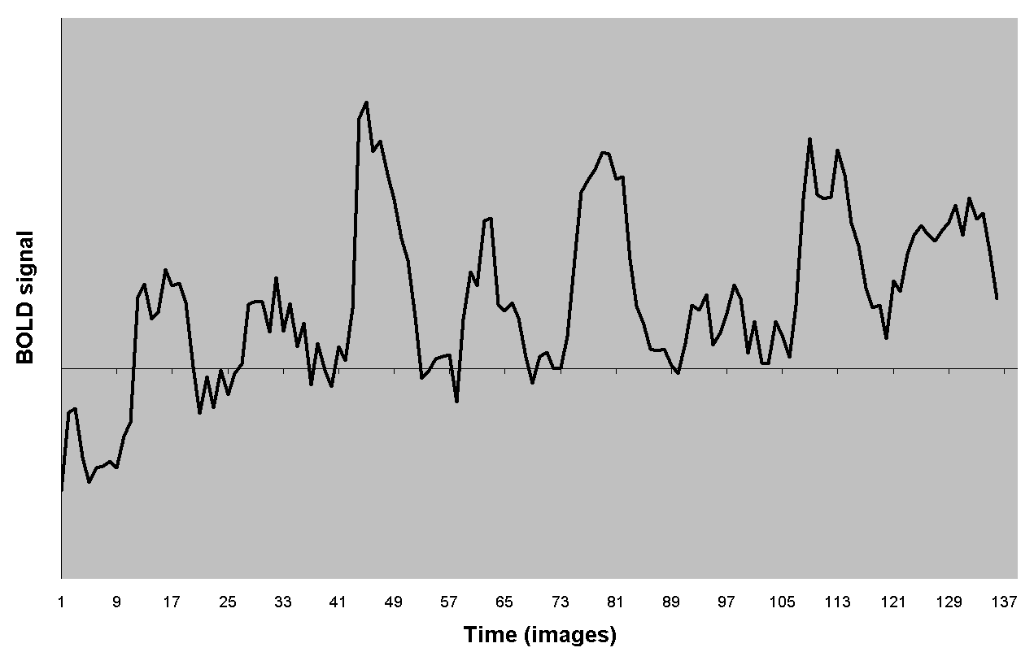
Goodness of fit of the GLM
=
fMRI Signal
=
“our data”
=

Slide 13
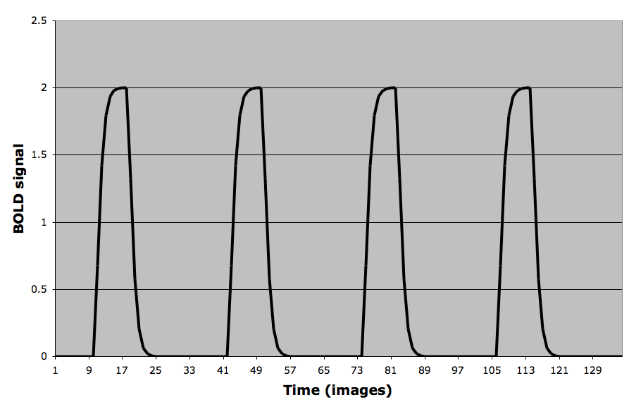
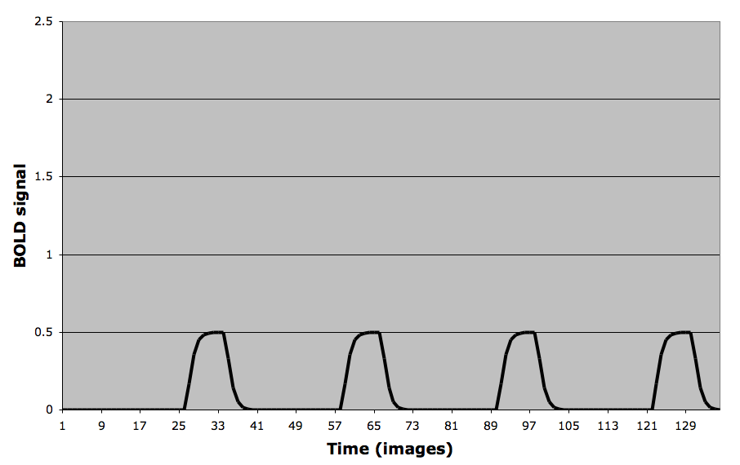
Goodness of fit of the GLM
when β₁=2
=
+
when β₂=0.5
fMRI Signal
=
predictors
x
Betas
“what we CAN explain”
“our data”
=

Slide 14
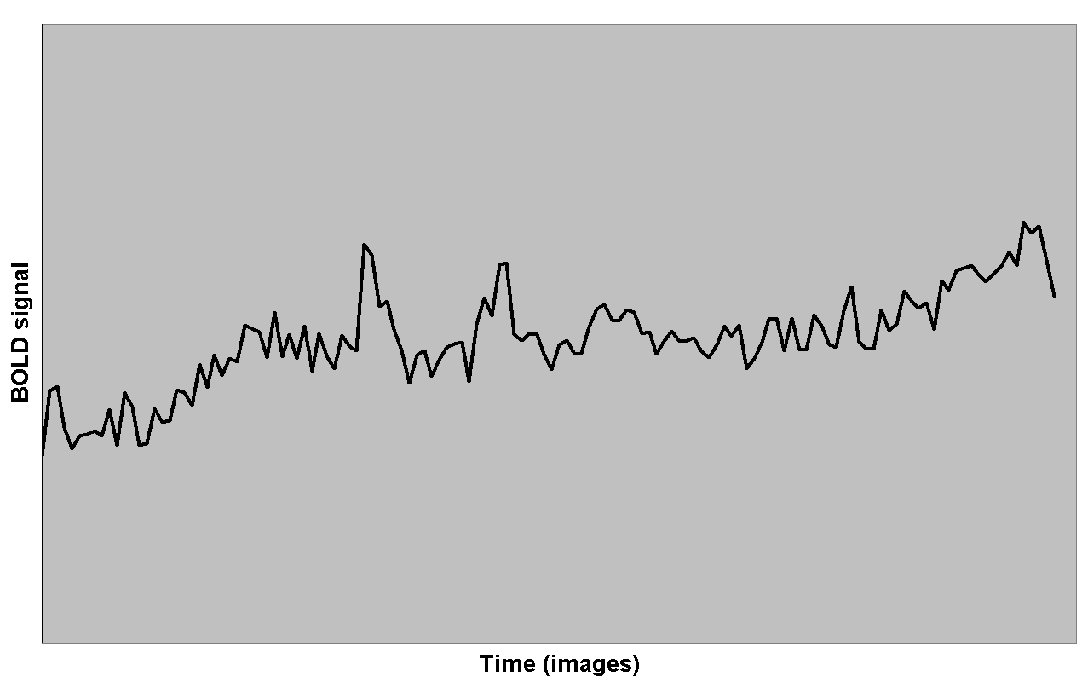
Goodness of fit of the GLM
when β₁=2
=
+
+
when β₂=0.5
fMRI Signal
=
predictors
x
+
Betas
Residuals
“what we CAN explain”
“what we CANNOT explain”
“our data”
=
+

Slide 15
Goodness of fit of the GLM
when β₁=2
=
+
+
when β₂=0.5
fMRI Signal
=
predictors
x
+
Betas
Residuals
“what we CAN explain”
“what we CANNOT explain”
“our data”
=
+
variance explained by GLM
unexplained variance
Statistical significance is basically a ratio of explained to unexplained variance
F test =

Slide 16
The variance of the error captures the variance of the fMRI signal that is not explained by the GLM

Slide 17
The variance of the error captures the variance of the fMRI signal that is not explained by the GLM

Slide 18
Detecting an Effect
Usually we are more interested in comparing responses to different stimuli: Does stimulus A gives a bigger response than stimulus B?
Notes:
Usually we are more interested in comparing responses to different stimuli, e.g.
whether stimulus A gives a bigger response than stimulus B. In other words,
we are interested in the difference between the response to A and B.
This is known as an effect (an effect could of course be just a single magnitude)
We want to derive estimates for an effect, its variance statistical significance

Slide 19
Detecting an Effect
Usually we are more interested in comparing responses to different stimuli: Does stimulus A gives a bigger response than stimulus B?
This is known as an effect (an effect could of course be just a single magnitude)
Notes:
Usually we are more interested in comparing responses to different stimuli, e.g.
whether stimulus A gives a bigger response than stimulus B. In other words,
we are interested in the difference between the response to A and B.
This is known as an effect (an effect could of course be just a single magnitude)
We want to derive estimates for an effect, its variance statistical significance

Slide 20
Detecting an Effect
Usually we are more interested in comparing responses to different stimuli: Does stimulus A gives a bigger response than stimulus B?
This is known as an effect (an effect could of course be just a single magnitude)
We want to derive estimates for:
an effect
its variance
its statistical significance
Notes:
Usually we are more interested in comparing responses to different stimuli, e.g.
whether stimulus A gives a bigger response than stimulus B. In other words,
we are interested in the difference between the response to A and B.
This is known as an effect (an effect could of course be just a single magnitude)
We want to derive estimates for an effect, its variance statistical significance

Slide 21
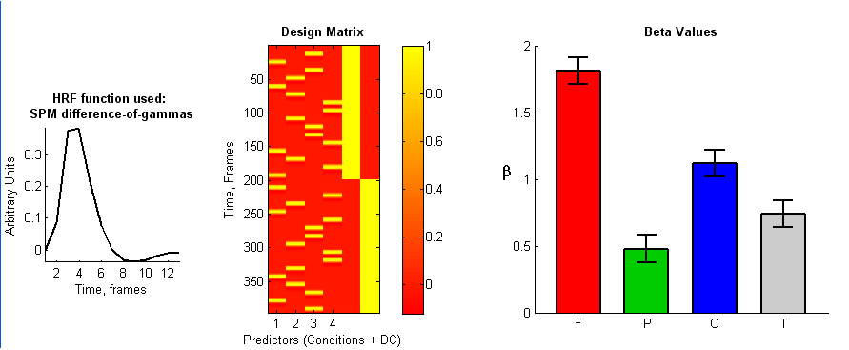
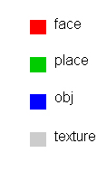
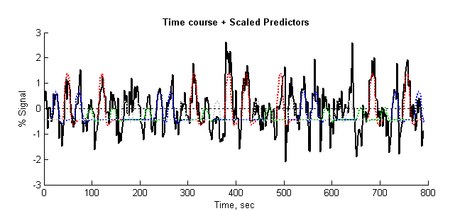
Defining an effect & its significance: Is the response to faces greater than nonfaces?
GLM explains
46.7% of the time course variance

Slide 22
Defining an effect (contrast)
The particular differences of the parameters that make up the effect
are specified by a vector c, a vector of the length as which specifies a
linear combination of the parameters.
Notes:
The particular differences of the parameters that make up the effect
are specified by a vector c, a vector of the length as which specifies a
linear combination of the parameters. This is estimated by the
same linear combination of the estimated parameters
The simplest contrast involves only one explanatory variable.
To test activation in the first condition versus baseline, the contrast vector is:
c’ = (1 0 0 0 0 0)
If we are interested in the difference between the first and second
conditions then the contrast vector is:
c‘ = (1-1 0 0 0 0).
We have now defined the effect via the contrast

Slide 23
Defining an effect (contrast)
The particular differences of the parameters that make up the effect
are specified by a vector c, a vector of the length as which specifies a
linear combination of the parameters.
The simplest contrast involves only one explanatory variable.
To test activation in the first condition versus baseline, the contrast vector is:
c’ = (1 0 0 0 )
Notes:
The particular differences of the parameters that make up the effect
are specified by a vector c, a vector of the length as which specifies a
linear combination of the parameters. This is estimated by the
same linear combination of the estimated parameters
The simplest contrast involves only one explanatory variable.
To test activation in the first condition versus baseline, the contrast vector is:
c’ = (1 0 0 0 0 0)
If we are interested in the difference between the first and second
conditions then the contrast vector is:
c‘ = (1-1 0 0 0 0).
We have now defined the effect via the contrast

Slide 24
Defining an effect (contrast)
The particular differences of the parameters that make up the effect
are specified by a vector c, a vector of the length as which specifies a
linear combination of the parameters.
The simplest contrast involves only one explanatory variable.
To test activation in the first condition versus baseline, the contrast vector is:
c’ = (1 0 0 0 )
If we are interested in the difference between the first and second
conditions then the contrast vector is:
c‘ = (1-1 0 0 ).
Notes:
The particular differences of the parameters that make up the effect
are specified by a vector c, a vector of the length as which specifies a
linear combination of the parameters. This is estimated by the
same linear combination of the estimated parameters
The simplest contrast involves only one explanatory variable.
To test activation in the first condition versus baseline, the contrast vector is:
c’ = (1 0 0 0 0 0)
If we are interested in the difference between the first and second
conditions then the contrast vector is:
c‘ = (1-1 0 0 0 0).
We have now defined the effect via the contrast

Slide 25
Defining an effect (contrast)
The particular differences of the parameters that make up the effect
are specified by a vector c, a vector of the length as which specifies a
linear combination of the parameters.
The simplest contrast involves only one explanatory variable.
To test activation in the first condition versus baseline, the contrast vector is:
c’ = (1 0 0 0 )
If we are interested in the difference between the first and second
conditions then the contrast vector is:
c‘ = (1-1 0 0 ).
We have now defined the effect via the contrast:
Notes:
The particular differences of the parameters that make up the effect
are specified by a vector c, a vector of the length as which specifies a
linear combination of the parameters. This is estimated by the
same linear combination of the estimated parameters
The simplest contrast involves only one explanatory variable.
To test activation in the first condition versus baseline, the contrast vector is:
c’ = (1 0 0 0 0 0)
If we are interested in the difference between the first and second
conditions then the contrast vector is:
c‘ = (1-1 0 0 0 0).
We have now defined the effect via the contrast

Slide 26
We have now defined the effect via the contrast

Slide 27
We have now defined the effect via the contrast
We would also like to estimate the variance of the effect:

Slide 28
We have now defined the effect via the contrast
We would also like to estimate the variance of the effect:
Finally, we test whether or not there is any evidence for the effect. That is, whether the effect differs from zero, using the ratio of the effect to its standard error, called the T statistic:

Slide 29
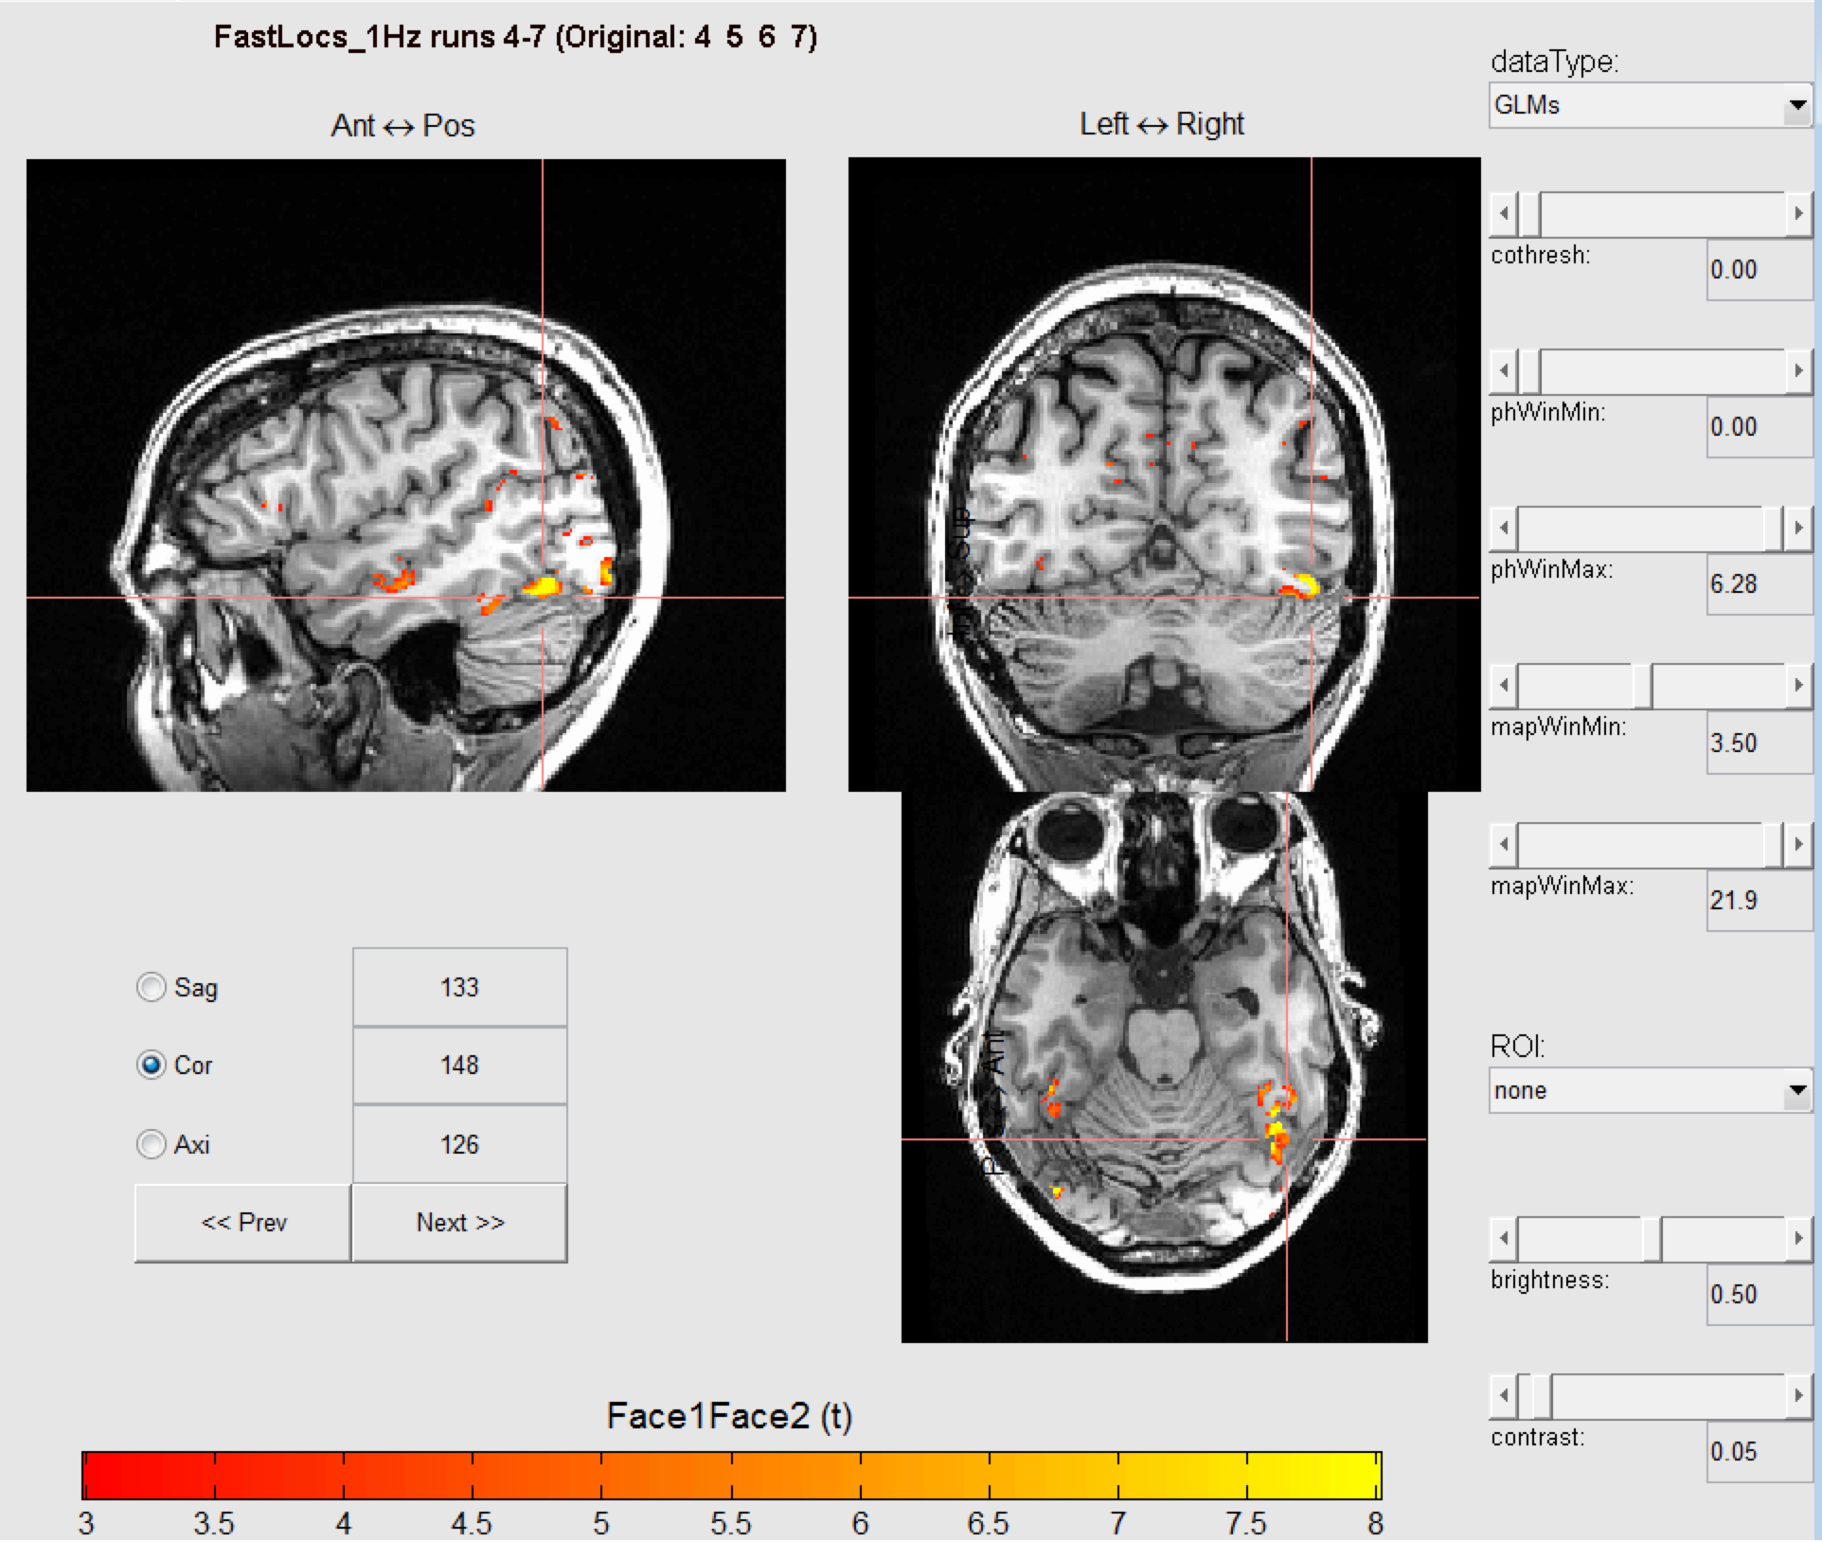
If you calculate the effect in each voxel you get a statistical parametric map (SPM)
>
Word
123

Slide 30
If you calculate the effect in each voxel you get a statistical parametric map (SPM)
>
Word
123
right
left

Slide 31
Smaller residuals, higher significance
The more variance we can explain (i.e., the less variance that goes into the residuals), the greater our statistical significance

Slide 32
Smaller residuals, higher significance
The more variance we can explain (i.e., the less variance that goes into the residuals), the greater our statistical significance
How can we explain more variance?

Slide 33
Smaller residuals, higher significance
The more variance we can explain (i.e., the less variance that goes into the residuals), the greater our statistical significance
How can we explain more variance?
Filter unwanted noise

Slide 34
Smaller residuals, higher significance
The more variance we can explain (i.e., the less variance that goes into the residuals), the greater our statistical significance
How can we explain more variance?
Filter unwanted noise
Use accurate models of HRF

Slide 35
Smaller residuals, higher significance
The more variance we can explain (i.e., the less variance that goes into the residuals), the greater our statistical significance
How can we explain more variance?
Filter unwanted noise
Use accurate models of HRF
Include additional predictors that will ‘soak up’ variance in the BOLD response in addition to stimulus predictors
Motion
Behavioral response

Slide 36
The “more robust estimator” of SPM
An alternative, adopted by SPM (Worsley & Friston) is to
'precolour', or smooth, the data (and the model).
This yields an unbiased estimator of but with slightly increased
variance. This small loss of efficiency is offset by a more robust estimator of the variance, that is, an estimator of whose estimated variance is less sensitive to departures from the assumed form of rather than modeling the correlation structure of the original observations, adopts an model for the smoothed data.

Slide 37
Errors in statistical analysis
Type I error - false positives
Type II error- failing to detect voxels with real activity

Slide 38
Statistical Adjustments

Slide 39
One concern with fMRI is that you have many voxels, which that may increase your type I error. In other words this is the problem of multiple comparisons
The greater the number of statistical tests conducted, the greater the chance of a false positive result.

Slide 40
One concern with fMRI is that you have many voxels, which that may increase your type I error. In other words this is the problem of multiple comparisons
The greater the number of statistical tests conducted, the greater the chance of a false positive result.
Bonferroni correction: P(no false positive)=(1-α)^{n}
α_{bon}= α/n

Slide 41
One concern with fMRI is that you have many voxels, which that may increase your type I error. In other words this is the problem of multiple comparisons
The greater the number of statistical tests conducted, the greater the chance of a false positive result.
Bonferroni correction: P(no false positive)=(1-α)^{n}
α_{bon}= α/n
E.g. if 4096 voxels are being tested reduces the alpha value from 0.01 to 0.00002

Slide 42
One concern with fMRI is that you have many voxels, which that may increase your type I error. In other words this is the problem of multiple comparisons
The greater the number of statistical tests conducted, the greater the chance of a false positive result.
Bonferroni correction: P(no false positive)=(1-α)^{n}
α_{bon}= α/n
E.g. if 4096 voxels are being tested reduces the alpha value from 0.01 to 0.00002
Problem: increases type II error (failing to detect active voxels)

Slide 43
Bonferroni Correction
It is a hack that reduces the number of activations.
What is N? How does smoothing the data influence this? Ask the professionals, but you will still make errors.

Slide 44
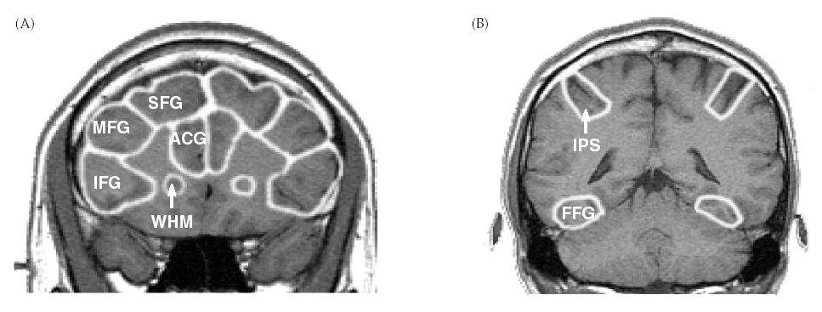
Region of Interest (ROI) approach
If you specify a region, then the false alarm issue and Bonferroni correction go away. You should have a reason (hypothesis) to specify the ROI.

Slide 45
Region of Interest (ROI) approach
Use localizer or anatomy to find a region (e.g. auditory cortex or amygdala).

Slide 46
Region of Interest (ROI) approach
Use localizer or anatomy to find a region (e.g. auditory cortex or amygdala).
Extract time course information from that region in separate independent runs.

Slide 47
Region of Interest (ROI) approach
Use localizer or anatomy to find a region (e.g. auditory cortex or amygdala).
Extract time course information from that region in separate independent runs.
See if the trends in that region are statistically significant. Because the runs that are used to generate the area are independent from those used to test the hypothesis, liberal statistics can be used.

Slide 48
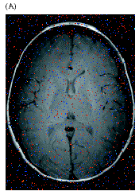
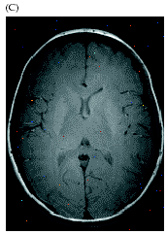
False Discovery Rate Genovese, Lazar, and Nichols (2002)
Finding objective and effective thresholds for voxelwise statistics derived from neuroimaging data has been a long-standing problem. With at least one test performed for every voxel in an image, some correction of the thresholds is needed to control the error rates, but standard procedures for multiple hypothesis testing (e.g., Bonferroni) tend to not be sensitive enough to be useful in this context. This paper introduces to the neuroscience literature statistical procedures for controlling the false discovery rate (FDR). Recent theoretical work in statistics suggests that FDR-controlling procedures will be effective for the analysis of neuroimaging data. These procedures operate simultaneously on all voxelwise test statistics to determine which tests should be considered statistically significant. The innovation of the procedures is that they control the expected proportion of the rejected hypotheses that are falsely rejected. We demonstrate this approach using both simulations and functional magnetic resonance imaging data from two simple experiments.

Slide 49
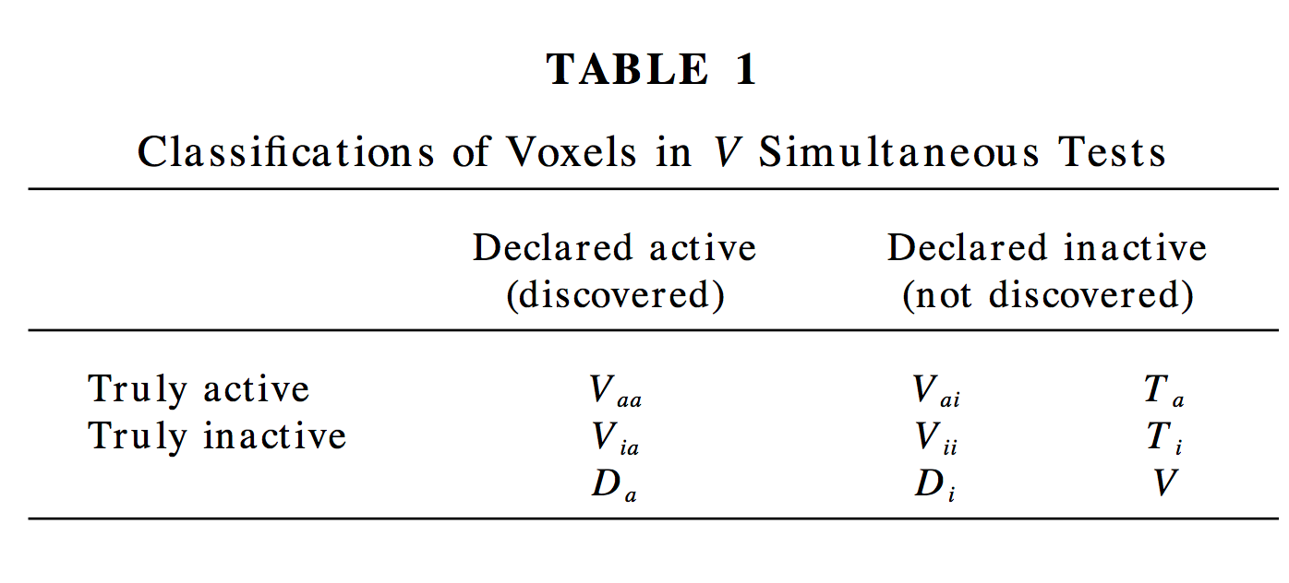
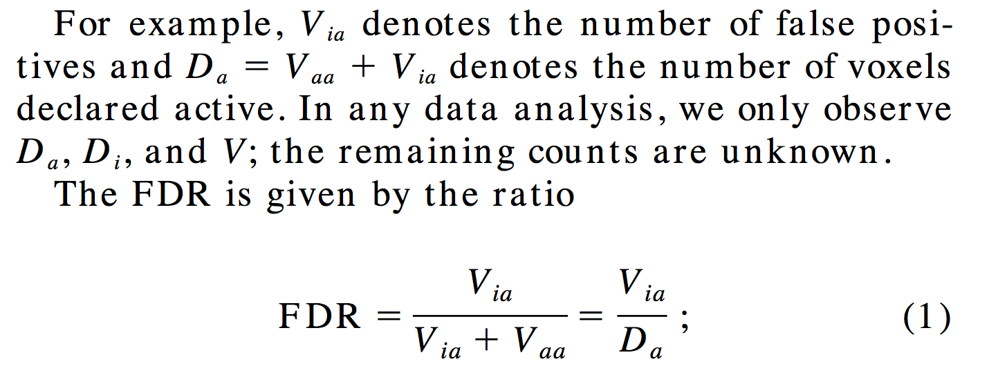

Slide 50
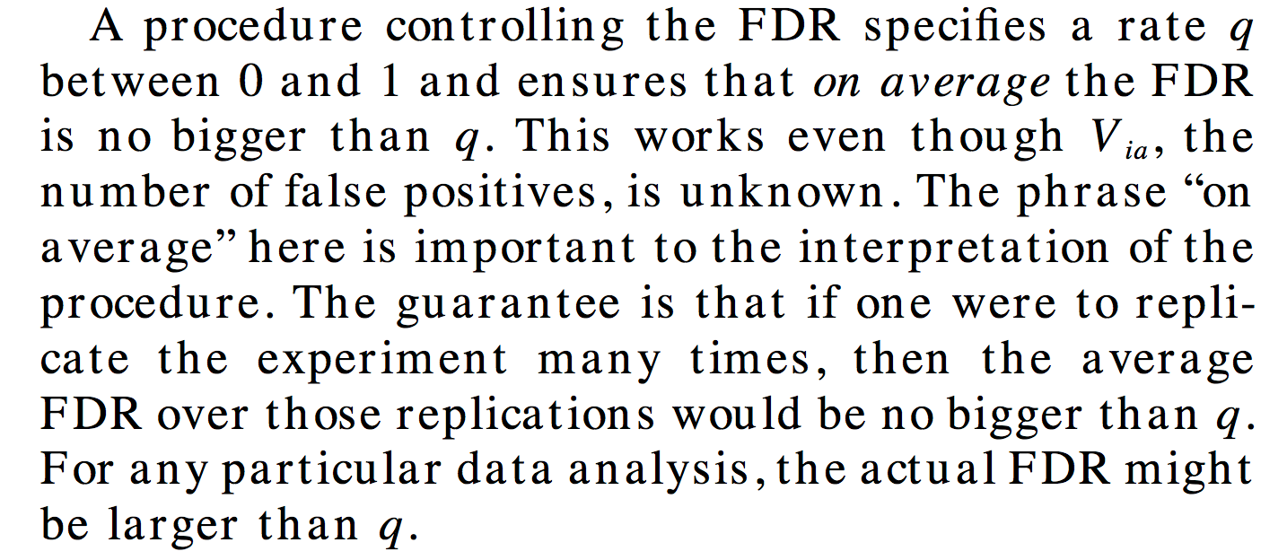

Slide 52
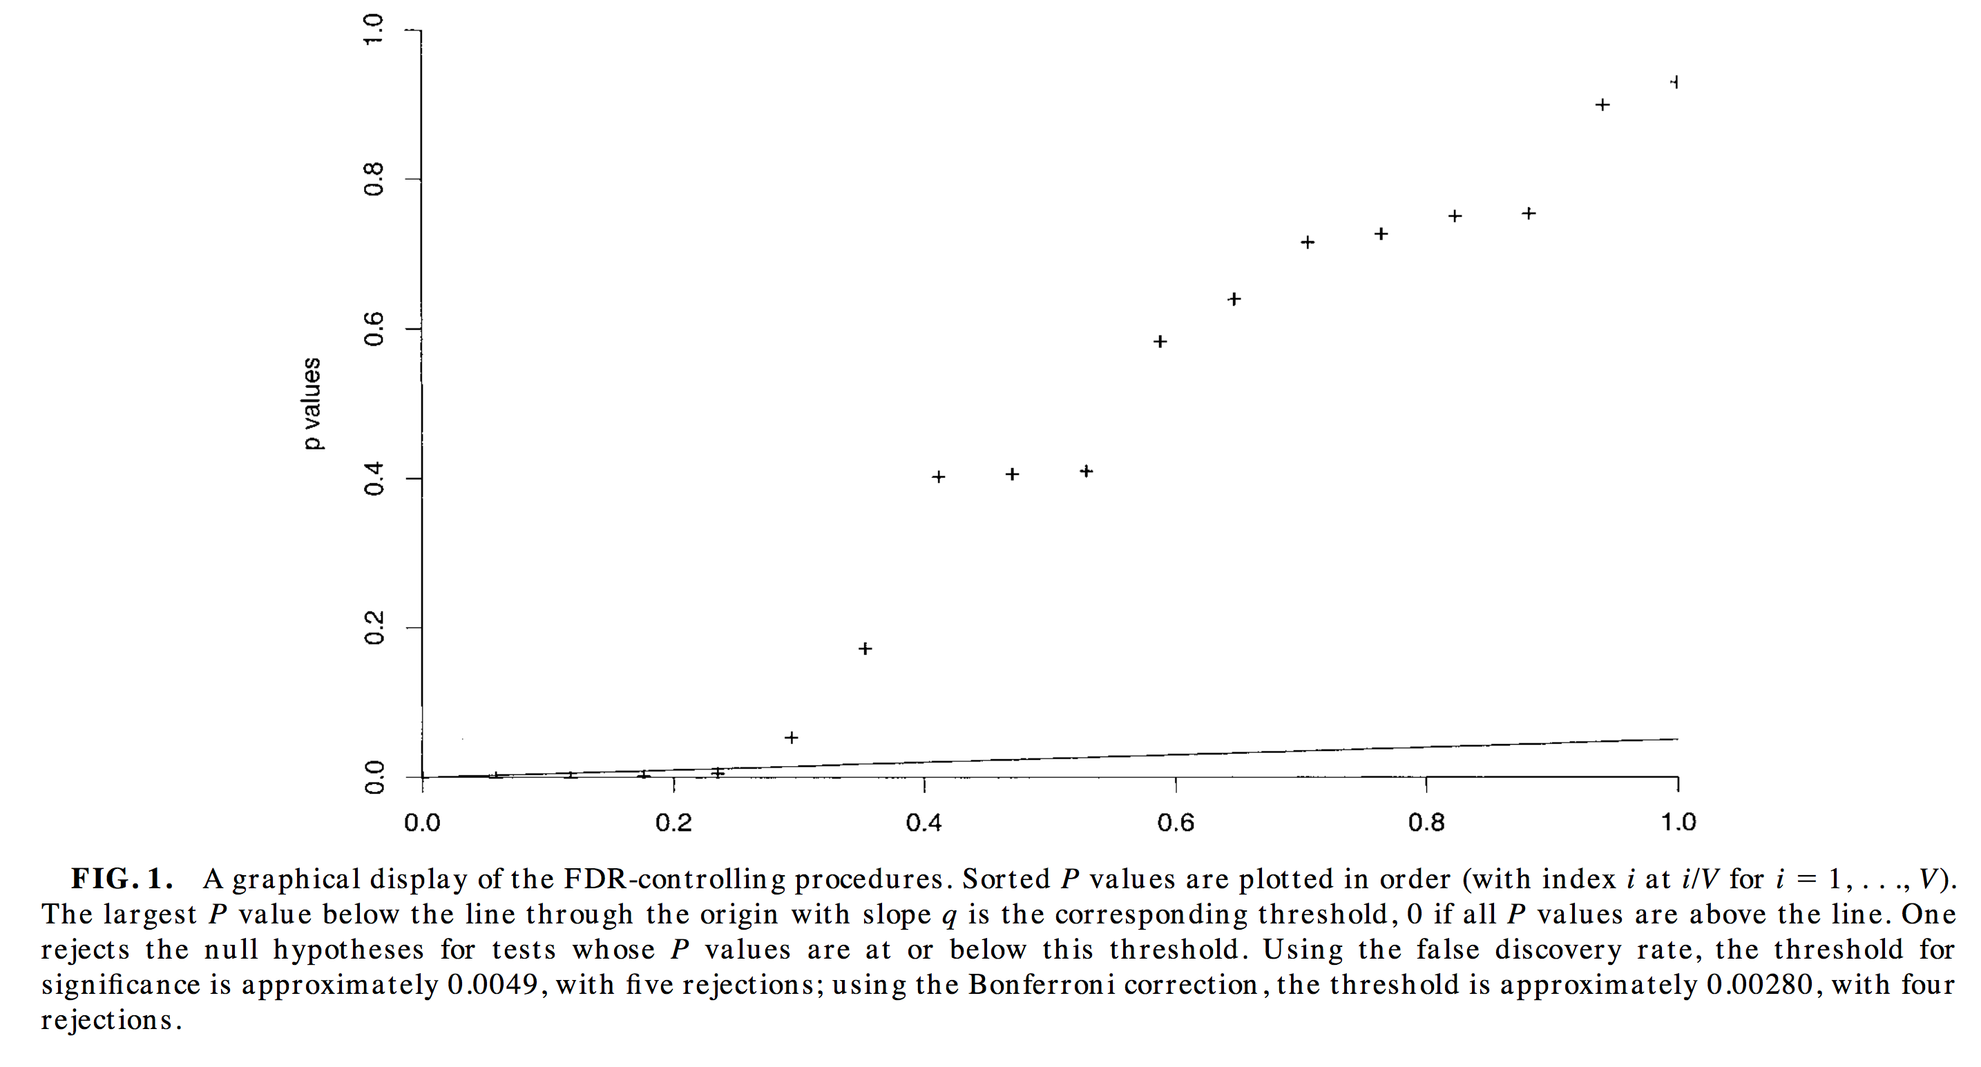

Slide 53
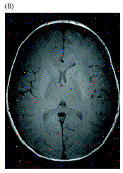
False Discovery Rates
P < 0.05
P < 0.01
P < 0.001

