Slide 1
Representational Similarity Analysis
OB=oddball
WM: working memory
SA: selective attention
Bugatus, Weiner, Grill-Spector, 2017

Slide 2
Some answers to your questions
In the context of classification of brain functions using fMRI data, are there certain kinds of situations in which a nonlinear support vector machine approach is preferable to a linear support vector machine?
What kinds of a priori hypotheses would lead one to use one or the other?

Slide 3
Problem: how can we compare distributed response patterns across different individuals?

Slide 4
Problem: how can we compare distributed response patterns across different individuals?
child
adult
A
L
M
P
-10 -5 0 5 10
Z-score
Golarai, Liberman & Grill-Spector, 2017; Epub 2015

Slide 5
Problem: how can we compare distributed response patterns across different individuals?
Different number of voxels in the same anatomical region
child
adult
A
L
M
P
-10 -5 0 5 10
Z-score
Golarai, Liberman & Grill-Spector, 2017; Epub 2015

Slide 6
Problem: how can we compare distributed response patterns across different individuals?
Different number of voxels in the same anatomical region
What method should be used to align data from different brains?
child
adult
A
L
M
P
-10 -5 0 5 10
Z-score
Golarai, Liberman & Grill-Spector, 2017; Epub 2015

Slide 7
Problem: how can we compare distributed response patterns across different individuals?
Different number of voxels in the same anatomical region
What method should be used to align data from different brains?
What metric/method quantifies similarity among distributed brain patterns?
child
adult
A
L
M
P
-10 -5 0 5 10
Z-score
Golarai, Liberman & Grill-Spector, 2017; Epub 2015

Slide 8
Representational Similarity analysis attempts to circumvent these issues by defining the representational space in each individual and then comparing the representational similarities across individuals, groups, species, measurement levels, etc

Slide 9
Representational Similarity Matrices of ventral temporal cortex in children and adults
Circumvent the issue of different number of voxels because the RSM has the same dimensionality across people
Children
Adults
child
adult
car
run 1
novel
indoor
outdoor
child
car
indoor
adult
outdoor
novel
run 2
run 2
-1 -0.5 0 0.5 1
Correlation (r)
Golarai, Liberman & Grill-Spector, 2017; Epub 2015

Slide 10
Representational Similarity Matrices of ventral temporal cortex in children and adults
Circumvent the issue of different number of voxels because the RSM has the same dimensionality across people
Never need to align different brains, because the RSM is computed within each participant
Children
Adults
child
adult
car
run 1
novel
indoor
outdoor
child
car
indoor
adult
outdoor
novel
run 2
run 2
-1 -0.5 0 0.5 1
Correlation (r)
Golarai, Liberman & Grill-Spector, 2017; Epub 2015

Slide 11
Representational Similarity Matrices of ventral temporal cortex in children and adults
Circumvent the issue of different number of voxels because the RSM has the same dimensionality across people
Never need to align different brains, because the RSM is computed within each participant
Allows comparison between people/species by measuring the correlations among RSM, or applying clustering analyses
Children
Adults
child
adult
car
run 1
novel
indoor
outdoor
child
car
indoor
adult
outdoor
novel
run 2
run 2
-1 -0.5 0 0.5 1
Correlation (r)
Golarai, Liberman & Grill-Spector, 2017; Epub 2015

Slide 12
In which I will answer some of your questions
In Kriegeskorte et al.’s (2008) paper, I was wondering if IT activation in monkeys was measured with extracellular field potential, or local field potential since I think both measurements can be obtained with single unit recording? The paper assures the readers that the approach of RSA can avoid a need for 1:1 mapping between humans and monkeys, but ultimately single-cell recording and BOLD are measuring different components of neural activity. Ultimately, your response will be a function of the measurement, so wouldn’t researchers want to measure local field potentials on the monkeys if this is the best correlate to BOLD
Here's another question for the group: I had always assumed that I'm just unable (as a human) to distinguish between members of other species... looks like monkeys can't tell each other apart?? Is this empirical evidence that -- for example -- one German shepherd can't VISUALLY tell her mother from her father? Would the distinction be stronger male vs. female? Do we think dogs can VISUALLY tell humans apart really well like we can?

Slide 13
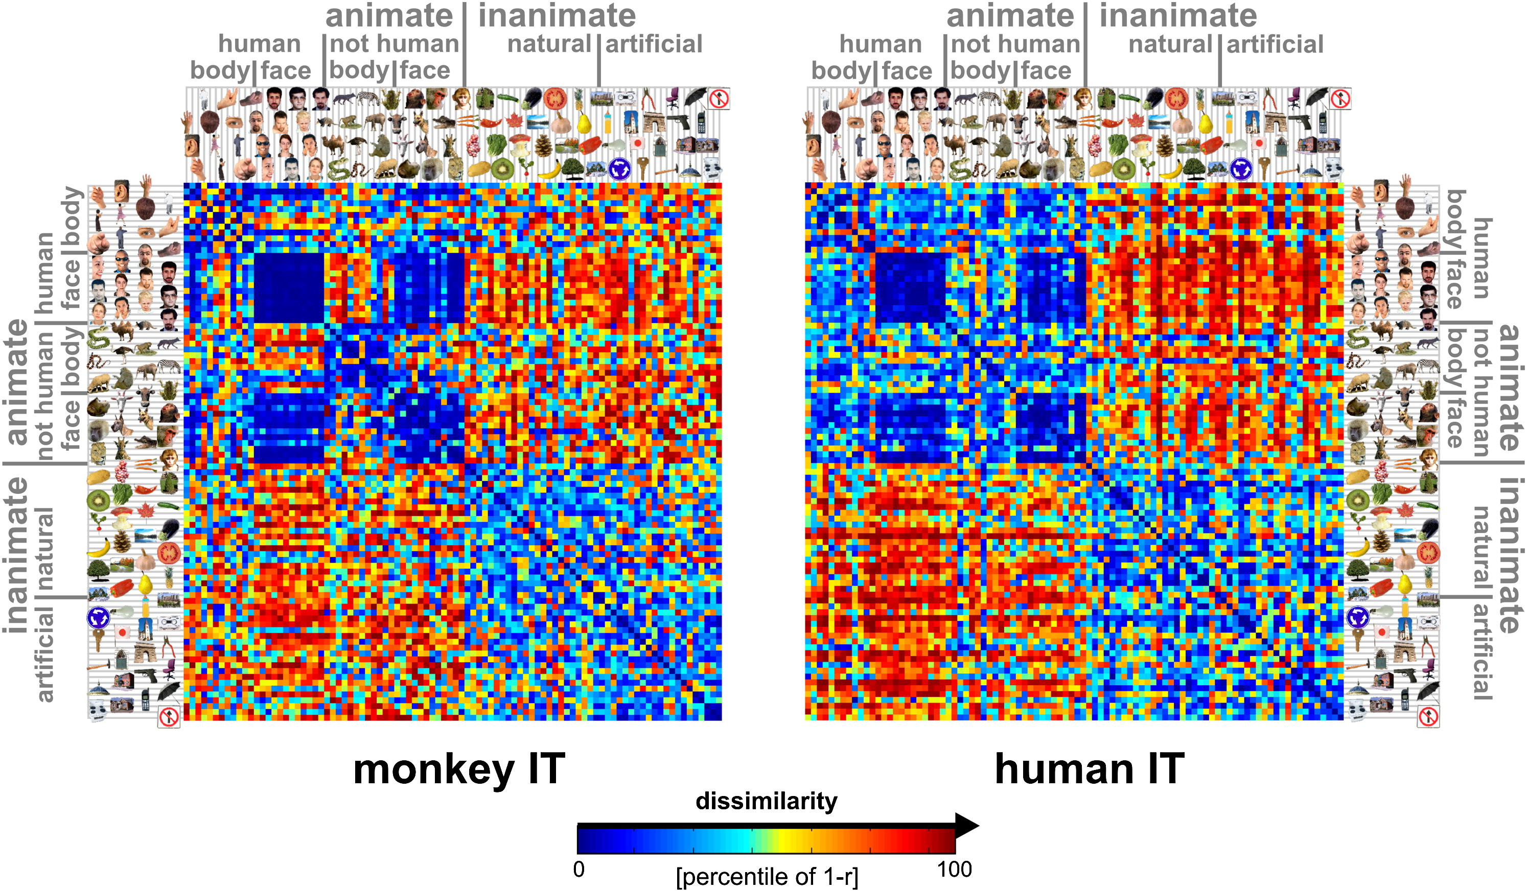
Representational dissimilarity analysis shows consistent representations across species and scales
Figure 1
Kriegeskorte et al Neuron 2008 60, 1126-1141DOI: (10.1016/j.neuron.2008.10.043)

Slide 14
Multidimensional scaling allows visualization of the representational space
Figure 2
Kruskal, J. B. (1964). "Multidimensional scaling by optimizing goodness of fit to a nonmetric hypothesis". Psychometrika. 29 (1): 1–27. doi:10.1007/BF02289565.
Kriegeskorte et al Neuron 2008 60, 1126-1141DOI: (10.1016/j.neuron.2008.10.043)

Slide 15
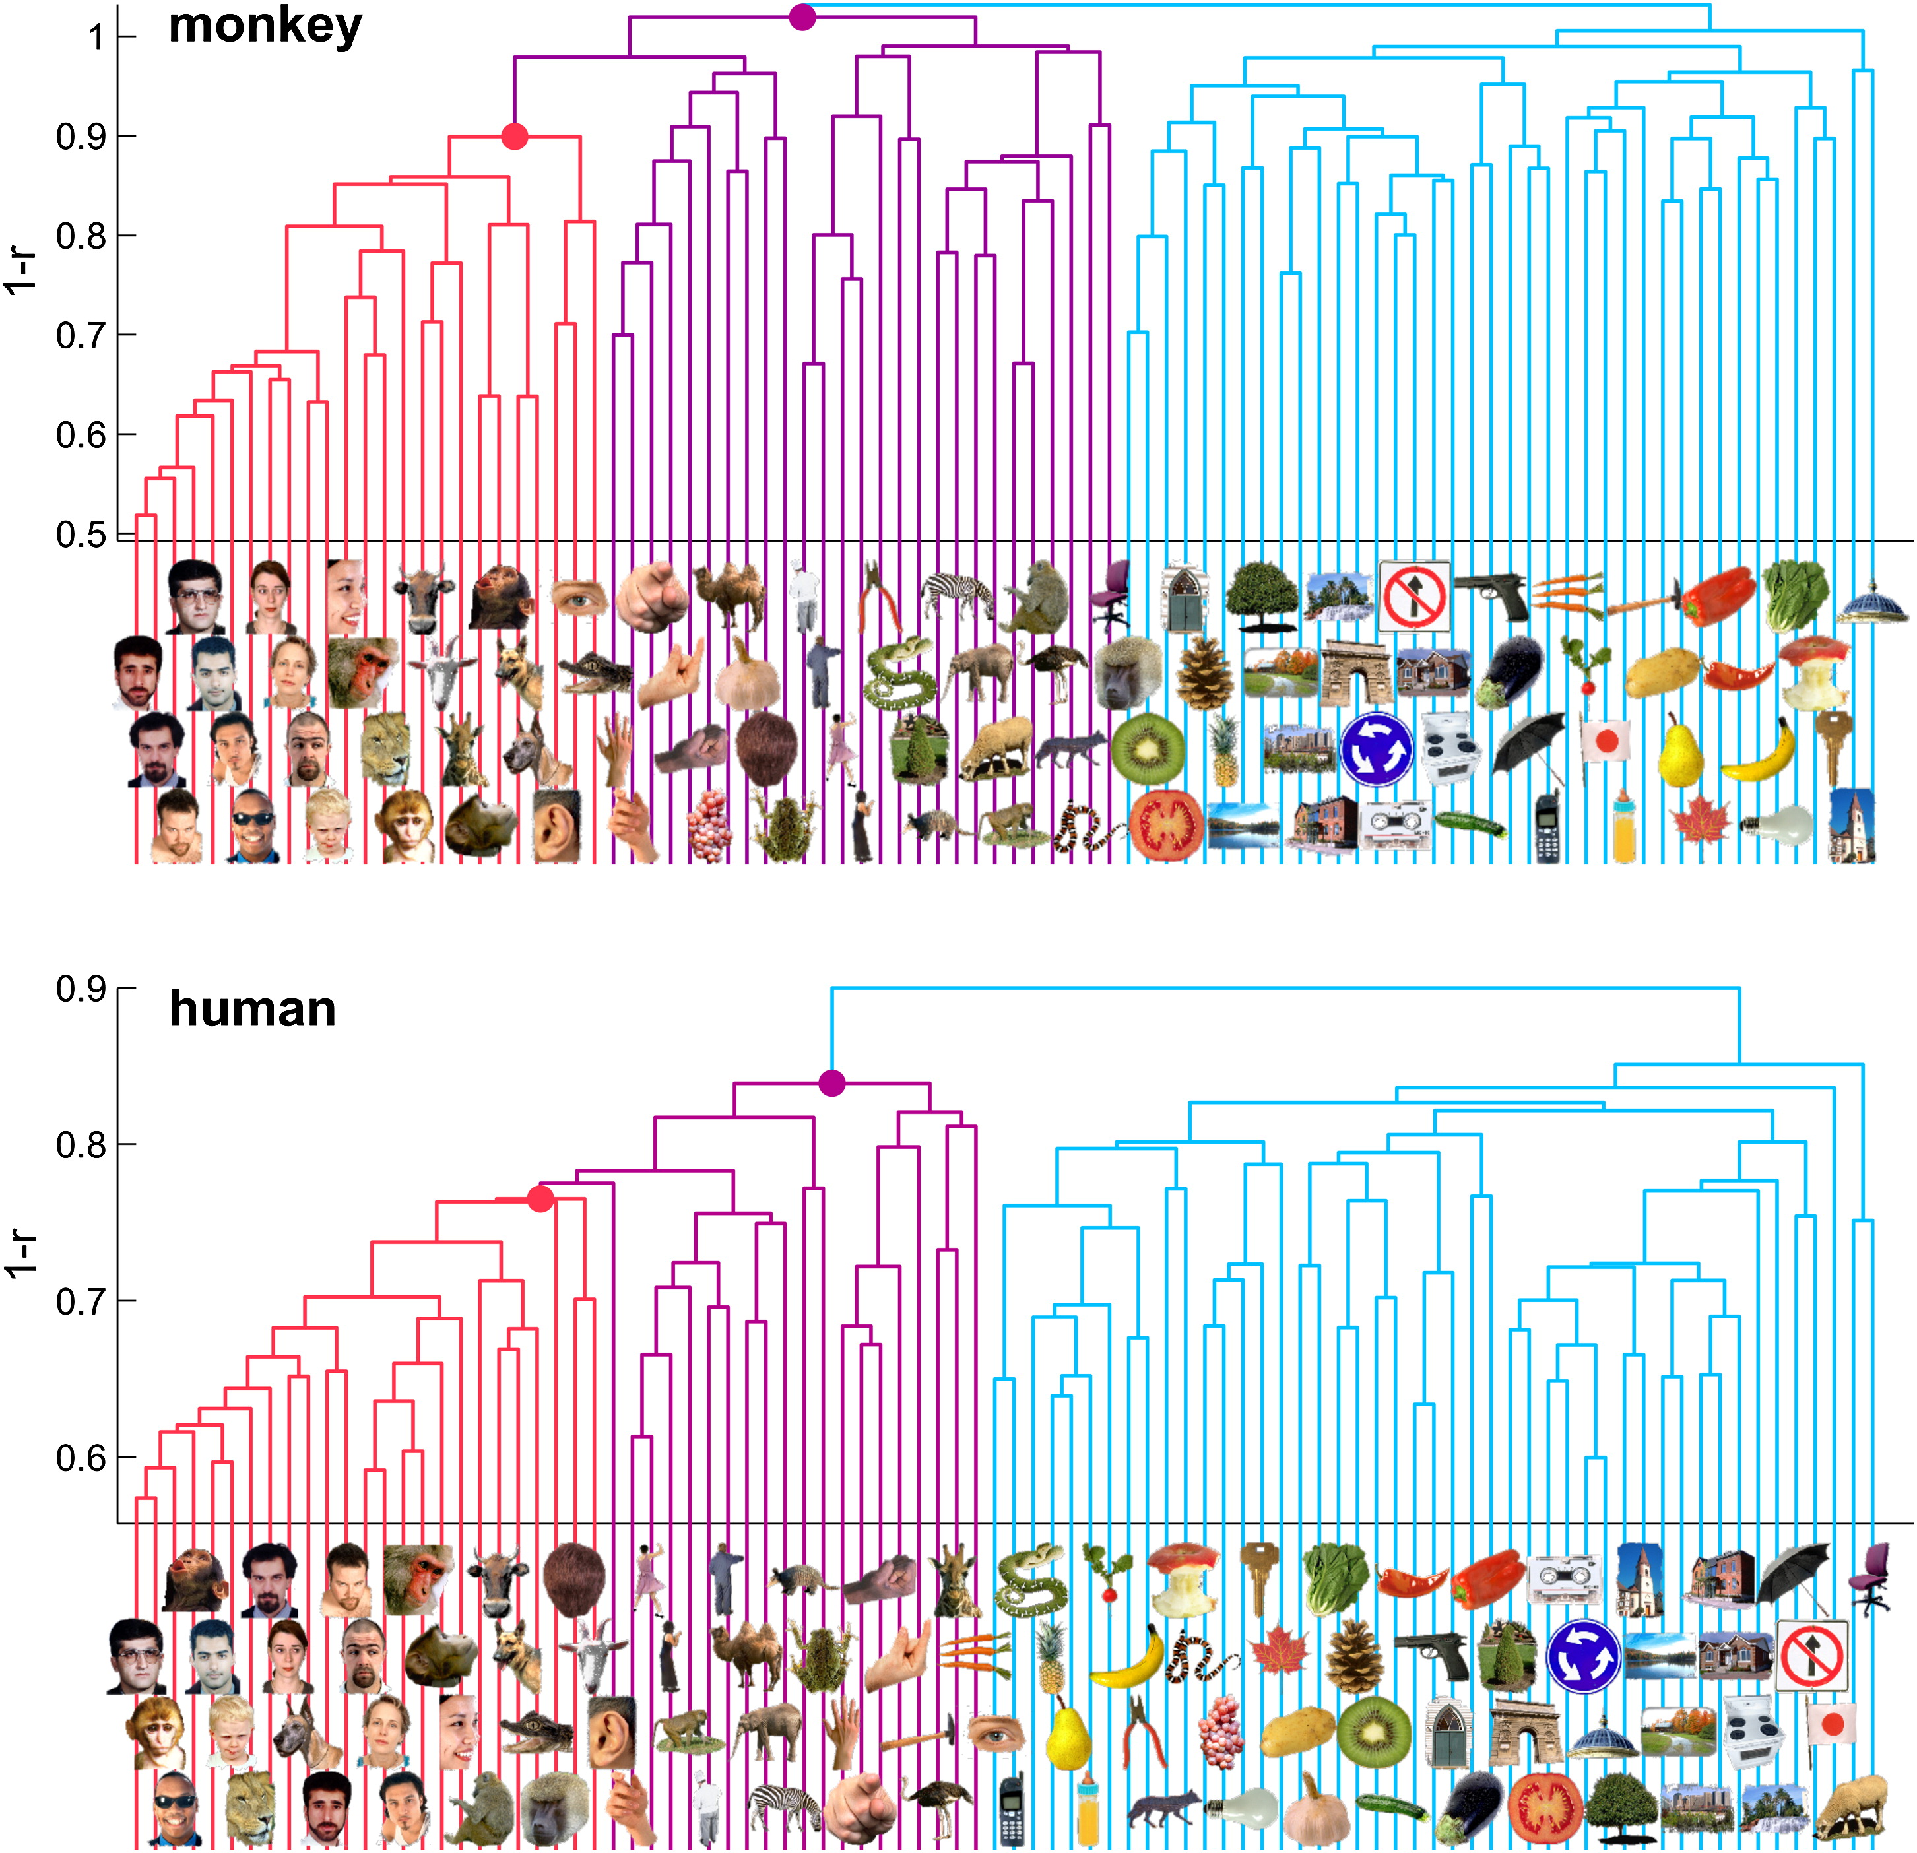
Hierarchical clustering based on the representational dissimilarity matrix enables comparison between representations across species
Figure 4
Kriegeskorte et al Neuron 2008 60, 1126-1141DOI: (10.1016/j.neuron.2008.10.043)

Slide 16
Some answers to your questions
Have there been studies on the stability of categorical structure shown by representational dissimilarity (covariance) matrices? How consistent are these representations in individuals over time?

Slide 17
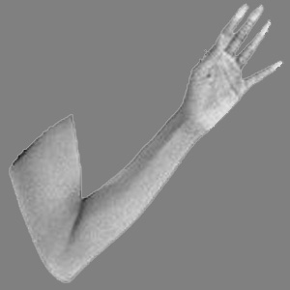
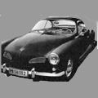
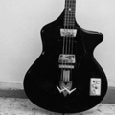
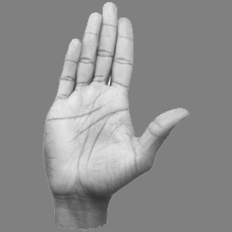
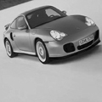
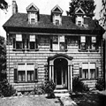
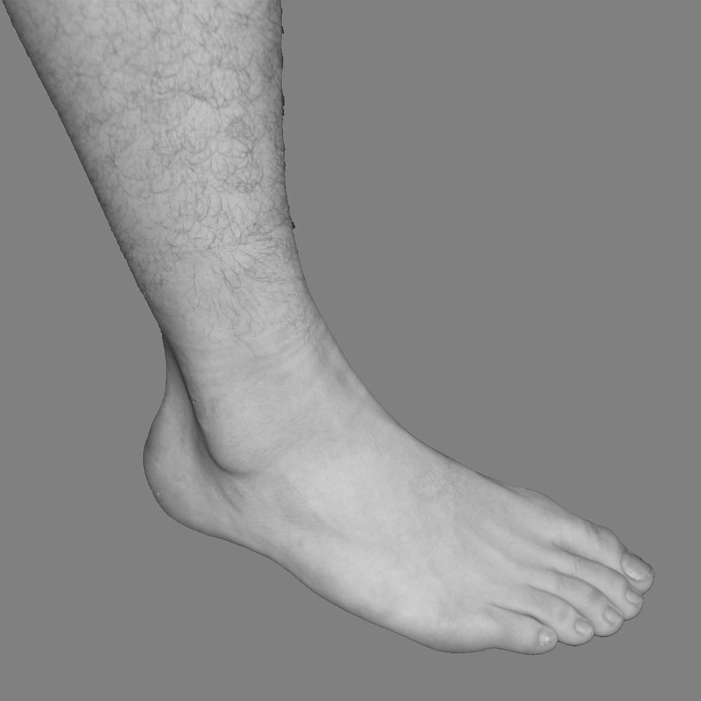
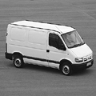
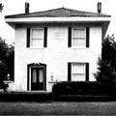
Multivoxel patterns to object categories in VTC remain stable across experiments, tasks, days
Block, 1-back (Experiment 1, Day1 and Experiment 3, Day 2)
Exp2, Day1
Exp1, Day2
Exp3, Day2
f
12 s
l
Exp1, Day1
c
Event-related, categorization (Experiment 2, Day 1)
h
f
l
c
h
f
l
c
h
f
l
c
h
correlation
2 s
F L C H
-0.5
0
0.5
*
Block, categorization (Experiment 4, Day 2)
100
80
60
12 s
Classifier [% correct]
40
20
0
Same day
Diff exp
Diff day
Same exp
Diff day
Diff exp
Weiner & Grill-Spector, 2010
Training Exp1, Day1
Training Exp1, Day2

Slide 18
In which I will answer some of your questions
It is also very unclear to me how much of these representational similarity effects are necessarily sensory and how much they are cognitive effects -- i.e. it might be argued that attention differentially modulates animate vs inanimate representations and that this, not the visual encoding, is actually driving the representational similarity/dissimilarity.

Slide 19
But this is not the same across the brain:
Task alters category representations in VLPFC but not VTC
Right hemisphere
Oddball Working Memory Selective Attention
Bugatus, Weiner, Grill-Spector, 2017

Slide 20
In which I will answer some of your questions
With regard to the Kreigeskorte et al. (2008) paper, what would we learn from a model that reproduces the empirical representational similarity structure of IT? How could we design models to do this in a way that makes it most likely for us to uncover something about the underlying neural computations rather than simply making a biologically-irrelevant model that recapitulates the data?

