Slide 1
Group Averaging of fMRI Data

Slide 2
Goal of Group Analyses
Determine the consistent pattern of brain responses across subjects

Slide 3
Goal of Group Analyses
Determine the consistent pattern of brain responses across subjects
  Statistics determine how likely the data will generalize to new subjects

Slide 4
Goal of Group Analyses
Determine the consistent pattern of brain responses across subjects
  Statistics determine how likely the data will generalize to new subjects
Increase statistical power by pooling data across subjects

Slide 5
Goal of Group Analyses
Determine the consistent pattern of brain responses across subjects
  Statistics determine how likely the data will generalize to new subjects
Increase statistical power by pooling data across subjects
Compare results between groups
  e.g. typical/patients; old/young; with/without intervention

Slide 6
Issues to consider when performing group analyses
Statistical considerations of how to combine data across subjects
  When combining data across people should we use fixed effects vs. random effects analyses?

Slide 7
Issues to consider when performing group analyses
Statistical considerations of how to combine data across subjects
  When combining data across people should we use fixed effects vs. random effects analyses?
Anatomical considerations of how to combine data across subjects
  What is the appropriate common brain space to combine data across subjects?

Slide 8
Statistical Considerations

Slide 9
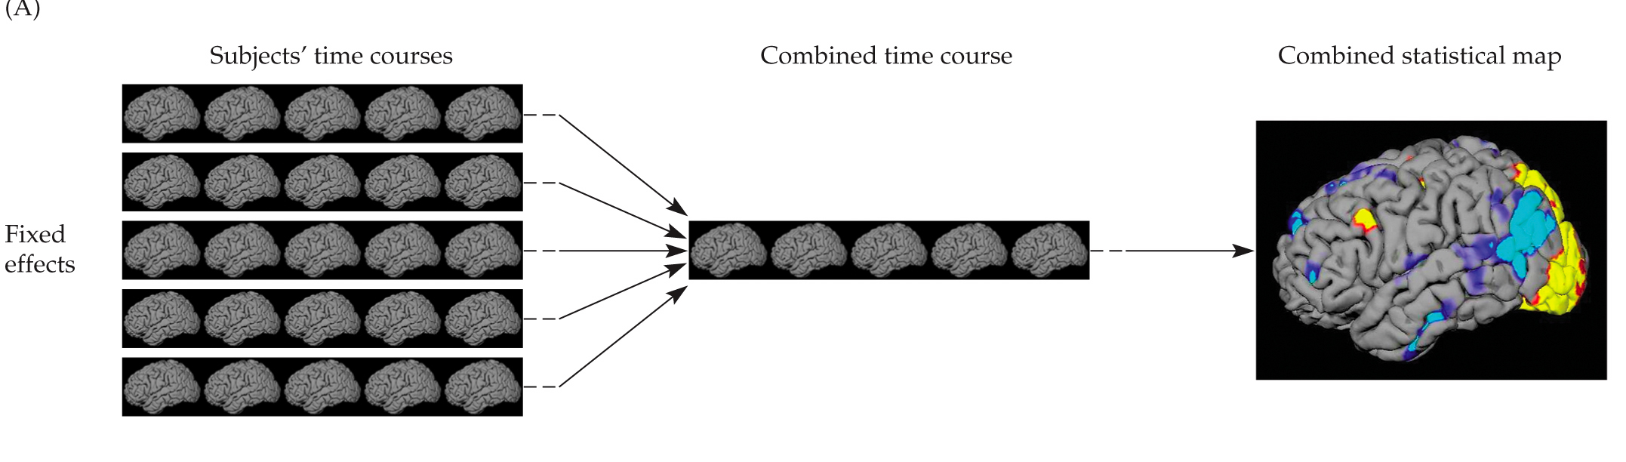
Fixed Effects: pool data across subjects by treating each subject as an independent sample and ignoring between-subjects differences

Slide 10
Fixed Effects: pool data across subjects by treating each subject as an independent sample and ignoring between-subjects differences
Fixed effects analysis increases the statistical power
At each voxel, the statistical analyses are done across data from all time points from all subjects, this increases the degrees of freedom and makes the statistical significance more robust.

Slide 11
Fixed Effects: pool data across subjects by treating each subject as an independent sample and ignoring between-subjects differences
Fixed effects analysis increases the statistical power
At each voxel, the statistical analyses are done across data from all time points from all subjects, this increases the degrees of freedom and makes the statistical significance more robust.
Downsides: (1) cannot generalize to new subjects. (2) ignores differences across individuals

Slide 12
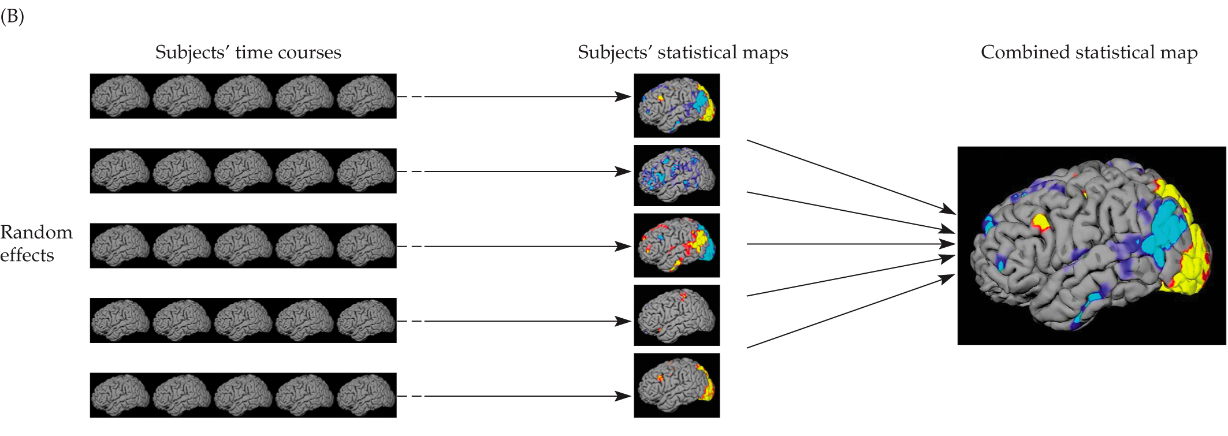
Random Effects: first analyze each subject’s data and then do a second order analysis taking into consideration between-subject effects

Slide 13
Random Effects: first analyze each subject’s data and then do a second order analysis taking into consideration between-subject effects
Random effects analysis allows generalization to population level.
At each voxel a statistic is computed separately for the data of each subject.
Second-level statistics runs over these subject-specific scores.

Slide 14
Random Effects: first analyze each subject’s data and then do a second order analysis taking into consideration between-subject effects
Random effects analysis allows generalization to population level.
At each voxel a statistic is computed separately for the data of each subject.
Second-level statistics runs over these subject-specific scores.
Downsides: does not increase statistical power as much

Slide 15
Anatomical Considerations

Slide 16
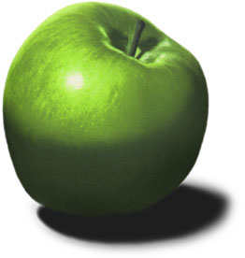
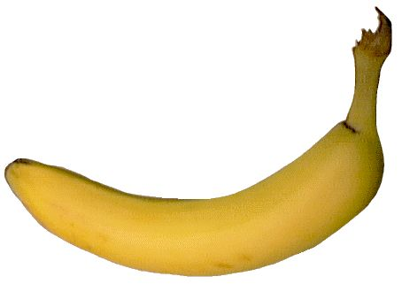
Anatomical Considerations
How similar are two brains?
Notes:
First, one has to ask: what is the reason for applying a new approach over and above the well known methods?
The general problem that has to be solved is how one is able to compare two different brains?
If this comparison is not done very careful, there is actually a danger of comparing apples with bananas!

Slide 17
Anatomical Considerations
How similar are two brains?
How do we align/compare different brains?
Notes:
First, one has to ask: what is the reason for applying a new approach over and above the well known methods?
The general problem that has to be solved is how one is able to compare two different brains?
If this comparison is not done very careful, there is actually a danger of comparing apples with bananas!

Slide 18
Anatomical Considerations
How similar are two brains?
How do we align/compare different brains?
Is there a common brain space?
Notes:
First, one has to ask: what is the reason for applying a new approach over and above the well known methods?
The general problem that has to be solved is how one is able to compare two different brains?
If this comparison is not done very careful, there is actually a danger of comparing apples with bananas!

Slide 19
Anatomical Considerations
How similar are two brains?
How do we align/compare different brains?
Is there a common brain space?
At what spatial resolution do we want to compare brains?
Notes:
First, one has to ask: what is the reason for applying a new approach over and above the well known methods?
The general problem that has to be solved is how one is able to compare two different brains?
If this comparison is not done very careful, there is actually a danger of comparing apples with bananas!

Slide 20
Anatomical Considerations
How similar are two brains?
How do we align/compare different brains?
Is there a common brain space?
At what spatial resolution do we want to compare brains?
What information is important to preserve when comparing brains?
Notes:
First, one has to ask: what is the reason for applying a new approach over and above the well known methods?
The general problem that has to be solved is how one is able to compare two different brains?
If this comparison is not done very careful, there is actually a danger of comparing apples with bananas!

Slide 21
Methods for registering brains
We don’t care about fine details we’ll put brains into common anatomical volume using an affine transformation
Notes:
First, one has to ask: what is the reason for applying a new approach over and above the well known methods?
The general problem that has to be solved is how one is able to compare two different brains?
If this comparison is not done very careful, there is actually a danger of comparing apples with bananas!

Slide 22
Methods for registering brains
We don’t care about fine details we’ll put brains into common anatomical volume using an affine transformation
We don’t care about anatomy, we care about preserving function across individuals
Notes:
First, one has to ask: what is the reason for applying a new approach over and above the well known methods?
The general problem that has to be solved is how one is able to compare two different brains?
If this comparison is not done very careful, there is actually a danger of comparing apples with bananas!

Slide 23
Methods for registering brains
We don’t care about fine details we’ll put brains into common anatomical volume using an affine transformation
We don’t care about anatomy, we care about preserving function across individuals
Anatomy matters! We care about preserving functional-structural relationships across individuals
Notes:
First, one has to ask: what is the reason for applying a new approach over and above the well known methods?
The general problem that has to be solved is how one is able to compare two different brains?
If this comparison is not done very careful, there is actually a danger of comparing apples with bananas!

Slide 24
We don’t care about fine details we’ll put brains into common anatomical volume
using an affine transformation
Affine transformation to Talairach & Tournoux Brain (1988) or to the MNI 305 template (Evans 1993)
Notes:
First, one has to ask: what is the reason for applying a new approach over and above the well known methods?
The general problem that has to be solved is how one is able to compare two different brains?
If this comparison is not done very careful, there is actually a danger of comparing apples with bananas!

Slide 25
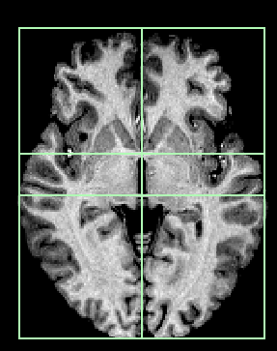
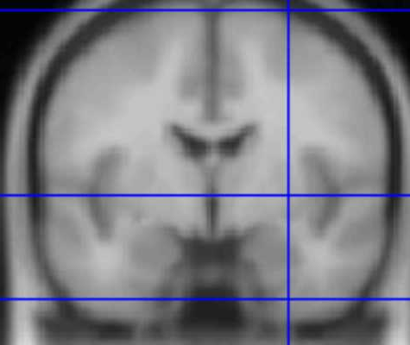
Affine transformation to the Taliarach vs. MNI 305 brain

Slide 26
Taliarach & Tournoux brain (1988)

Slide 27
The MNI 305 brain
Alan Evans from the Montreal Neurological institute (MNI) wanted to define a brain that is more representative of the population. Evans and colleagues created a template that was approximately matched to the Talairach brain in a two-stage procedure.
http://www.nil.wustl.edu/labs/kevin/man/answers/mnispace.html

Slide 28
The MNI 305 brain
Alan Evans from the Montreal Neurological institute (MNI) wanted to define a brain that is more representative of the population. Evans and colleagues created a template that was approximately matched to the Talairach brain in a two-stage procedure.
First, they took 241 normal MRI scans, and manually defined various landmarks, in order to identify a line very similar to the AC-PC line, and the edges of the brain. Each brain was scaled to match the landmarks to equivalent positions on the Talairach atlas.
http://www.nil.wustl.edu/labs/kevin/man/answers/mnispace.html

Slide 29
The MNI 305 brain
Alan Evans from the Montreal Neurological institute (MNI) wanted to define a brain that is more representative of the population. Evans and colleagues created a template that was approximately matched to the Talairach brain in a two-stage procedure.
First, they took 241 normal MRI scans, and manually defined various landmarks, in order to identify a line very similar to the AC-PC line, and the edges of the brain. Each brain was scaled to match the landmarks to equivalent positions on the Talairach atlas.
Then they then took 305 normal MRI scans (all right handed, 239 M, 66 F, age 23.4 +/- 4.1), and used an automated 9 parameter linear algorithm to match the brains to the average of the 241 brains that had been matched to the Talairach atlas. From this they generated an average of 305 brain scans thus transformed - the MNI305 (Evans 1993)
http://www.nil.wustl.edu/labs/kevin/man/answers/mnispace.html

Slide 30
The MNI 305 brain
Alan Evans from the Montreal Neurological institute (MNI) wanted to define a brain that is more representative of the population. Evans and colleagues created a template that was approximately matched to the Talairach brain in a two-stage procedure.
First, they took 241 normal MRI scans, and manually defined various landmarks, in order to identify a line very similar to the AC-PC line, and the edges of the brain. Each brain was scaled to match the landmarks to equivalent positions on the Talairach atlas.
Then they then took 305 normal MRI scans (all right handed, 239 M, 66 F, age 23.4 +/- 4.1), and used an automated 9 parameter linear algorithm to match the brains to the average of the 241 brains that had been matched to the Talairach atlas. From this they generated an average of 305 brain scans thus transformed - the MNI305 (Evans 1993)
In addition, one of the MNI lab members, Colin Holmes, was scanned 27 times, and the scans were coregistered and averaged to create a very high detail MRI dataset of one brain. This average was also matched to the MNI305, to create the image known as "colin27".
http://www.nil.wustl.edu/labs/kevin/man/answers/mnispace.html

Slide 31
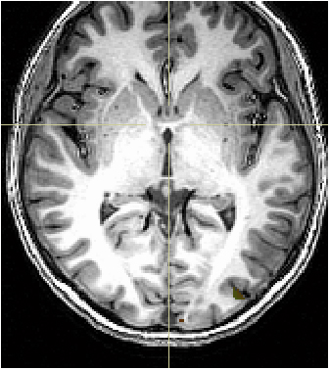
Spatial normalization: Talairach transformation
1. Rotation of 3D data set into the AC-PC plane (AC = anterior
commissure, PC = posterior commissure)
AC
PC

Slide 32
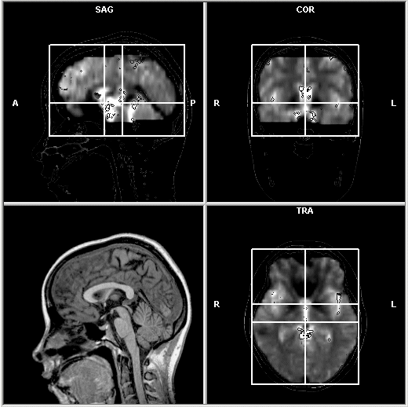
Spatial normalization: Talairach transformation
1. Rotation of 3D data set into the AC-PC plane (AC = anterior
commissure, PC = posterior commissure)
2. Selection of the (6) extreme points of the cerebrum and definition
of 12 subvolumes
AC
PC

Slide 33
Spatial normalization: Talairach transformation
1. Rotation of 3D data set into the AC-PC plane (AC = anterior
commissure, PC = posterior commissure)
2. Selection of the (6) extreme points of the cerebrum and definition
of 12 subvolumes
3. Scaling of the 3D data set into the dimension of the standard brain
of the Talairach and Tornoux atlas (1988) using a piecewise affine
and continuous transformation for each of the 12 defined subvolumes
AC
PC

Slide 34
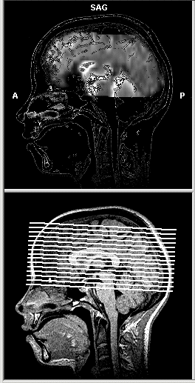
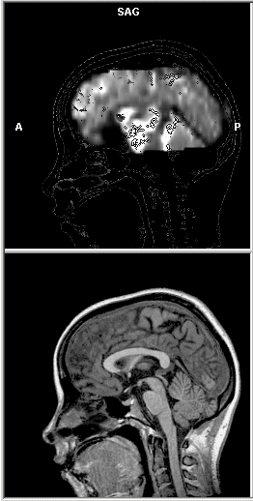
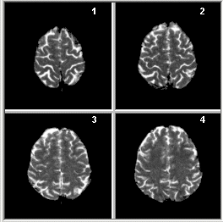
Talairach Normalization
Align slices to brain volume
Transformation to AC-PC plane (rigid body)
Subvolume scaling to fit into Talairach proportional grid (piecewise linear)
Align Slices to
Brain Volume
Affine body transformation
to AC-PC Plane
Talirach Normalization

Slide 35
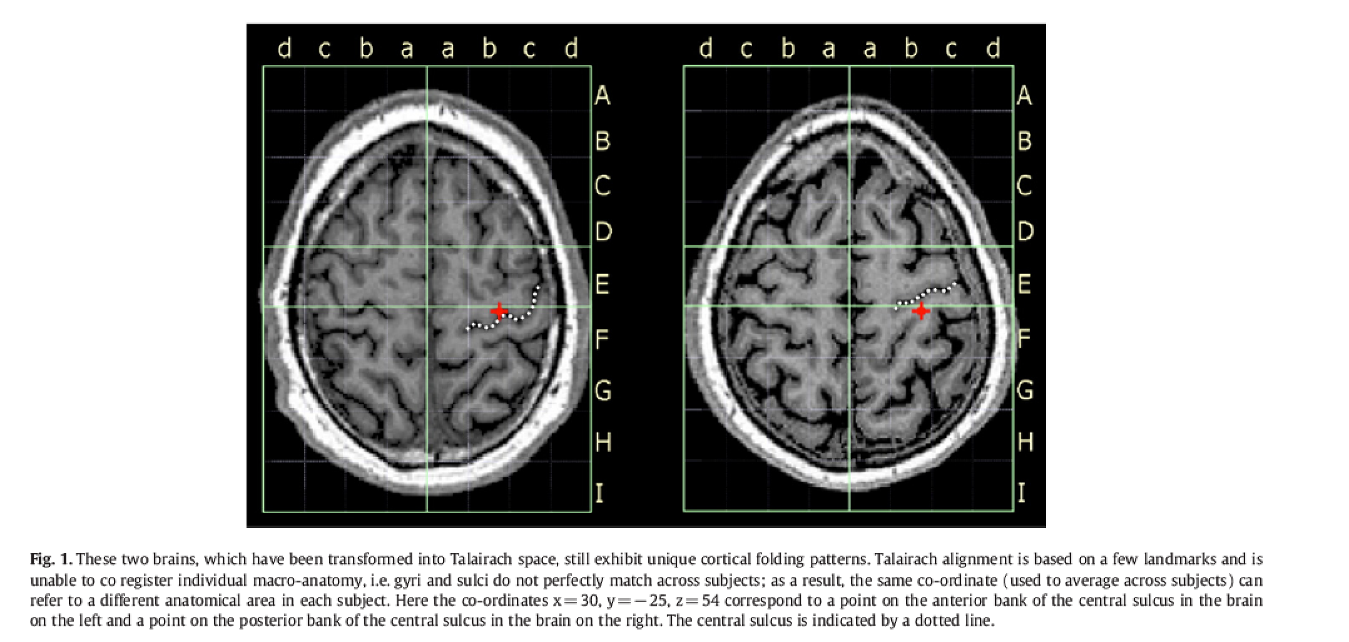
Problem: Affine transformation such as the Talairach transformation does not preserve functional-anatomical relations
Frost & Goebel 2011

Slide 36
Affine Transformation of
Brains to the Talairach Space (or to MNI Template)
Pro: Widespread acceptance
Cons:
Does not respect anatomy
Crude alignment; requires spatial smoothing, which introduces severe problems like blurring of functionally distinct areas and the suppression of significant small areas
Notes:
There are two main approaches to provide a spatial correspondency between different brains:

Slide 37
Methods for registering brains
We don’t care about fine details we’ll put brains into common anatomical volume using an affine transformation
  Affine transformation to Talairach & Tournoux Brain (1998) or to the MNI 305 template (Evans 1993)
We don’t care about anatomy, we care about preserving function across individuals
  Region of Interest (ROI) analysis (Kanwisher 1997)
  Hyperalignment (Haxby 2011)
Anatomy matters! We care about preserving functional-structural relationships across individuals
  Cortex-based alignment (Fischl 1999) to FreeSurfer average brain or average of your subjects (Frost & Goebel 2011)
  Non linear transformation to MNI ICBM 152 or MNI-Colins27 brain (http://nist.mni.mcgill.ca/?page_id=714)
Notes:
First, one has to ask: what is the reason for applying a new approach over and above the well known methods?
The general problem that has to be solved is how one is able to compare two different brains?
If this comparison is not done very careful, there is actually a danger of comparing apples with bananas!

Slide 38
Methods for registering brains
We don’t care about fine details we’ll put brains into common anatomical volume using an affine transformation
  Affine transformation to Talairach & Tournoux Brain (1998) or to the MNI 305 template (Evans 1993)
We don’t care about anatomy, we care about preserving function across individuals
  Region of Interest (ROI) analysis (Kanwisher 1997)
  Hyperalignment (Haxby 2011)
Notes:
First, one has to ask: what is the reason for applying a new approach over and above the well known methods?
The general problem that has to be solved is how one is able to compare two different brains?
If this comparison is not done very careful, there is actually a danger of comparing apples with bananas!

Slide 39
Region-Of-Interest (ROI) Approach
Kanwisher 1997, 2017
Use (a) localizer run(s) to find a region of interest (e.g. primary auditory cortex).

Slide 40
Region-Of-Interest (ROI) Approach
Kanwisher 1997, 2017
Use (a) localizer run(s) to find a region of interest (e.g. primary auditory cortex).
Extract time course information from that region in separate independent runs.

Slide 41
Region-Of-Interest (ROI) Approach
Kanwisher 1997, 2017
Use (a) localizer run(s) to find a region of interest (e.g. primary auditory cortex).
Extract time course information from that region in separate independent runs.
See if the trends in that region are statistically significant.
Because the runs that are used to generate the area are independent from those used to test the hypothesis, liberal statistics can be used.

Slide 42
Region-Of-Interest (ROI) Approach
Kanwisher 1997, 2017
Use (a) localizer run(s) to find a region of interest (e.g. primary auditory cortex).
Extract time course information from that region in separate independent runs.
See if the trends in that region are statistically significant.
Because the runs that are used to generate the area are independent from those used to test the hypothesis, liberal statistics can be used.
Apply to group analysis by using subject-specific ROI definitions.

Slide 43
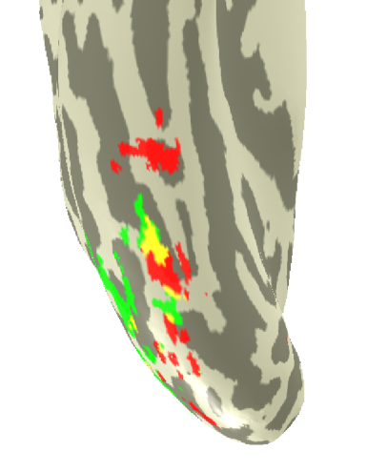
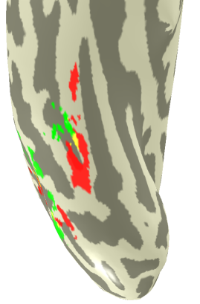
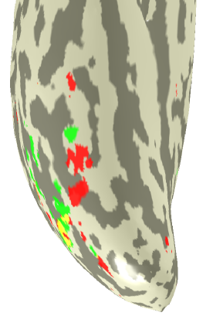
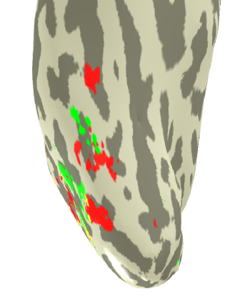

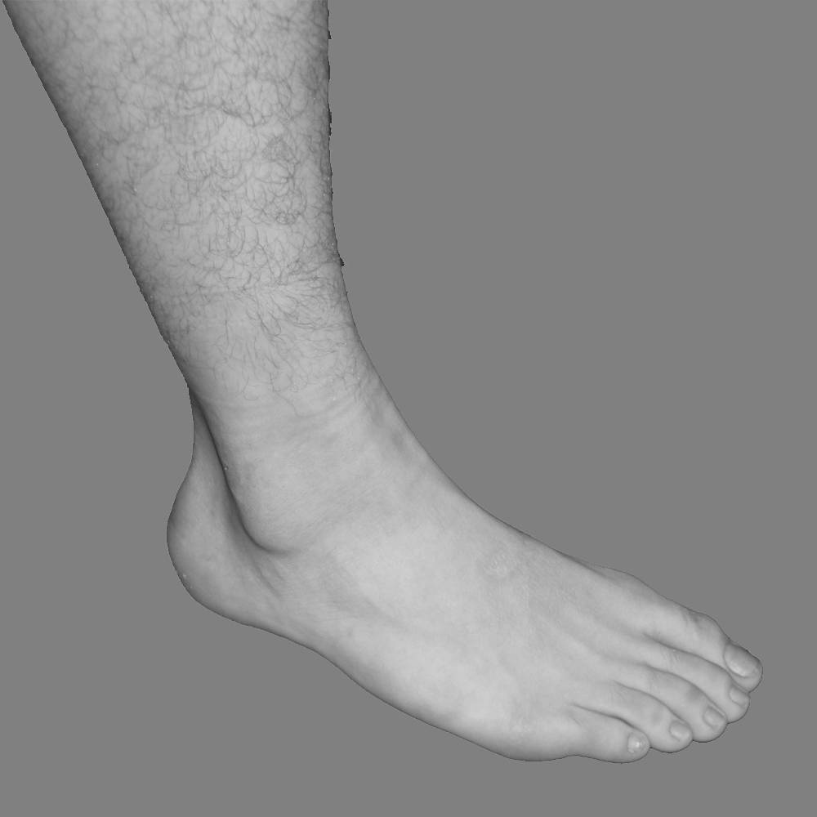

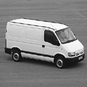

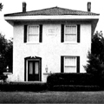
Precision: use consistent functional and anatomical criteria across subjects
Subject 1
Subject 2
Subject 3
Subject 4
mFus
OTS
pFus
VO2
ITG
VO1
VO1
VO1
VO2
hMT+
hV4
hV4
hV4
VO1
hV4
IOG
>
All maps thresholded at t > 3
No spatial smoothing
>
faces & limbs overlap
Weiner & Grill-Spector, 2010, 2012, 2013, 2014

Slide 44
ROI Analyses
Pros: Optimal statistical analysis possible
Cons: Not easily applicable in complex cognitive
tasks, focuses on known areas, not automatic
and depends on criteria to identify regions (threshold,
contrast etc.)
Notes:
There are two main approaches to provide a spatial correspondency between different brains:

Slide 45
Methods for registering brains
We don’t care about fine details we’ll put brains into common anatomical volume using an affine transformation
  Affine transformation to Talairach & Tournoux Brain (1998) or to the MNI 305 template (Evans 1993)
We don’t care about anatomy, we care about preserving function across individuals
  Region of Interest (ROI) analysis (Kanwisher 1997)
  Hyperalignment (Haxby 2011)
Anatomy matters! We care about preserving functional-structural relationships across individuals
  Cortex-based alignment (Fischl 1999) to FreeSurfer average brain or average of your subjects (Frost & Goebel 2011)
  Non linear transformation to MNI ICBM 152 or MNI-Colins27 brain (http://nist.mni.mcgill.ca/?page_id=714)
Notes:
First, one has to ask: what is the reason for applying a new approach over and above the well known methods?
The general problem that has to be solved is how one is able to compare two different brains?
If this comparison is not done very careful, there is actually a danger of comparing apples with bananas!

Slide 46
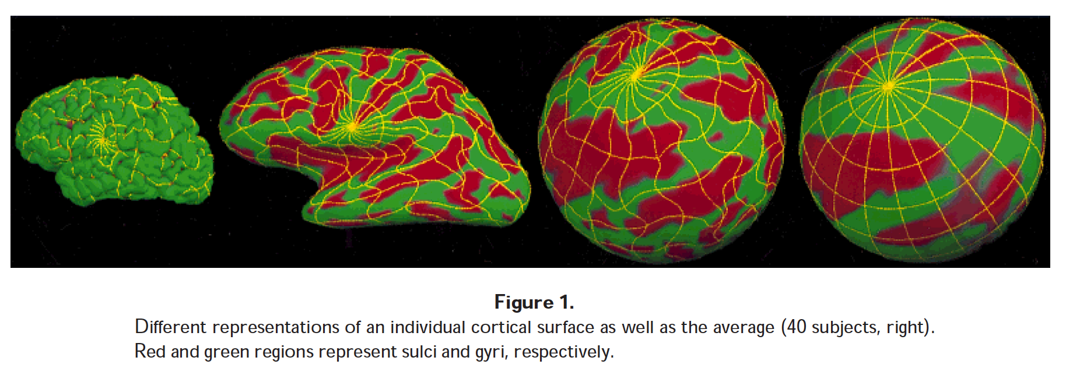
Cortex Based Alignment (CBA) Fischl 1999

Slide 47
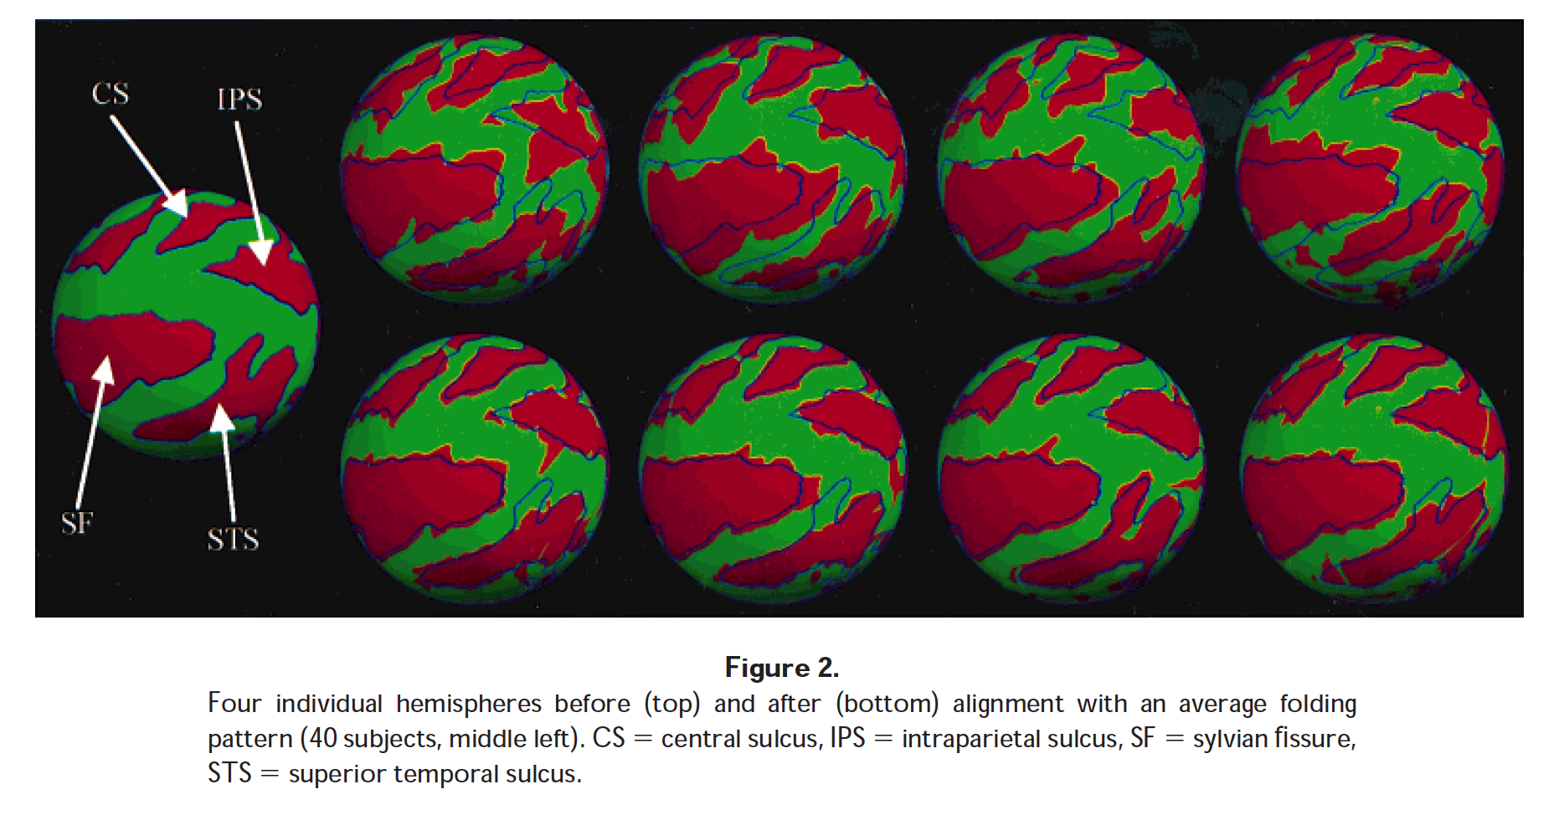
Cortex Based Alignment (CBA) Fischl 1999

Slide 48
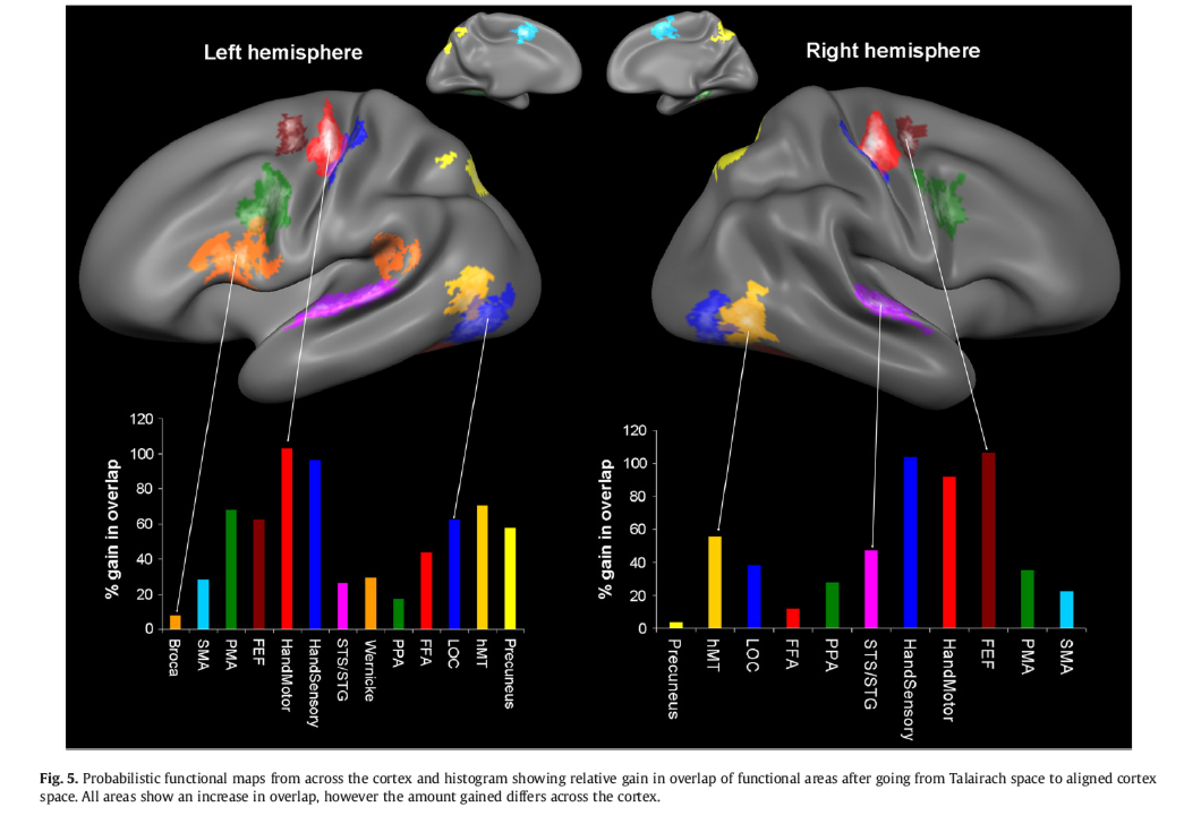
Cortex Based Alignment (CBA) increases between subject consistency of functional ROIs as well as preserves functional-structural relationships
Frost & Goebel 2011

Slide 49
Cortex Based Alignment (CBA)
Pros:
Maintains anatomical correspondence of regions
Adding small sulci to this process may further improve the alignment between function and anatomy
Cons:
The pattern of cortical folding may vary across individuals
Depends on an assumption that there is a tight correspondence between function and anatomy, but this correspondence may vary across the brain
Notes:
There are two main approaches to provide a spatial correspondency between different brains:

Slide 50
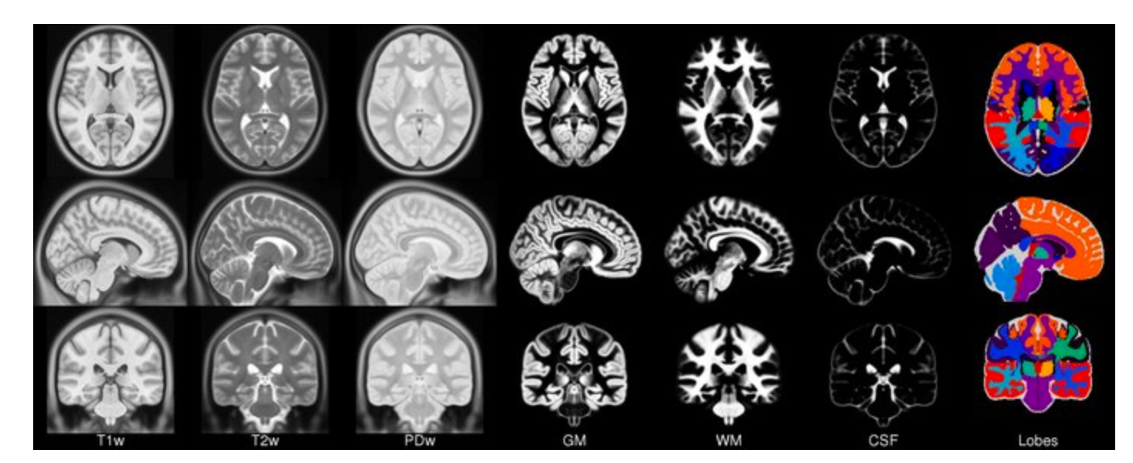
MNI: ICBM 152 Nonlinear atlases (2009)
http://nist.mni.mcgill.ca
A number of unbiased non-linear averages of the MNI152 database have been generated that combines the attractions of both high-spatial resolution and signal-to-noise while not being subject to the vagaries of any single brain (Fonov et al., 2011). The procedure involved multiple iterations of a process where, at each iteration, individual native MRIs were non-linearly fitted to the average template from the previous iteration, beginning with the MNI152 linear template.

Slide 51
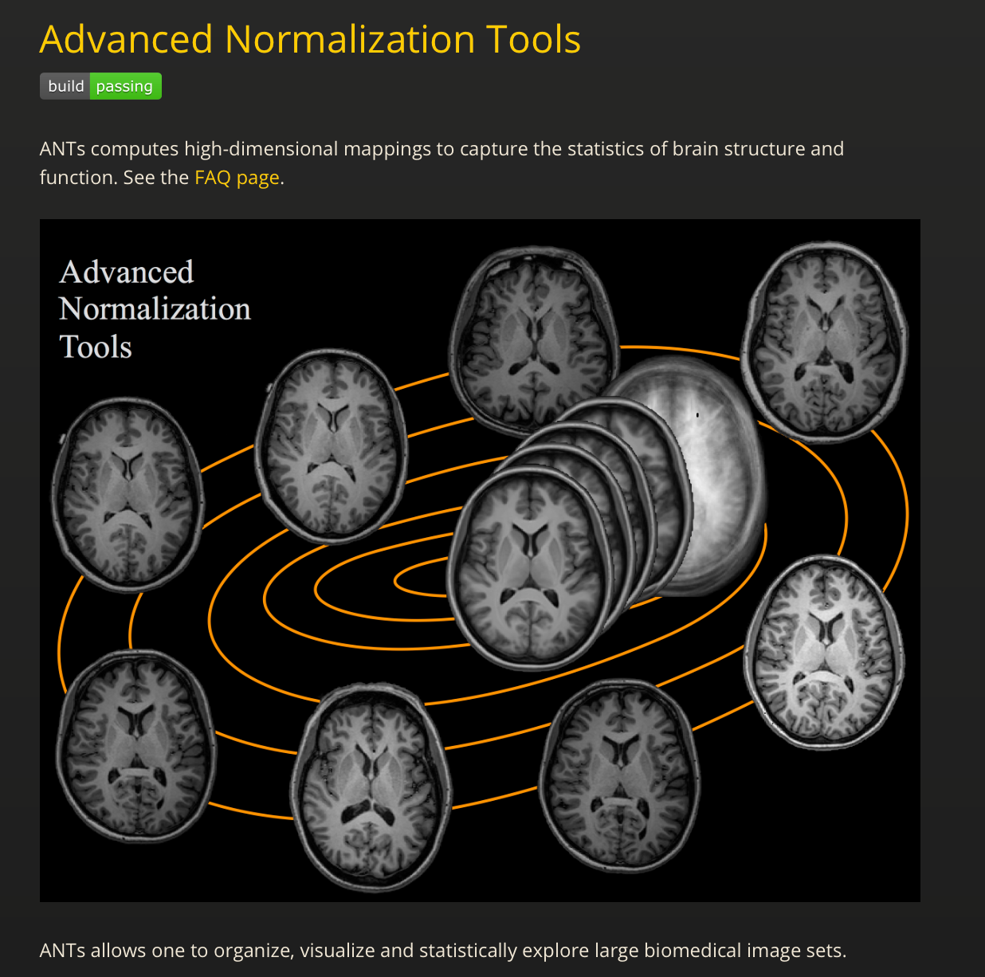
http://stnava.github.io/ANTs/

Slide 52
Methods for registering brains
We don’t care about fine details we’ll put brains into common anatomical volume using an affine transformation
  Affine transformation to Talairach & Tournoux Brain (1998) or to the MNI 305 template (Evans 1993)
We don’t care about anatomy, we care about preserving function across individuals
  Region of Interest (ROI) analysis (Kanwisher 1997)
  Hyperalignment (Haxby 2011)
Anatomy matters! We care about preserving functional-structural relationships across individuals
  Cortex-based alignment (Fischl 1999) to FreeSurfer average brain or average of your subjects (Frost & Goebel 2011)
  Non linear transformation to MNI ICBM 152 or MNI-Colins27 brain (http://nist.mni.mcgill.ca/?page_id=714)
Notes:
First, one has to ask: what is the reason for applying a new approach over and above the well known methods?
The general problem that has to be solved is how one is able to compare two different brains?
If this comparison is not done very careful, there is actually a danger of comparing apples with bananas!

