Slide 1
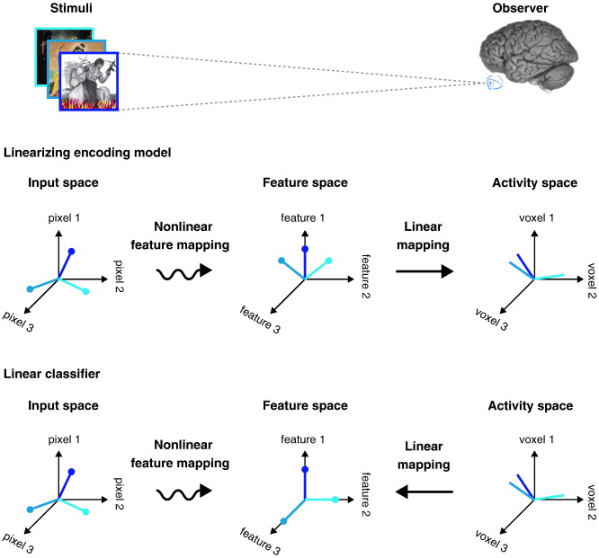
Encoding approaches for fMRI data
Thomas Naselaris, Kendrick N. Kay, Shinji Nishimoto, Jack L. Gallant, Encoding and decoding in fMRI (2011). NeuroImage, 56 (2):400–410

Slide 2
Limitations of decoding MVPs
Limited by between-voxels “biases” at the resolution you measure
  These biases need to be reproducible
  Need to occur across voxels

Slide 3
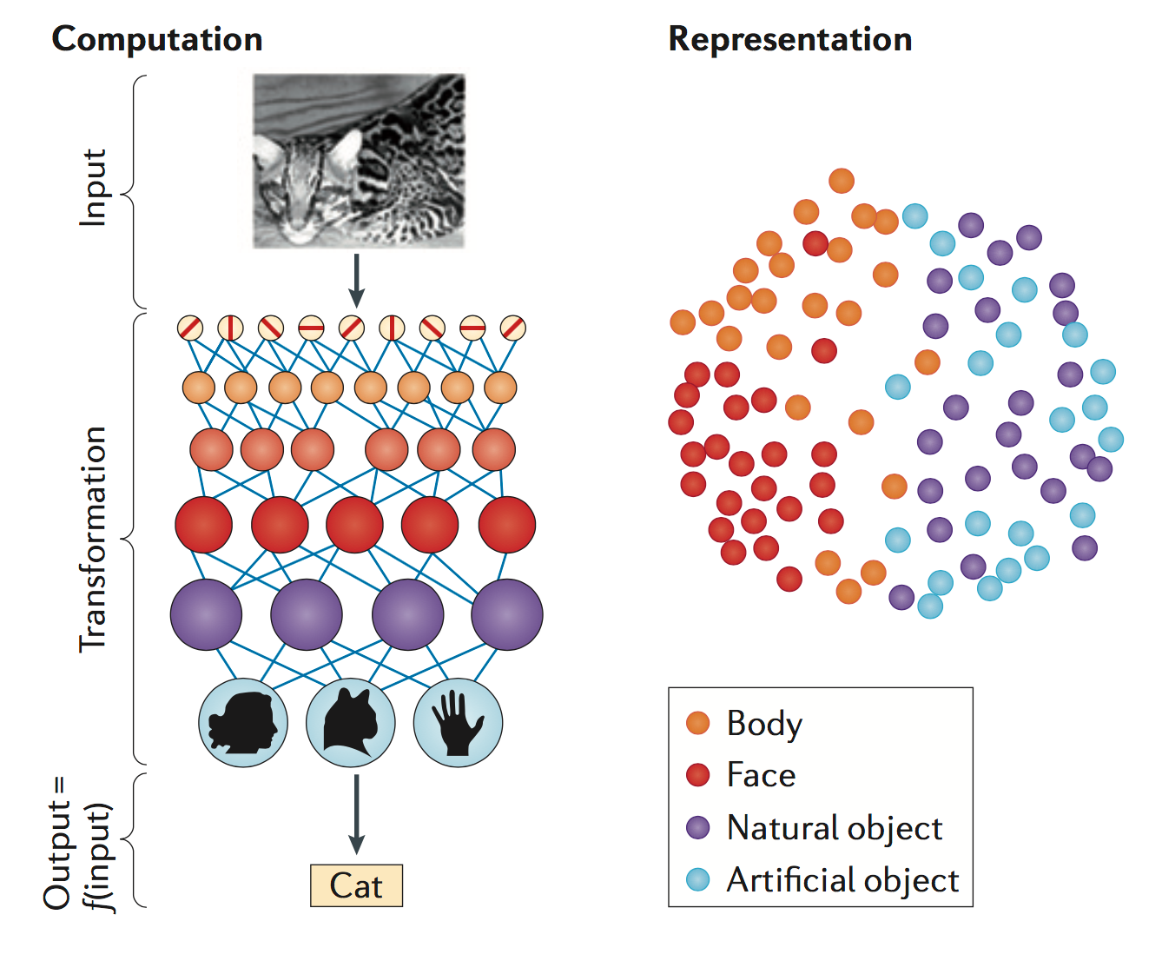
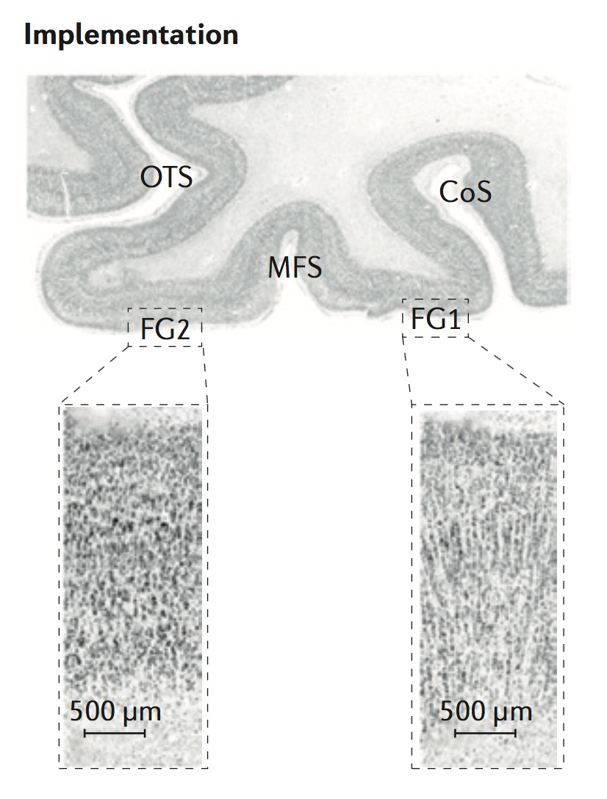
What is our goal as neuroscientists?

Slide 4
What is our goal as neuroscientists?
Anatomical MRI
(DWI; qMR)

Slide 5
What is our goal as neuroscientists? FMRI seems particularly suited to study representations
ROI analyses
Maps
Decoding

Slide 6
What is our goal as neuroscientists? Can we use fMRI to study cortical computations?
ROI analyses
Maps
Decoding
?

Slide 7
Limitations of decoding approaches
Requires the representation to generate a reproducible response spanning an anatomical expanse or functional regions across a set of voxels spanning many mm-cm

Slide 8
Limitations of decoding approaches
Requires the representation to generate a reproducible response spanning an anatomical expanse or functional regions across a set of voxels spanning many mm-cm
Can inform about the experimental condition from the brain activation if it is from set of trained labels but does not generalize to new conditions

Slide 9
Limitations of decoding approaches
Requires the representation to generate a reproducible response spanning an anatomical expanse or functional regions across a set of voxels spanning many mm-cm
Can inform about the experimental condition from the brain activation if it is from set of trained labels but does not generalize to new conditions
Useful for applications like prosthetics, mind reading, but does decoding tell us how the brain works?

Slide 10
Limitations of decoding approaches
Requires the representation to generate a reproducible response spanning an anatomical expanse or functional regions across a set of voxels spanning many mm-cm
Can inform about the experimental condition from the brain activation if it is from set of trained labels but does not generalize to new conditions
Useful for applications like prosthetics, mind reading, but does decoding tell us how the brain works?
Need a generative (encoding) model that can predict brain responses to any stimuli and on the way will tell us what computation happens in a voxel, set of voxels or brain areas

Slide 11
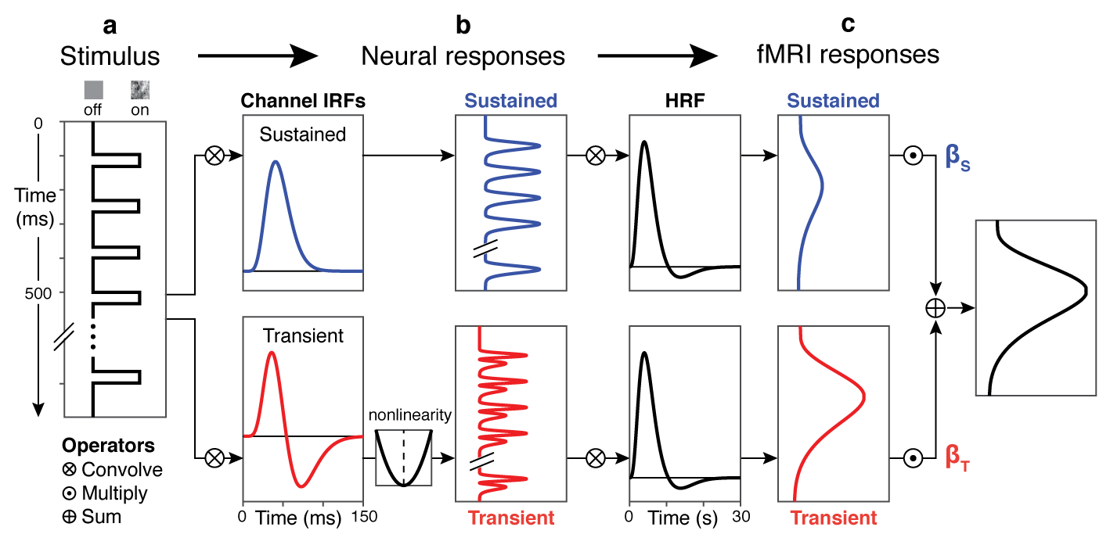
Standard fMRI approach
β

Slide 12
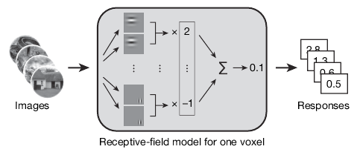
Encoding approach
β

Slide 13
Note that the encoding model allows you to implement a non linear neural model even as the relation between neurons and BOLD remains linear
Model of
neural responses
Learn the parameters of the model
from brain measurements
Thomas Naselaris, Kendrick N. Kay, Shinji Nishimoto, Jack L. Gallant, Encoding and decoding in fMRI (2011). NeuroImage, 56 (2):400–410

Slide 14
Examples of encoding models

Slide 15
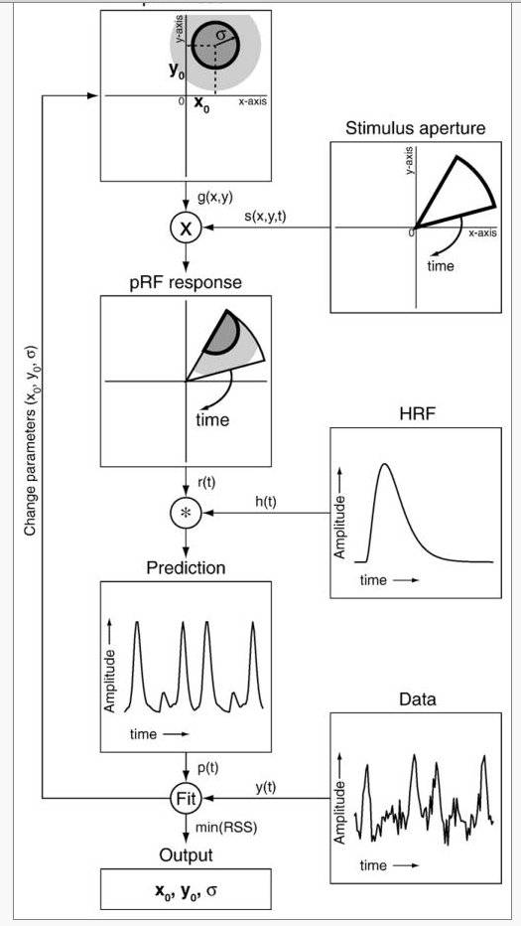
A flow chart describing the pRF linear
model estimation procedure
Example encoding model:
A population receptive field (pRF)
The pRF model is a 2D Gaussian with parameters (x,y,σ) which are calculated for every voxel independently.
Dumoulin and Wandell, 2008

Slide 16
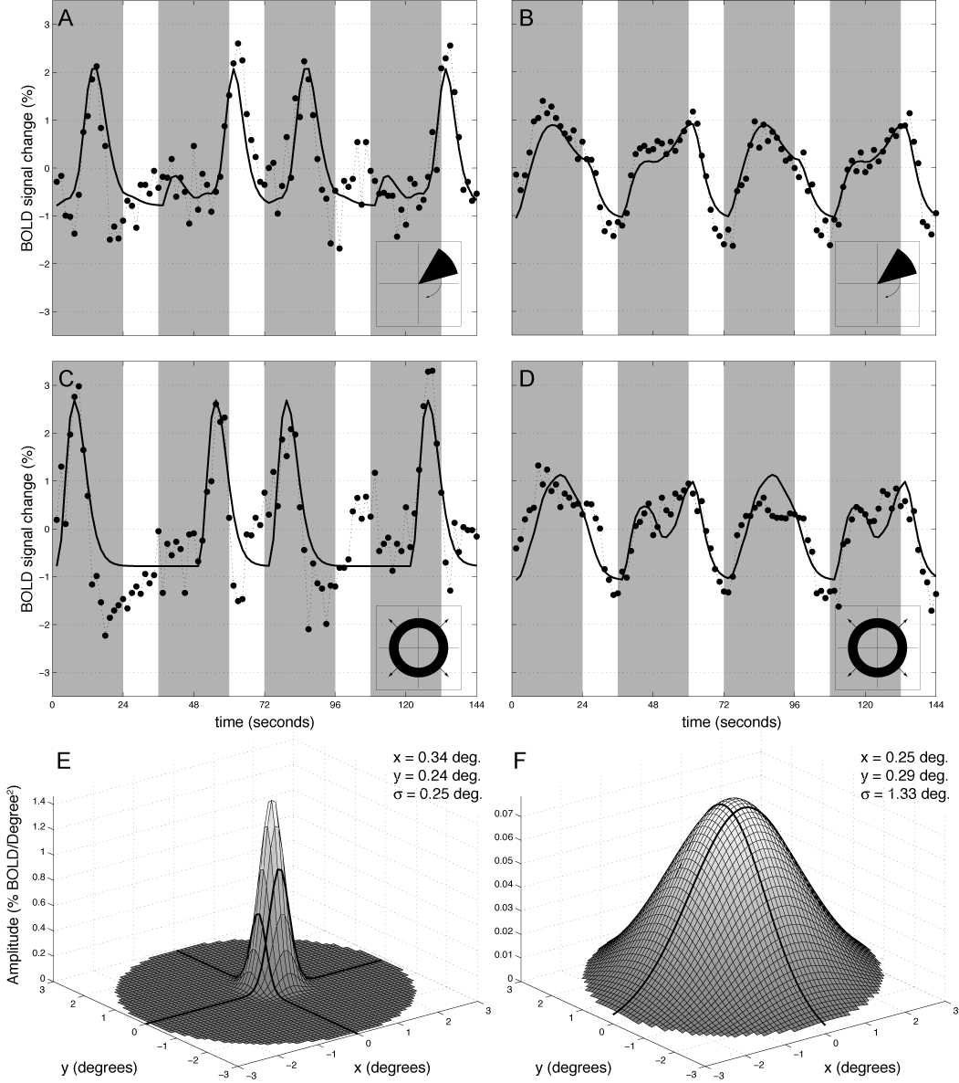
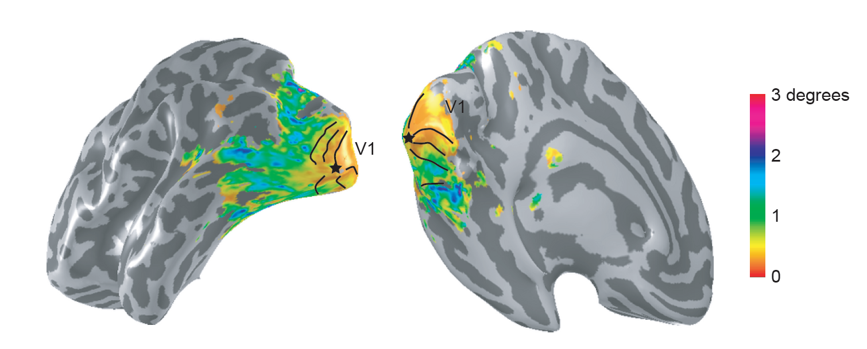
The Population Receptive Field (pRF) estimates retinotopic sensitivity in each voxel using a 2D Gaussian model.
Population Receptive Field Size
6 degrees
4
2
0
Dumoulin and Wandell, 2008

Slide 17
How do we evaluate the goodness of an encoding model?

Slide 18
How do we evaluate the goodness of an encoding model?
Cross validation

Slide 19
How do we evaluate the goodness of an encoding model?
Cross validation
Test how well it predicts new data

Slide 20
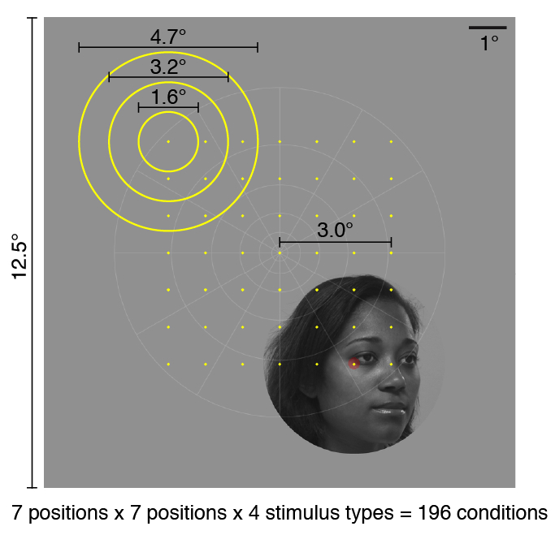
Important aspect of an encoding model: prediction
Use the pRF to predict the voxel’s responses to new stimuli
Data
6
1
2
3
4
5
6
7
0
% signal
Row
-6
8
Data
Model
4
% signal
0
Row
1
2
3
4
5
6
7
Small faces
This example left IOG voxel responds to faces in the lower right visual field
Kay, Weiner, Grill-Spector, Current Biology, 2015
Notes:
Critically, because this is a generative model, we can use the estimated pRF from the small faces to predict responses to medium and large faces

Slide 21
We can use the pRF to predict the voxel’s
response to medium and large faces
Data
Model
Model
6
1
2
3
4
5
6
7
1
2
3
4
5
6
7
1
2
3
4
5
6
7
0
% signal
Row
Row
Row
-6
8
Data
Model
4
% signal
0
Row
1
2
3
4
5
6
7
1
2
3
4
5
6
7
1
2
3
4
5
6
7
Small faces
Medium faces
Large faces
This example left IOG voxel responds to faces in the lower right visual field
Kay, Weiner, Grill-Spector, Current Biology, 2015
Notes:
Critically, because this is a generative model, we can use the estimated pRF from the small faces to predict responses to medium and large faces

Slide 22
Notes:
Importantly, this prediction follows the data very closely
Thus, I have shown you that, at least for this voxel – (1) responses are modulated by the location of the face in the visual field and (2) the pRF model provides a good fit to the empirical observations.
Following, I will show you cross validated pRFs for all the voxels across the ventral stream.

Slide 23
How do we evaluate the goodness of an encoding model?
Cross validation
Test how well it predicts new data
Model based decoding

Slide 24
Once you have an encoding model of the brain you can also use it for decoding
Thomas Naselaris, Kendrick N. Kay, Shinji Nishimoto, Jack L. Gallant, Encoding and decoding in fMRI (2011). NeuroImage, 56 (2):400–410

Slide 25
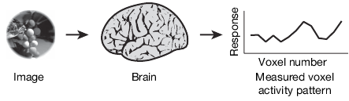
Generating an encoding model
high resolution fMRI
of V1, V2 and V3
Encoding model of neural responses
domain knowledge:
Gabor filters are a good
computation model
learned model:
fit parameters of a Gabor
filter pyramid
Kay et al, Nature, 2008

Slide 26
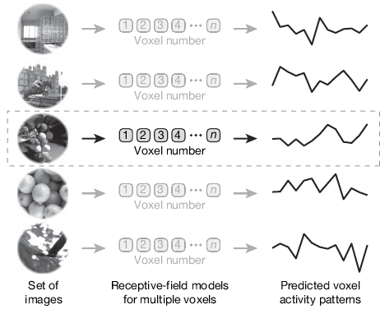
Testing the model via decoding:
classifying natural images from fMRI
novel stimulus
classify by nearest neighbor similarity to training set fMRI
Kay et al, Nature, 2008

Slide 27
How do we evaluate the goodness of an encoding model?
Cross validation
Test how well it predicts new data
Model based decoding
Comparison of above performances relative to other models

Slide 28
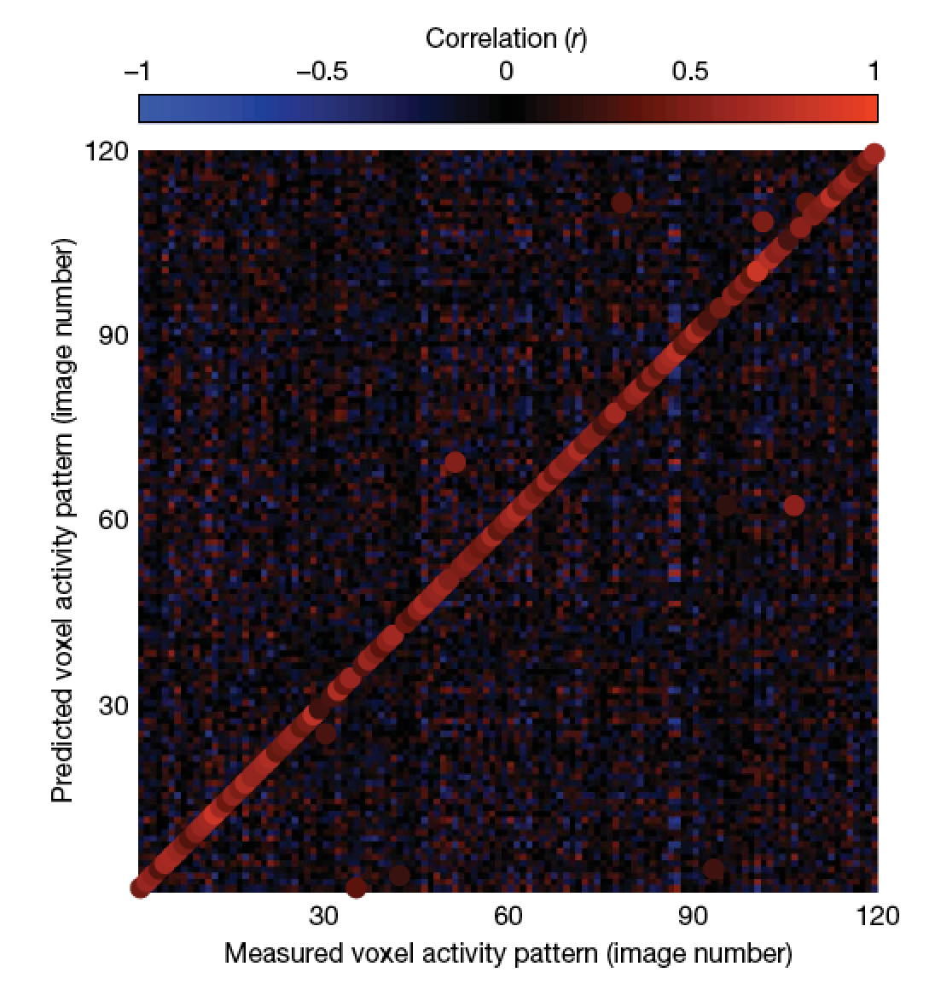
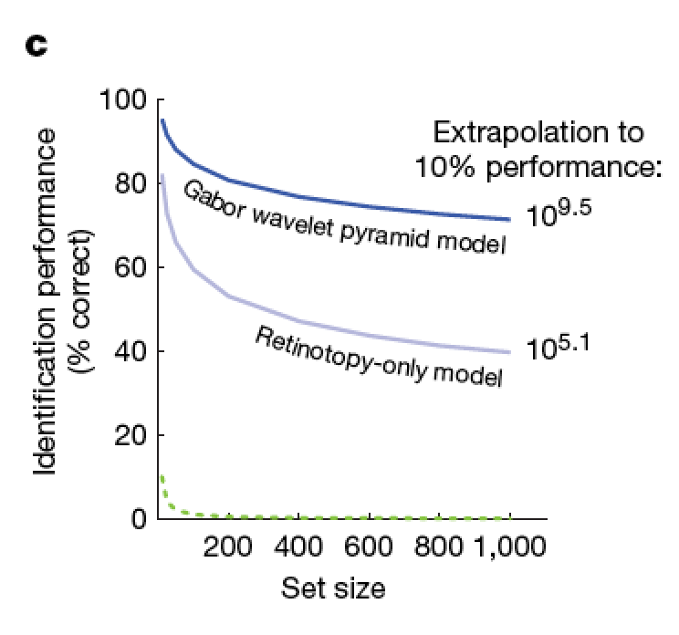
Gabor model performs better than retinotopic model
Kay et al, Nature, 2008

Slide 29
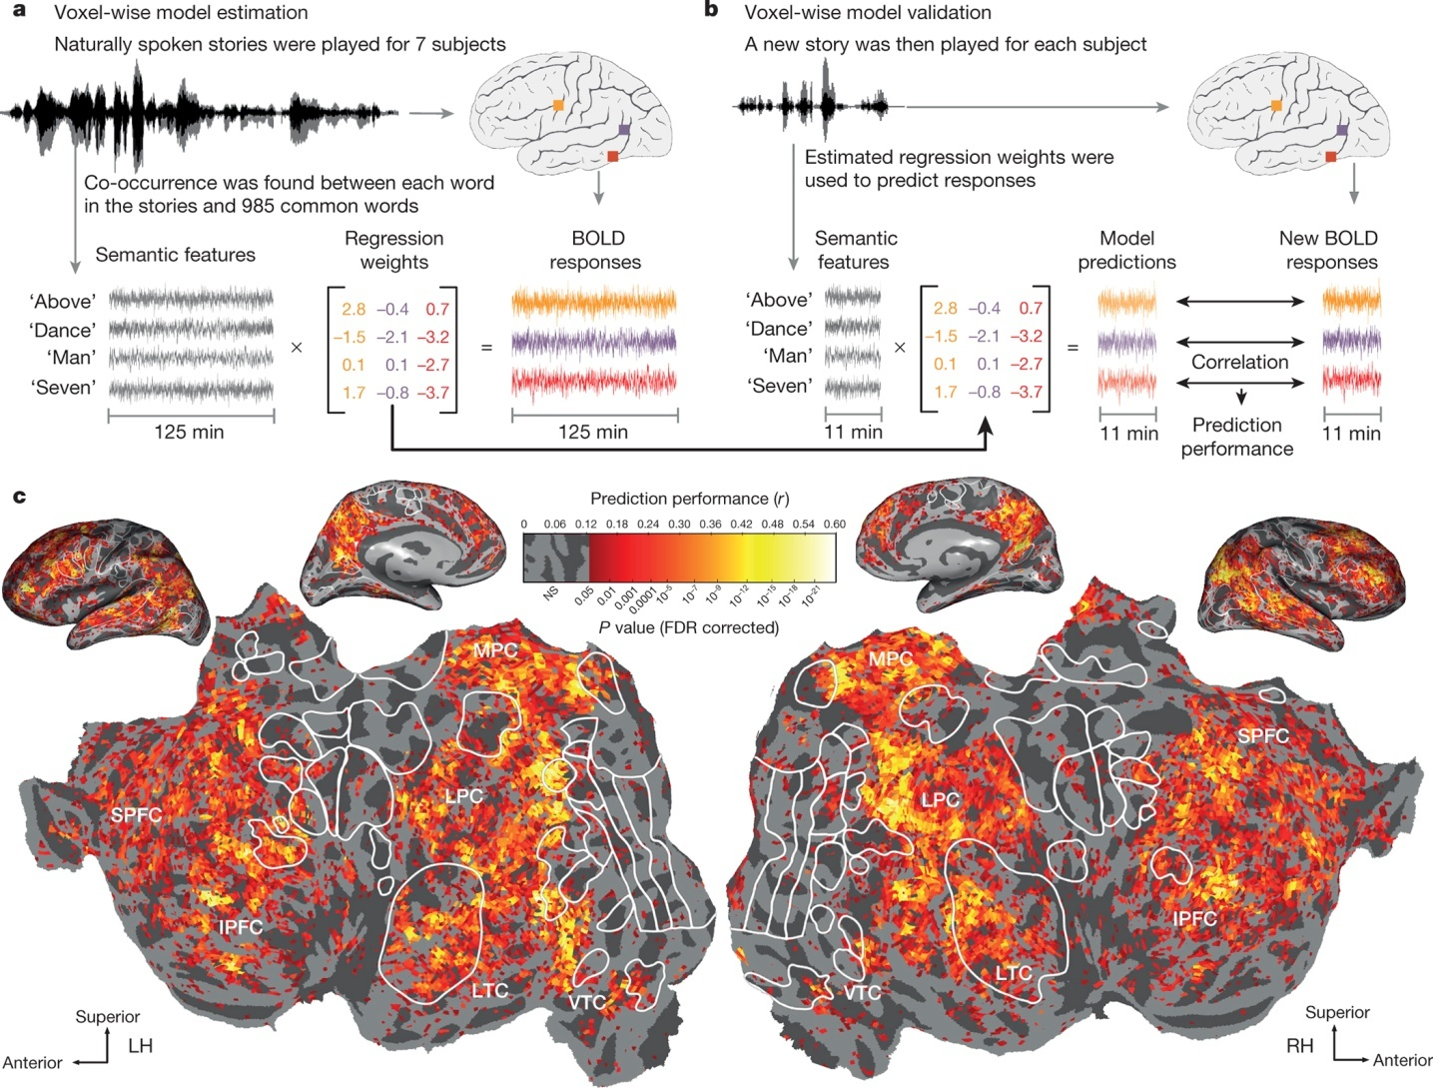
Encoding model of semantic information at each voxel across the brain
A G Huth et al. Nature 532, 453–458 (2016) doi:10.1038/nature17637

Slide 30
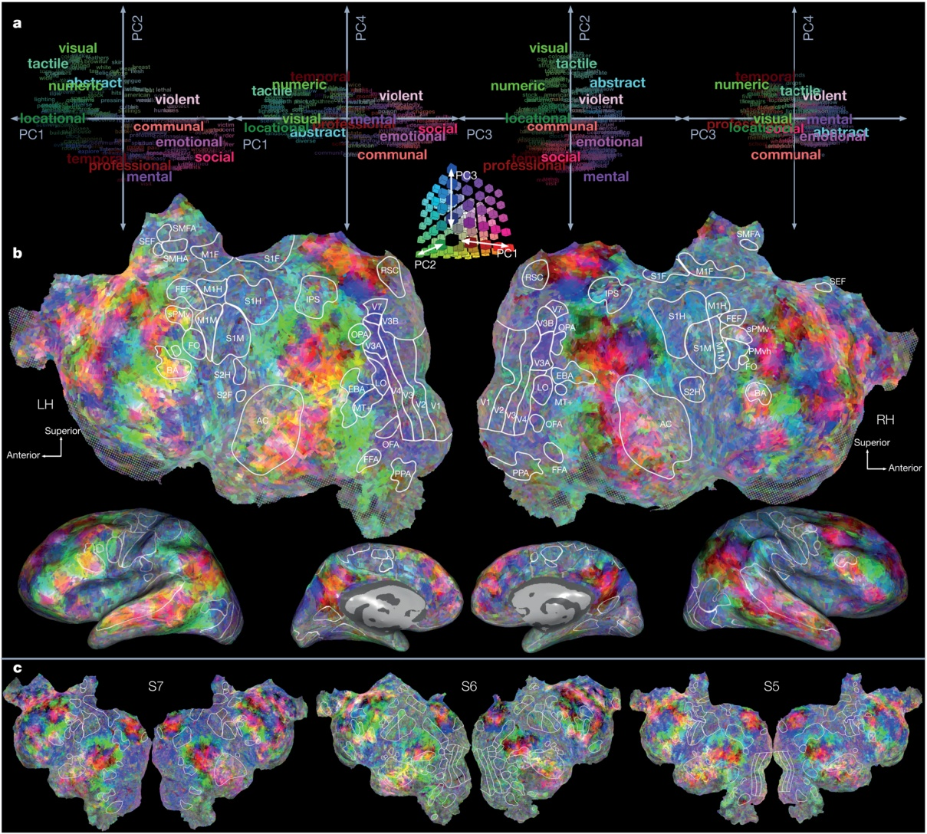
Principal components of voxel-wise semantic model
A G Huth et al. Nature 532, 453–458 (2016) doi:10.1038/nature17637

Slide 31
Encoding models provide hyper-resolution

Slide 32
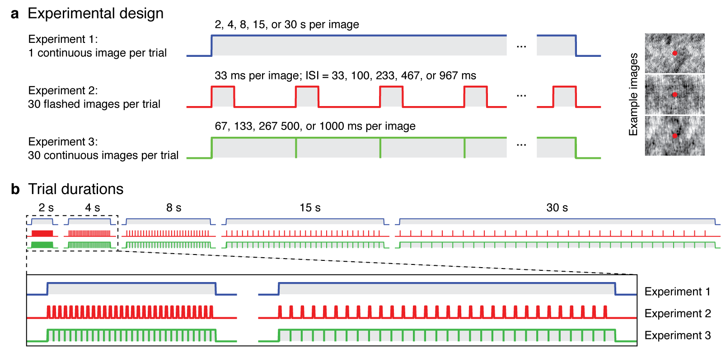
Encoding model may be necessary when the standard model fails to predict fMRI data

Slide 33
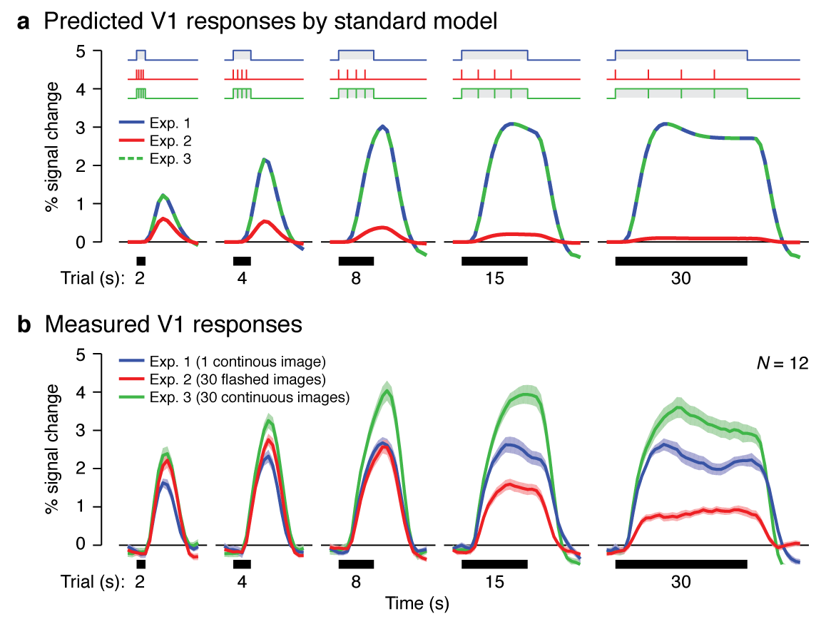
Standard fMRI approach
β

Slide 34
Standard fMRI approach
β

Slide 35
An encoding model may enable modeling temporal properties of neural responses
despite the sluggishness of BOLD responses

Slide 36
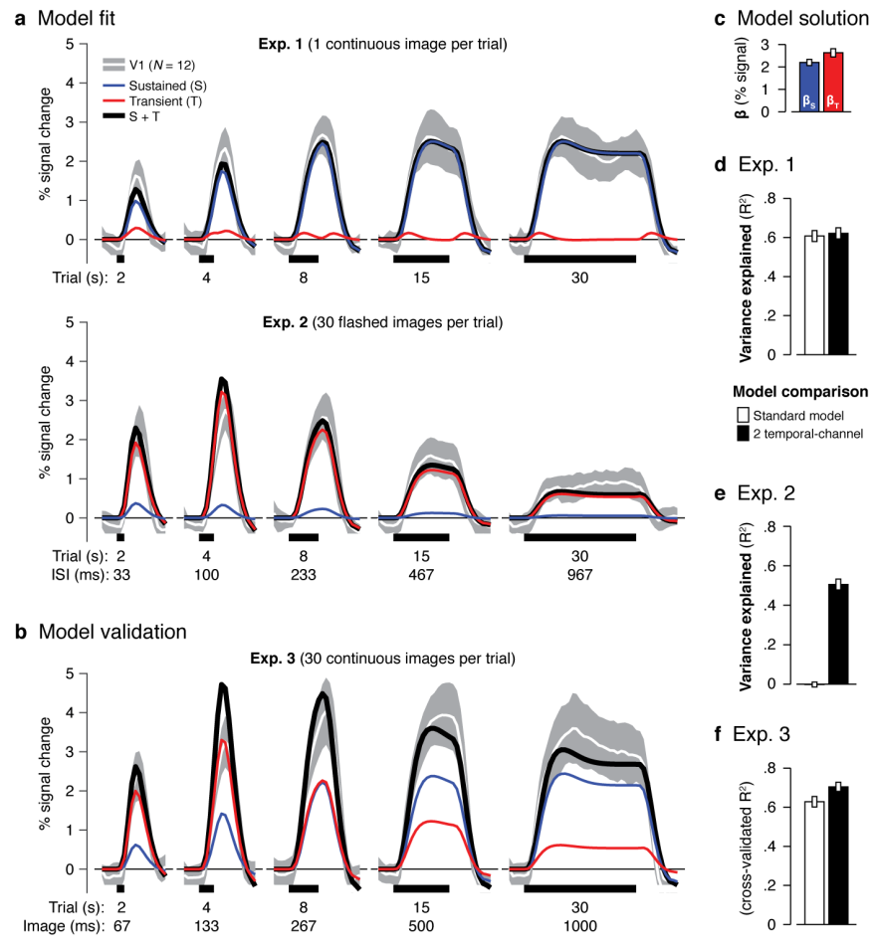
Two channel model is better at predicting V1 responses than the standard model

Slide 37
Comparing encoding and decoding models

Slide 38
Comparing encoding and decoding models
Does an ROI contain information about some specific set of features?

Slide 39
Comparing encoding and decoding models
Does an ROI contain information about some specific set of features?
Is the information represented within some ROI important for behavior?

Slide 40
Comparing encoding and decoding models
Does an ROI contain information about some specific set of features?
Is the information represented within some ROI important for behavior?
Are there specific ROIs that contain relatively more information about a specific set of features?

Slide 41
Comparing encoding and decoding models
Does an ROI contain information about some specific set of features?
Is the information represented within some ROI important for behavior?
Are there specific ROIs that contain relatively more information about a specific set of features?
Are there specific features that are preferentially represented by a single ROI?

Slide 42
Comparing encoding and decoding models
Does an ROI contain information about some specific set of features?
Is the information represented within some ROI important for behavior?
Are there specific ROIs that contain relatively more information about a specific set of features?
Are there specific features that are preferentially represented by a single ROI?

